Slide 1

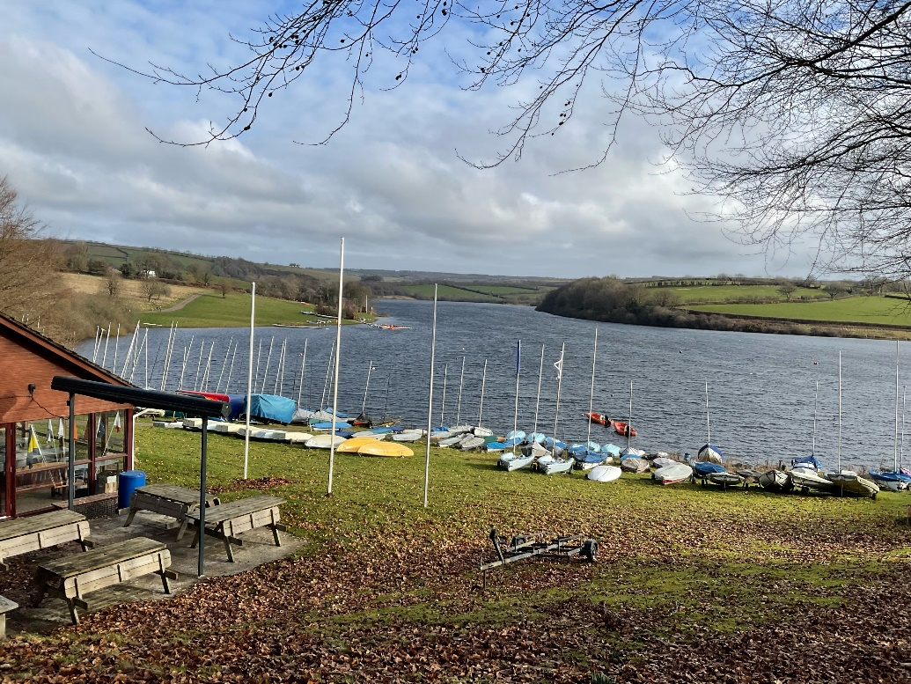
The Wimbleball Lake Story

Slide 2

Wimbleball Lake is an outdoor area with a lake, lakeside walks and an activity centre
This means it is a place where I can spend time in the countryside

Slide 3

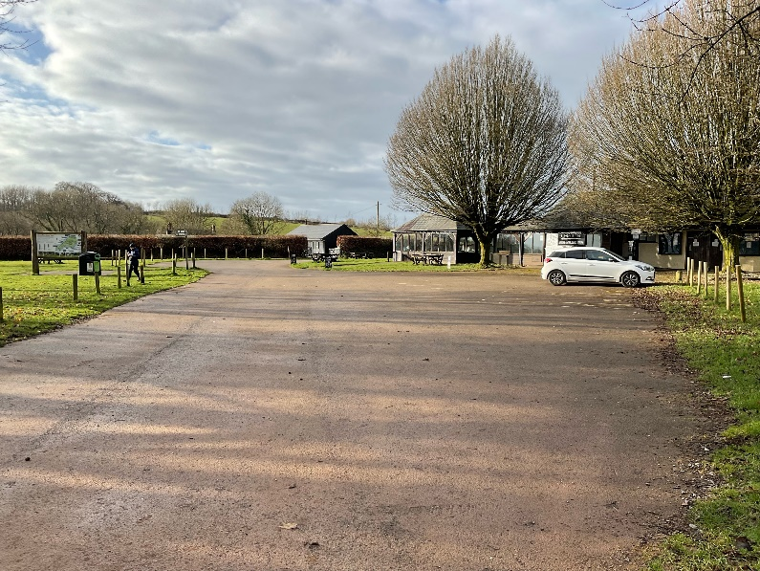
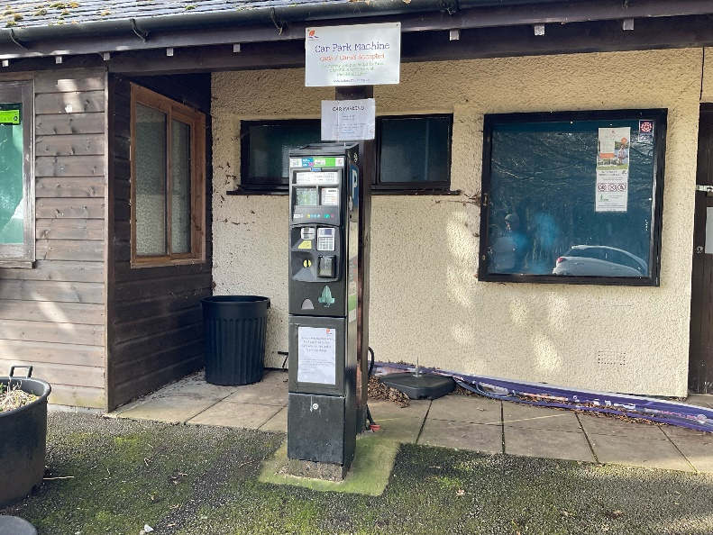
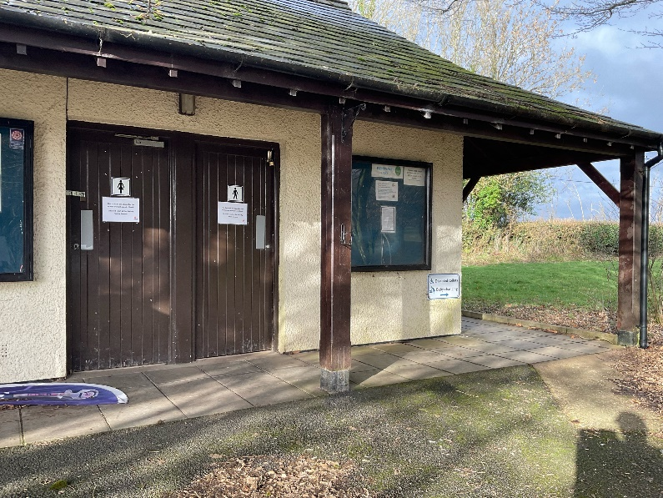
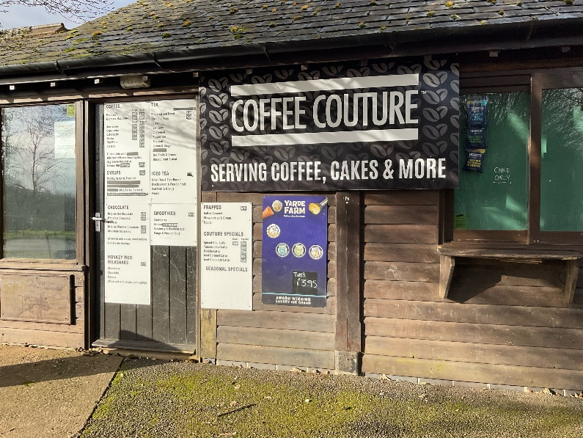
When I arrive to visit Wimbleball Lake
I might see:
The machine where people buy a ticket to park their car
The car park
A building with toilets inside
A cafe

Slide 4
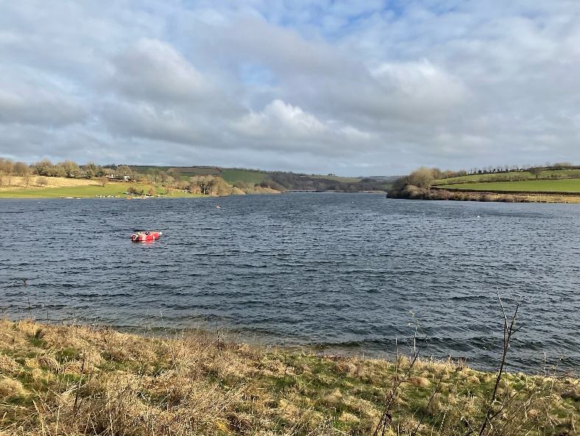
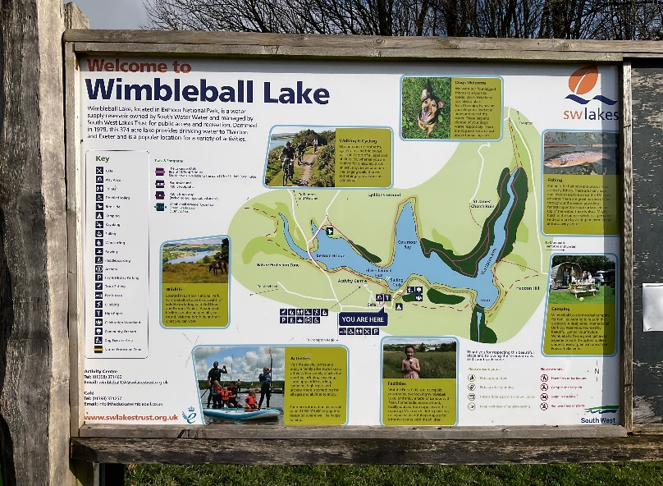
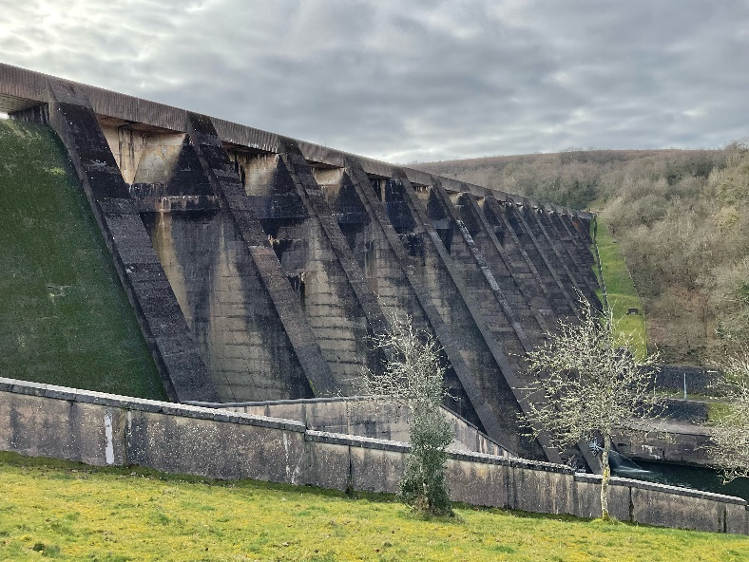
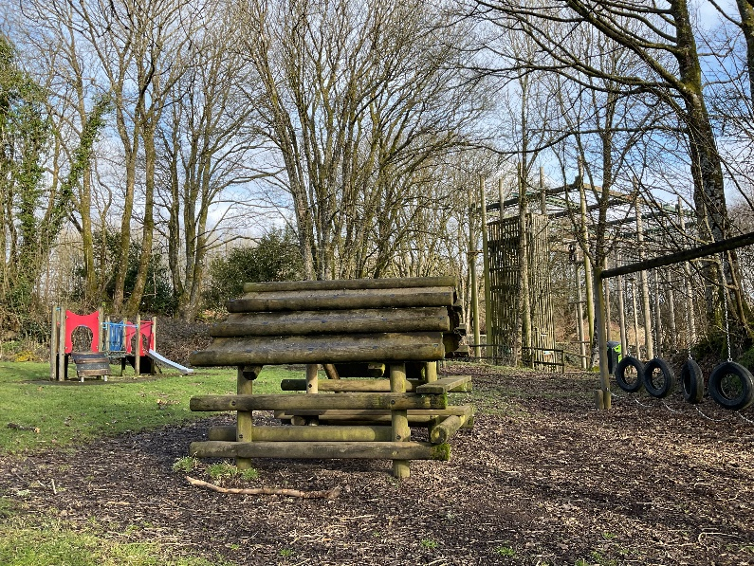
When I visit Wimbleball Lake
I might see:
The lake
A noticeboard
A large stone dam
A play area

Slide 5
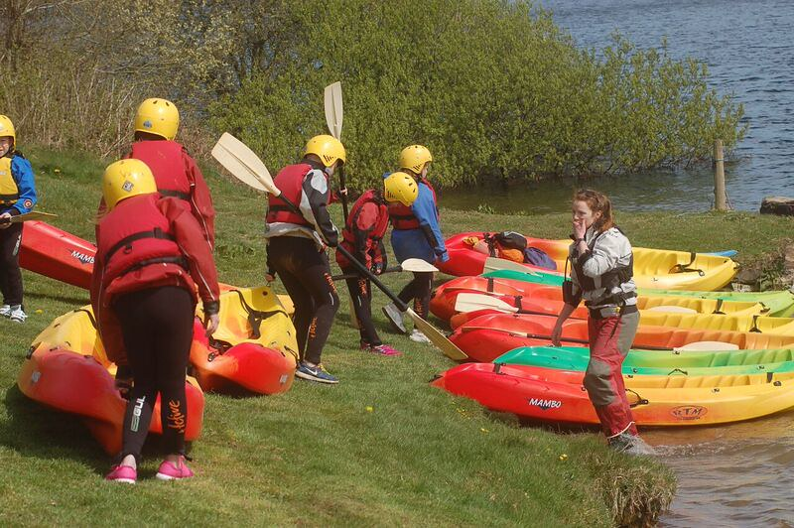
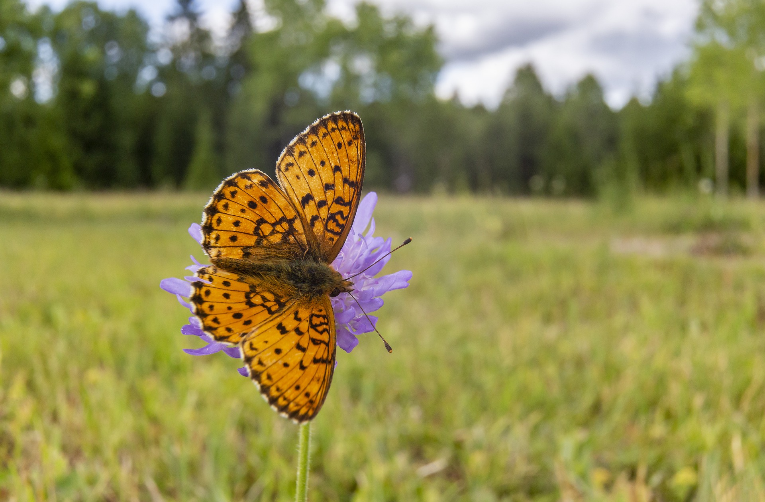
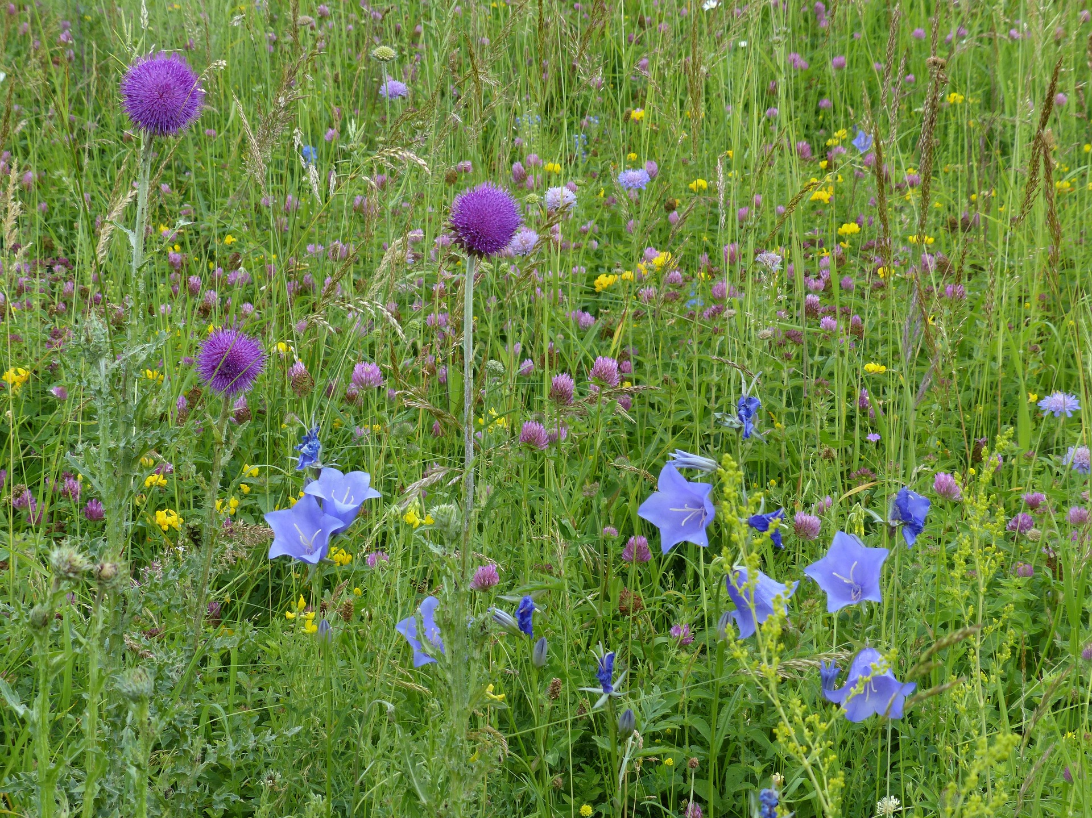
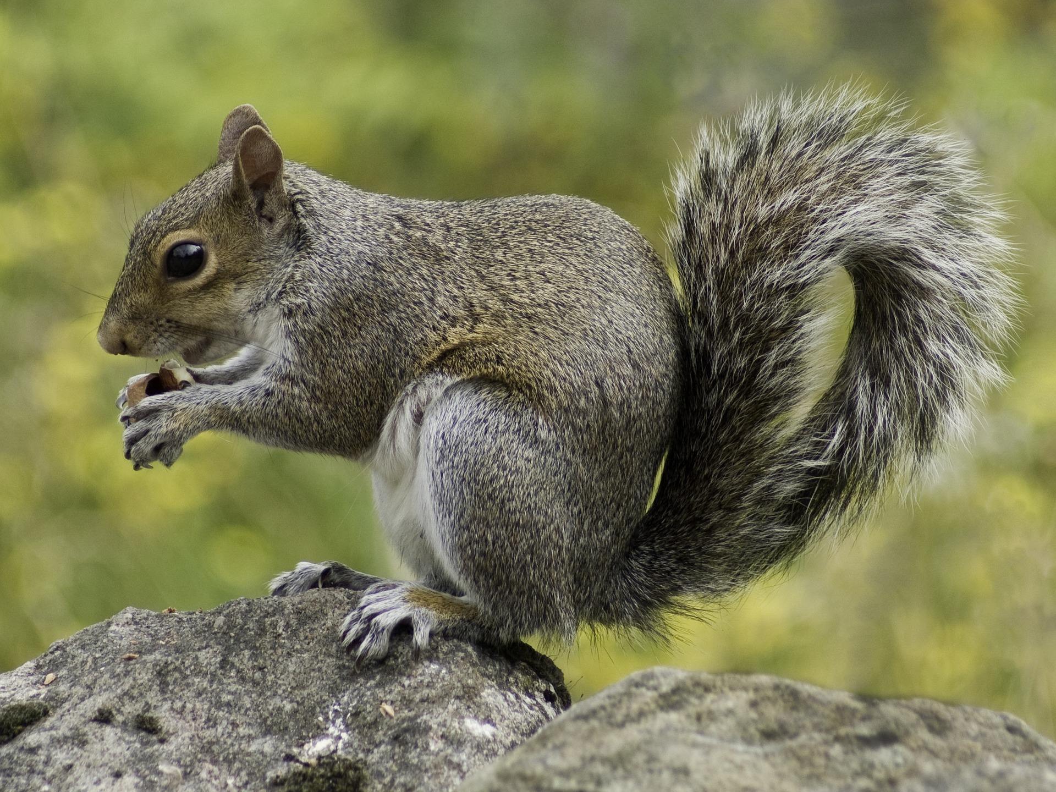
When I visit Wimbleball Lake
I might see:
Boats
Butterflies
Wild flowers
Grey squirrels

Slide 6

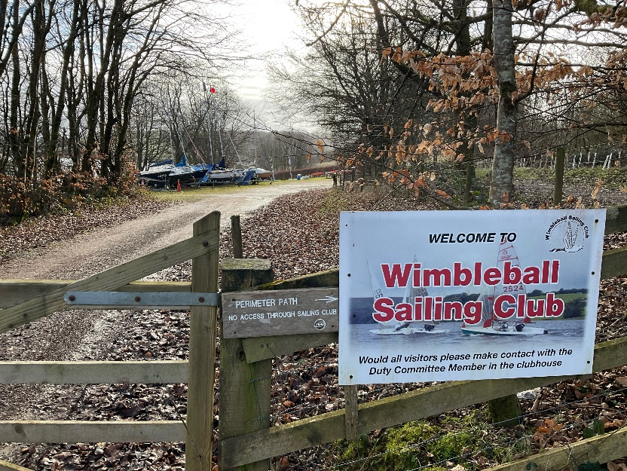
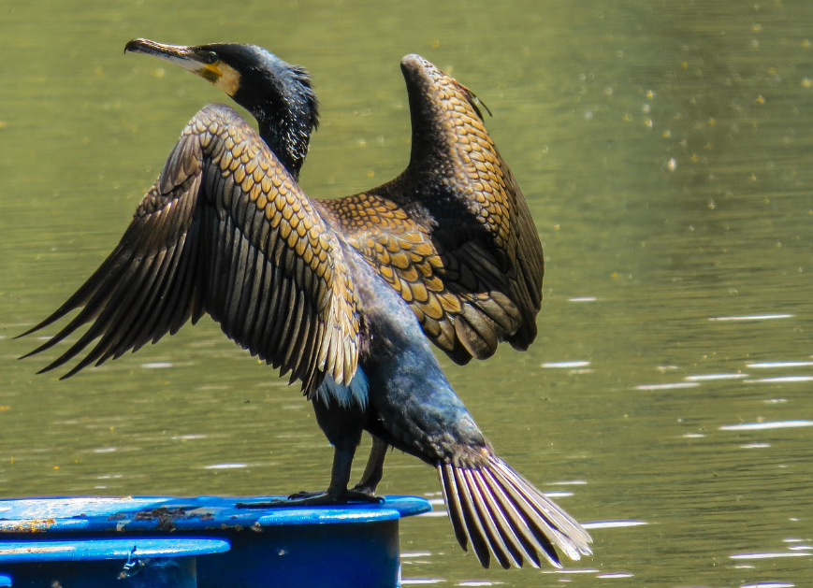
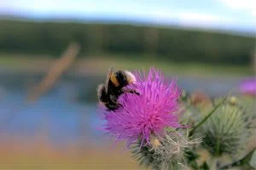
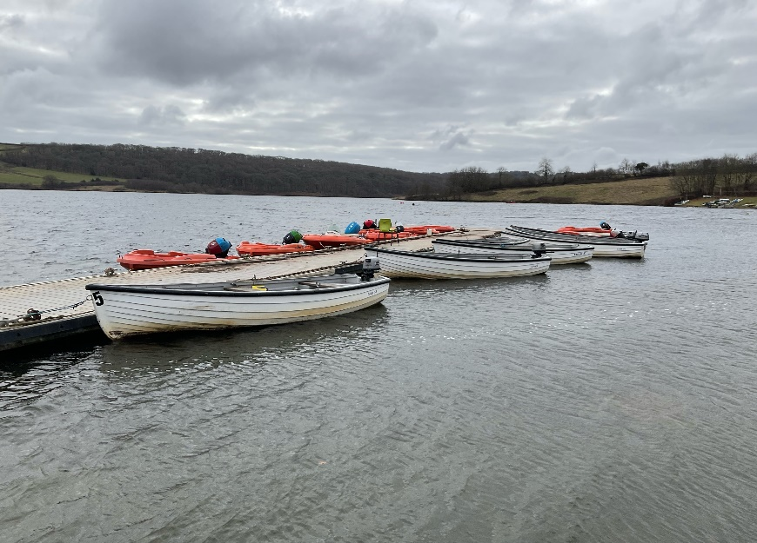
When I visit Wimbleball Lake
I might hear:
People enjoying activities such as sailing
Water loving birds like cormorants
Insects, such as bees
Water lapping against the boats and the edges of the lake

Slide 7

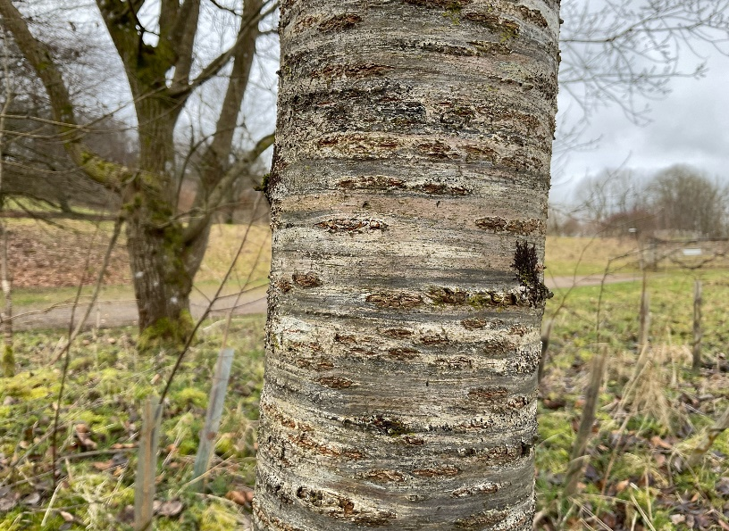
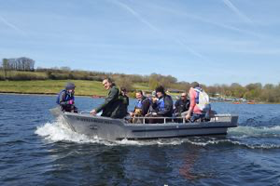
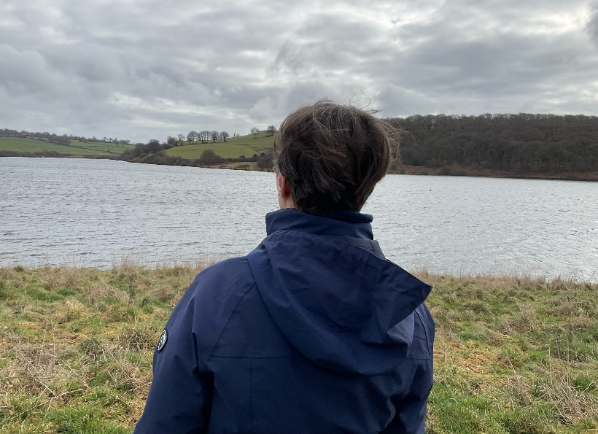
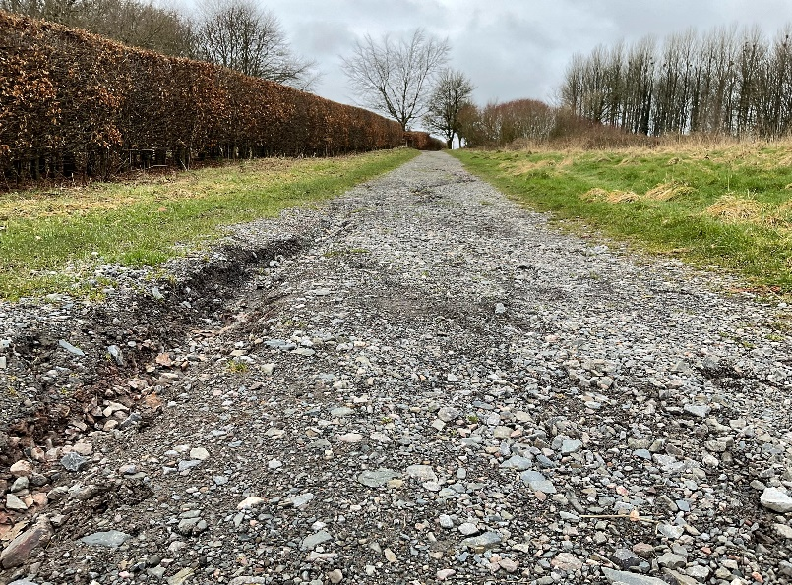
When I visit Wimbleball Lake
I might touch or feel:
Rough bark on the trees
The movement of a boat if we take a trip on one.
The wind blowing on my face
A stony path

Slide 8

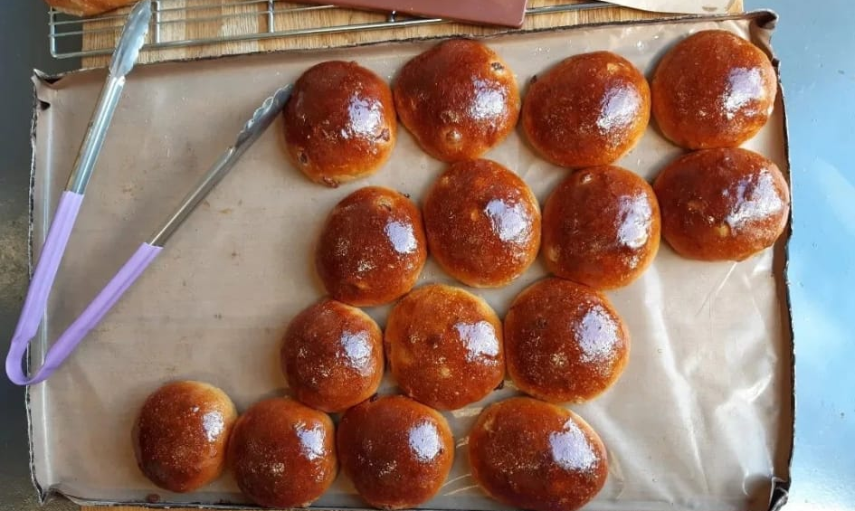
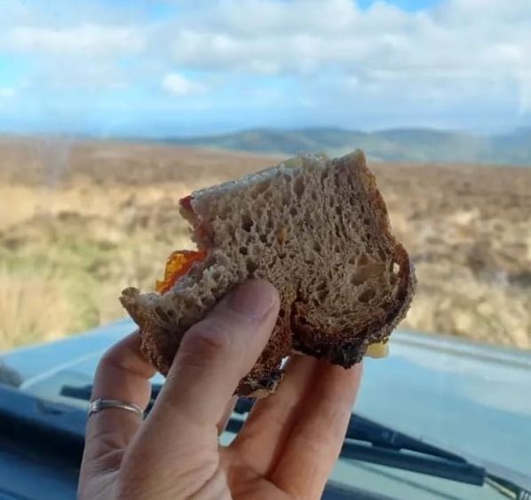
When I visit Wimbleball Lake
I might taste:
Food and drink from the café
My picnic

Slide 9


When I visit Wimbleball Lake
I might smell:
Coffee from the cafe

Slide 10
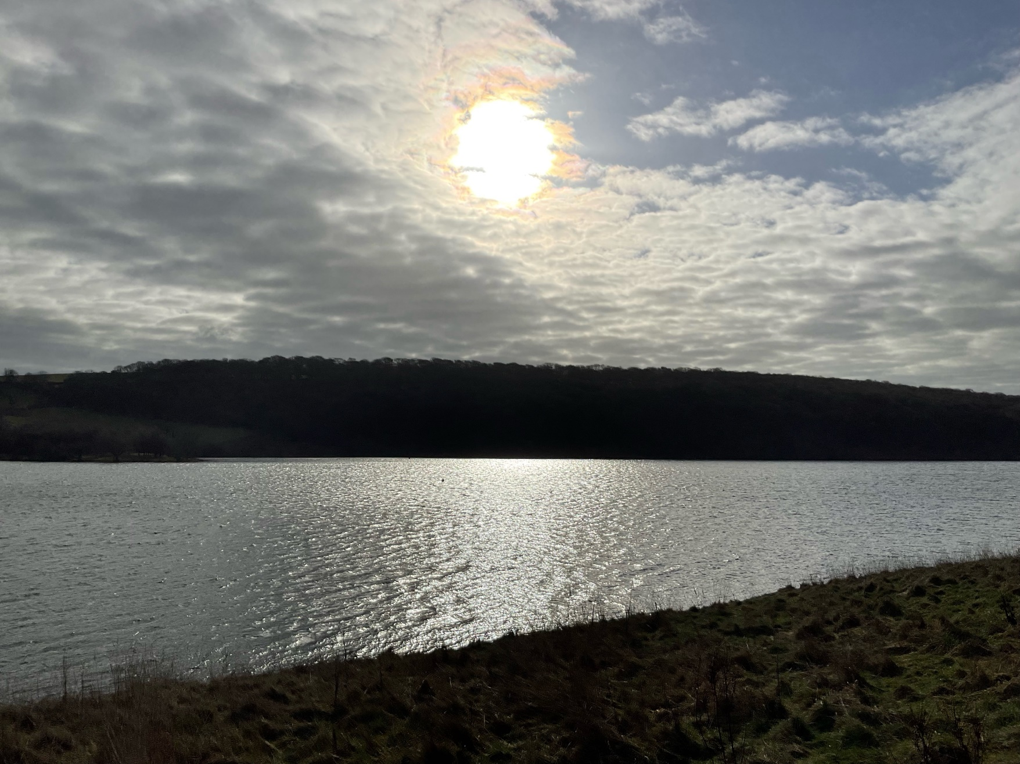
Most of all Wimbleball Lake is a place where I can enjoy time outdoors

Slide 11
Some additional information for my visit
This Sensory Story starts from the pay and display car park at Wimbleball Lake Activity Centre TA22 9NU
This car park has public toilets
There is a cafe next to the car park – opening times vary by season

Slide 12
The Wimbleball Lake Story
Produced For Exmoor National Park by Access & Inclusion UK 2023
www.accessandinclusion.com

