Slide 1

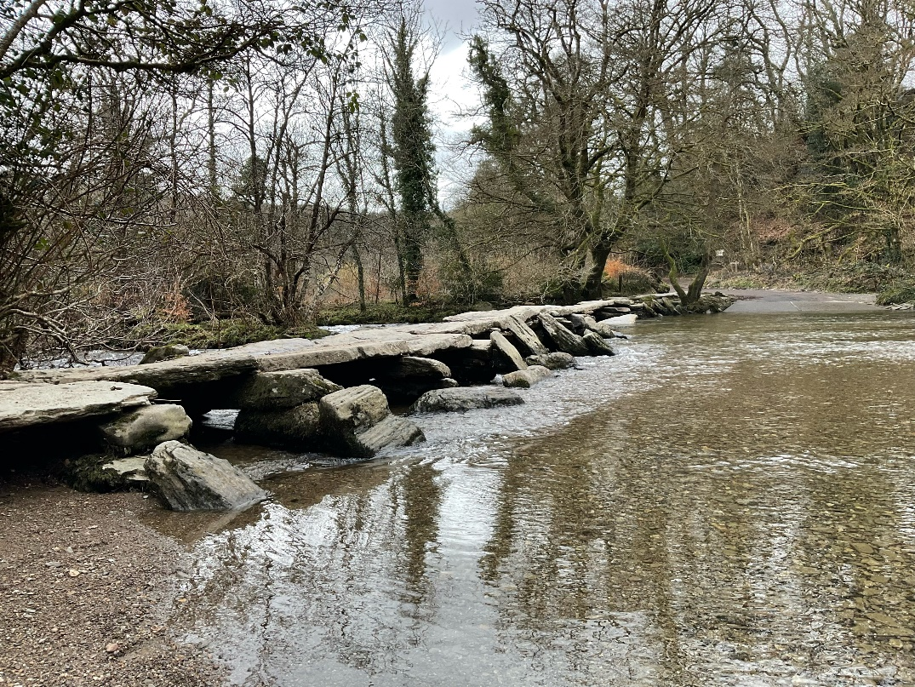
The Tarr Steps Story

Slide 2

Tarr Steps is an outdoor area with a special bridge, a river, woods and meadows
This means it is a place where I can spend time in the countryside

Slide 3

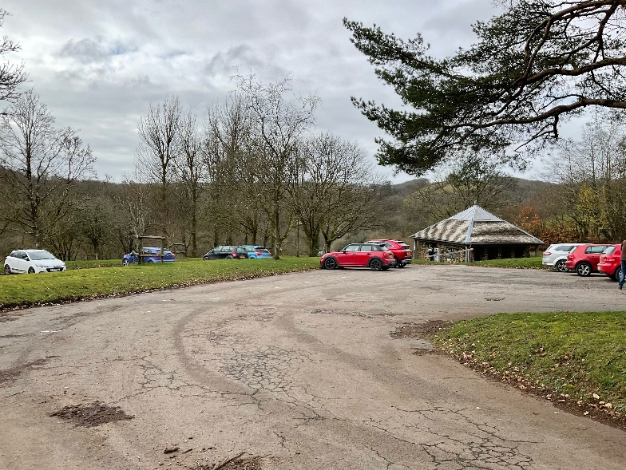
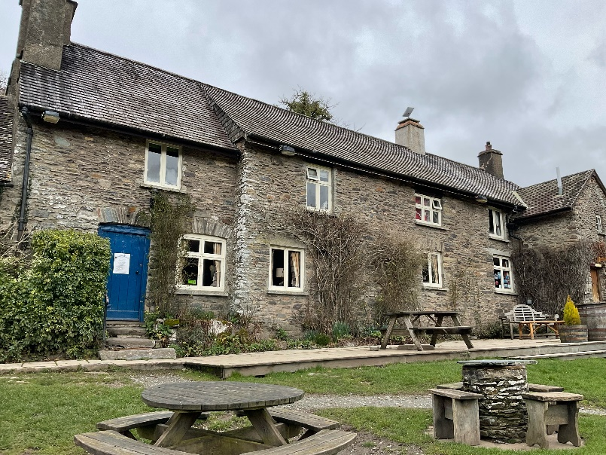
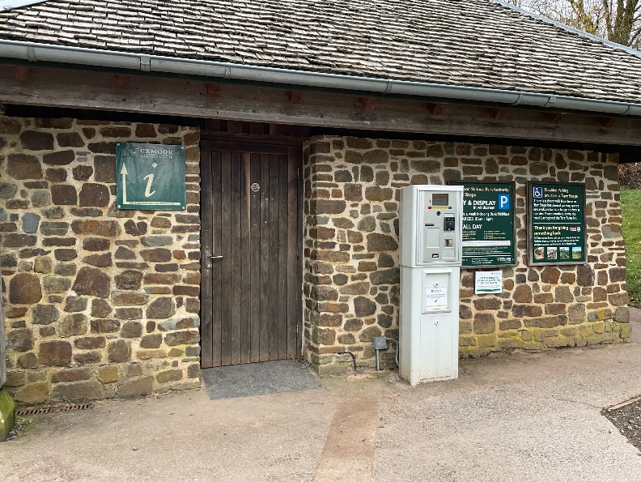
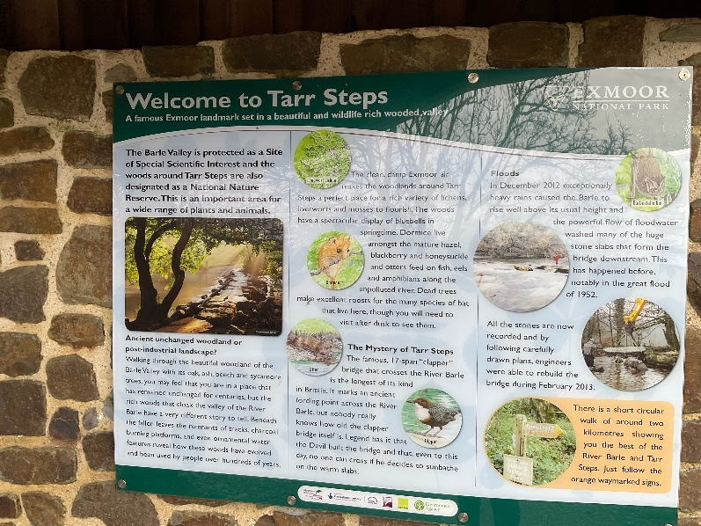
When I arrive to visit Tarr Steps
I might see:
The car park
A pub called the Tarr Farm Inn
A building made of stone with toilets inside.
An information board

Slide 4

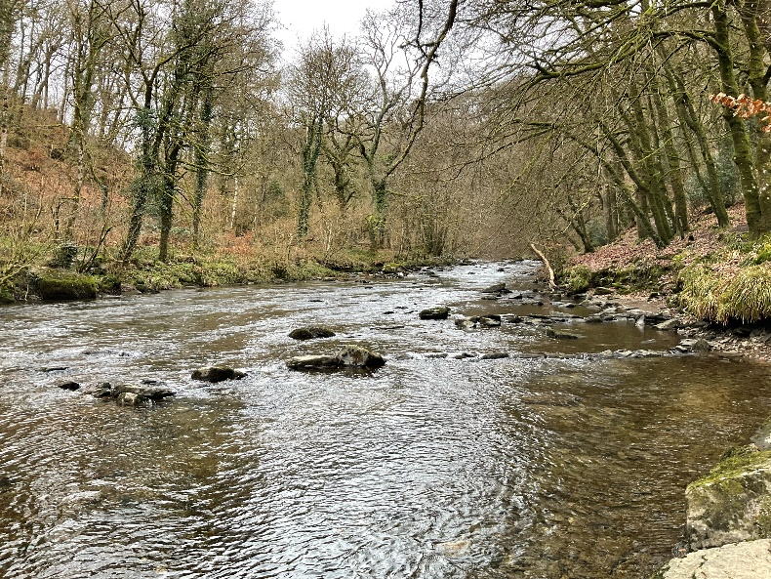
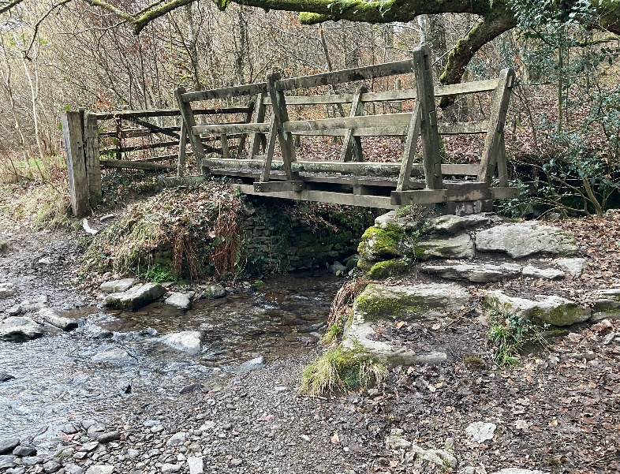
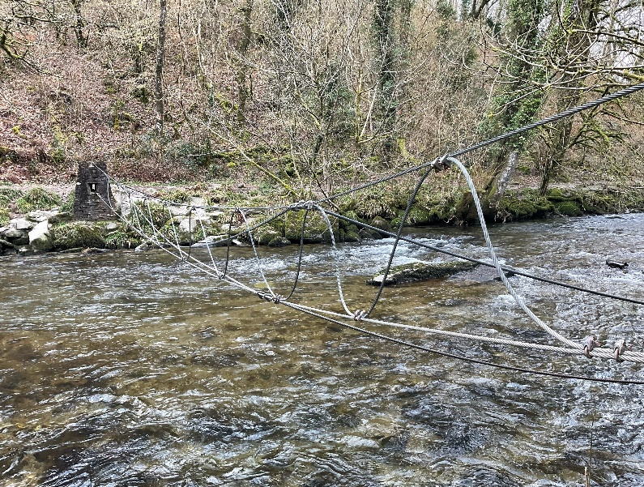
When I visit Tarr Steps
I might see:
The old bridge called Tarr Steps
A river
A wooden footbridge
A metal ‘tree catcher’. This is to stop trees which may have fallen into the river from going any further

Slide 5
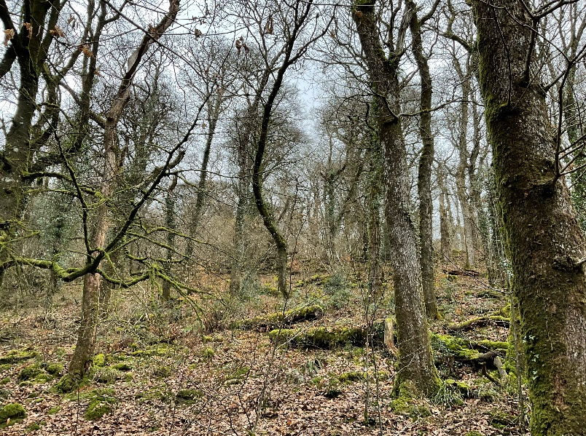
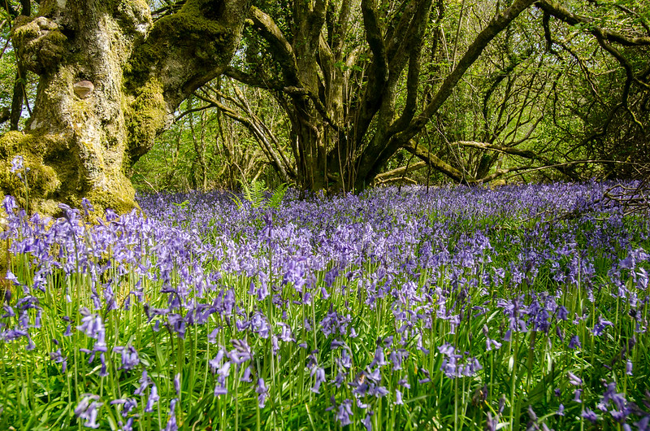
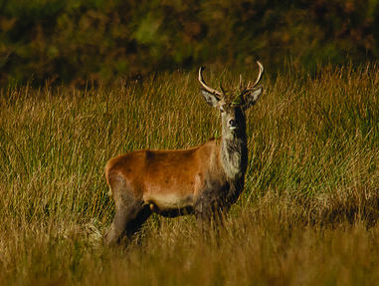
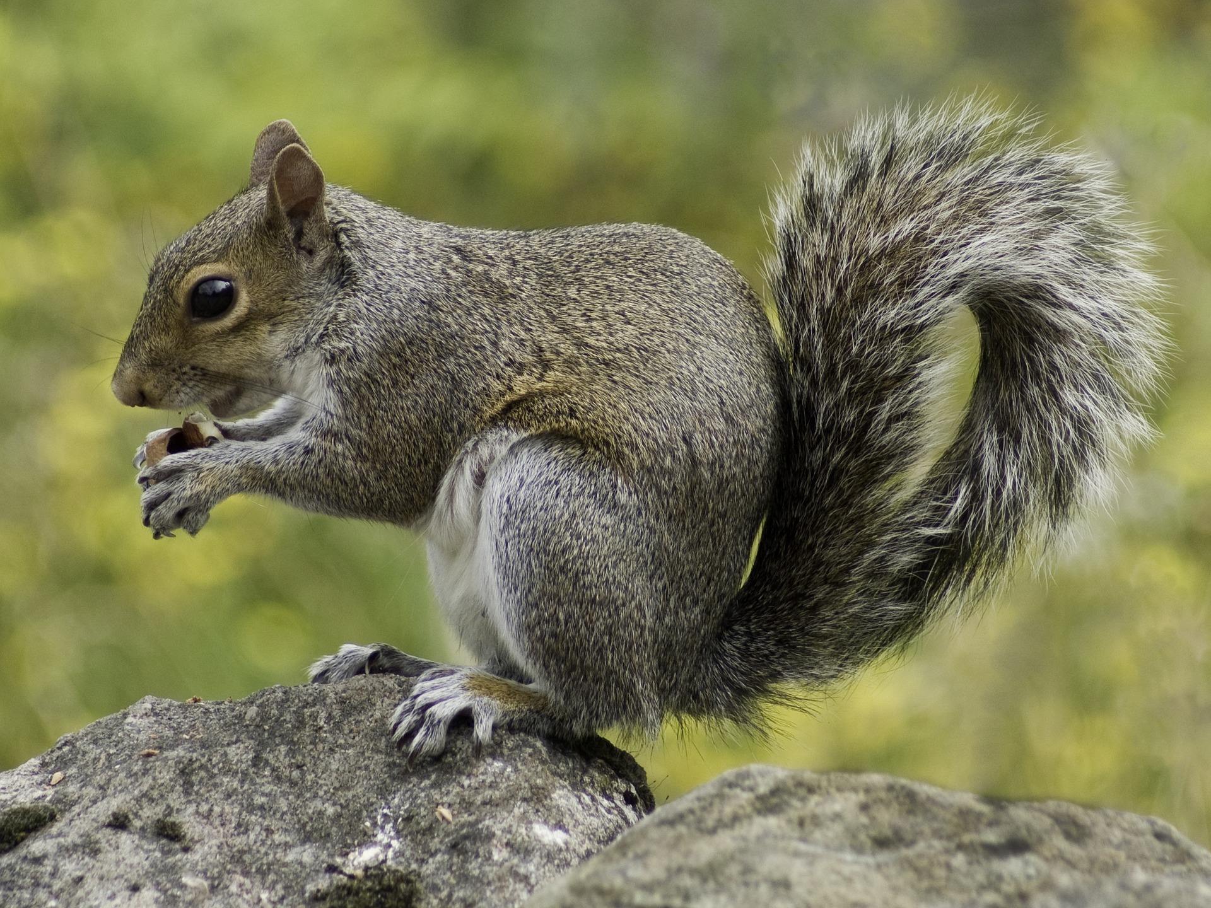
When I visit Tarr Steps
I might see:
Trees
Bluebells during the Spring
Deer
Grey squirrels

Slide 6

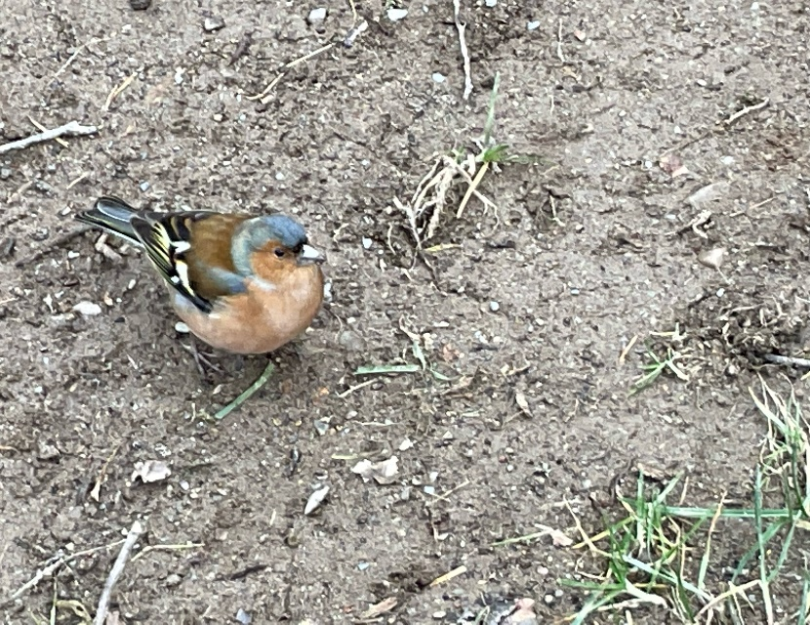
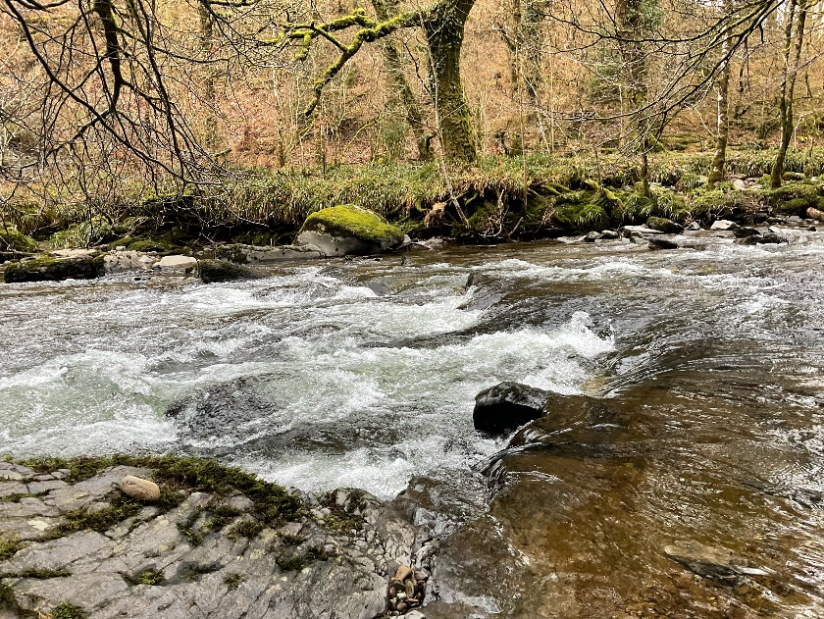
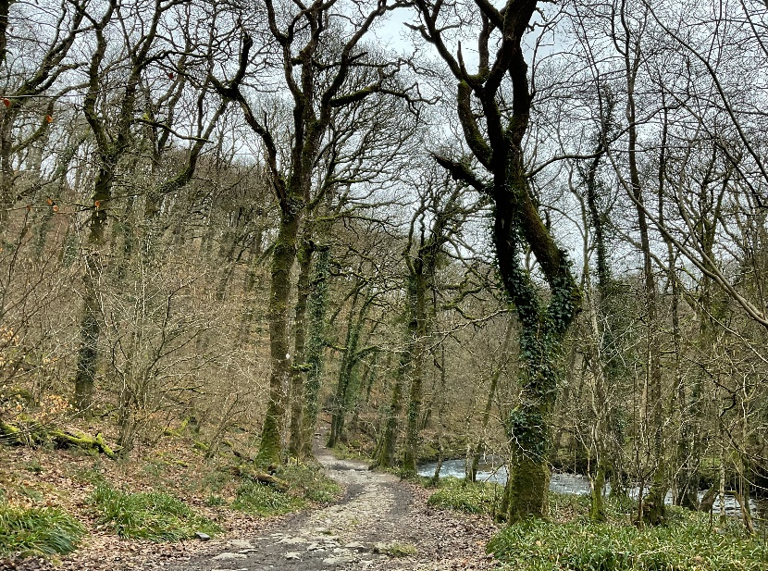
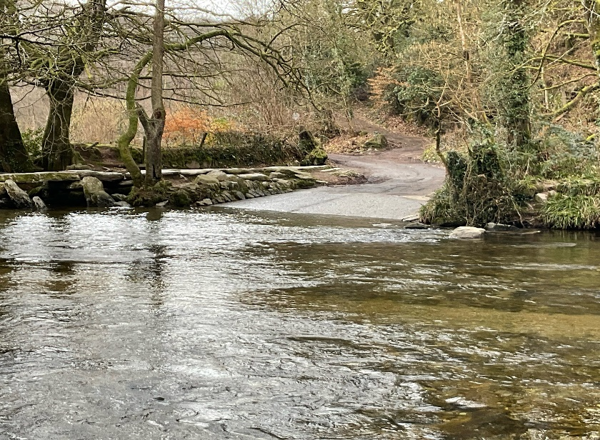
When I visit Tarr Steps
I might hear:
Birds
The water in the river
The wind blowing
Cars driving through the shallow part of the water to get to the other side.This
is called a ‘ford’.

Slide 7

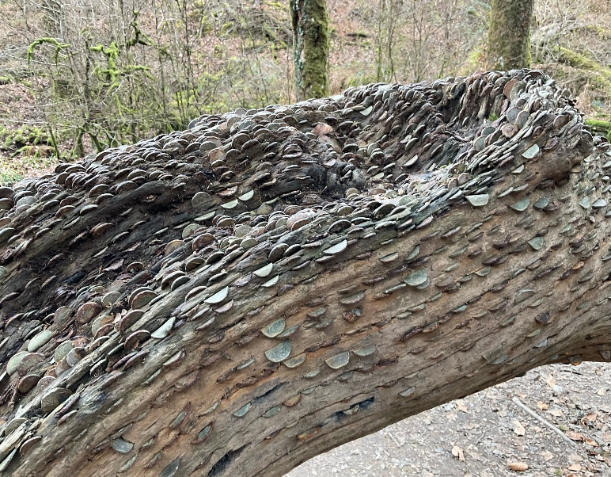
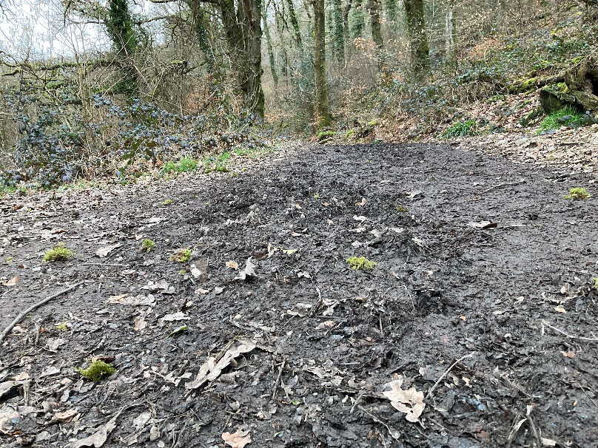
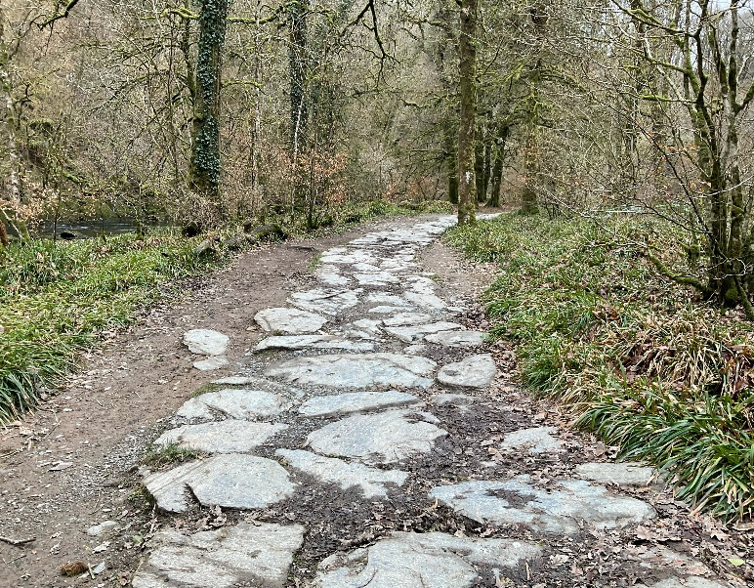
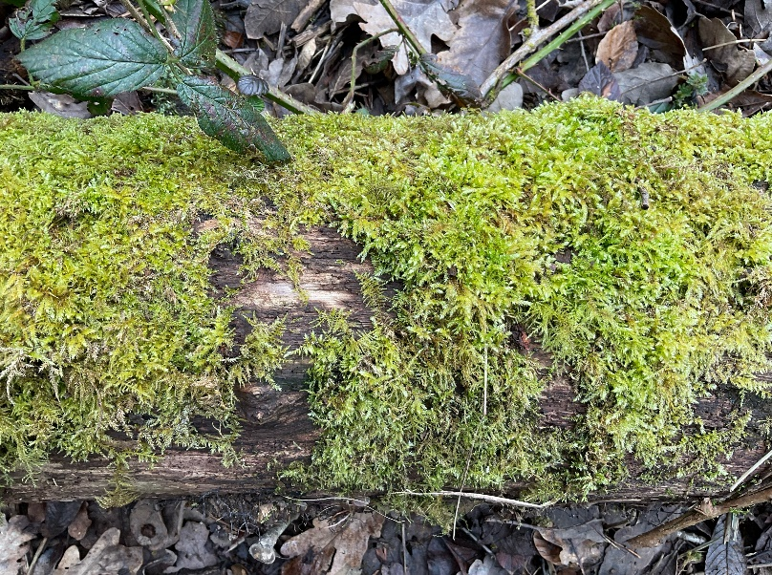
When I visit Tarr Steps
I might touch or feel:
A tree with coins pressed into the trunk. This is called the Money Tree.
Mud
A stone path
Moss

Slide 8

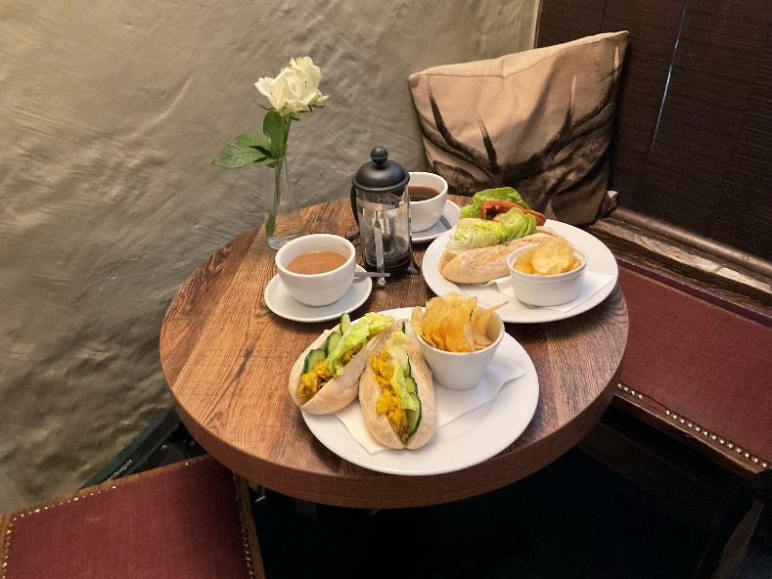

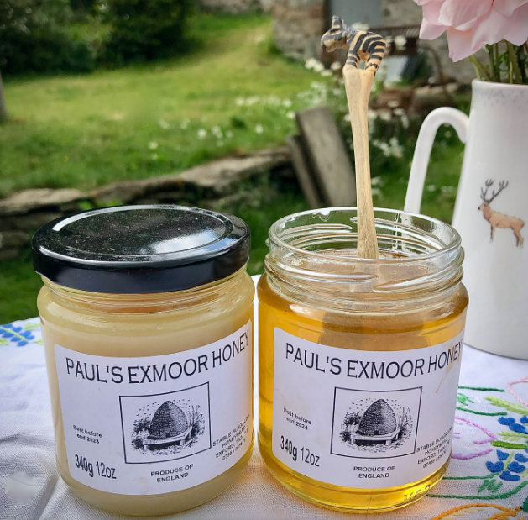
When I visit Tarr Steps
I might taste:
Food and drink from the pub if we go there.
Ice cream
Honey

Slide 9

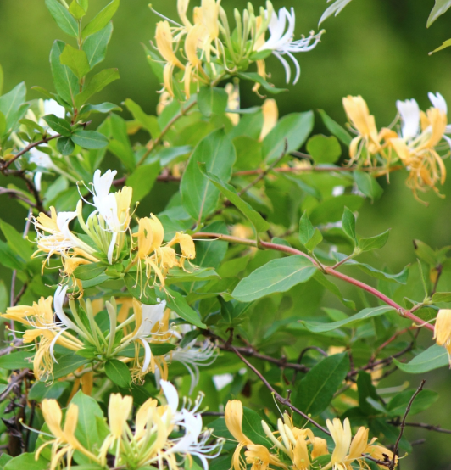
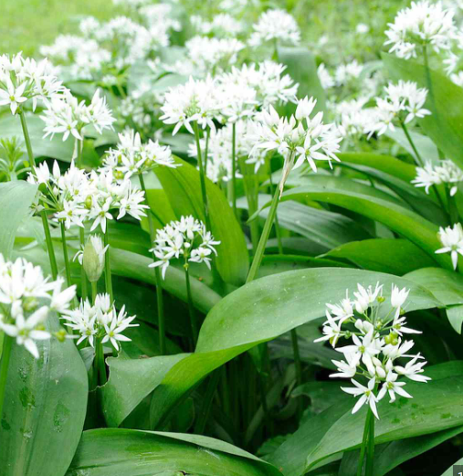
When I visit Tarr Steps
I might smell:
Honeysuckle
Wild garlic

Slide 10
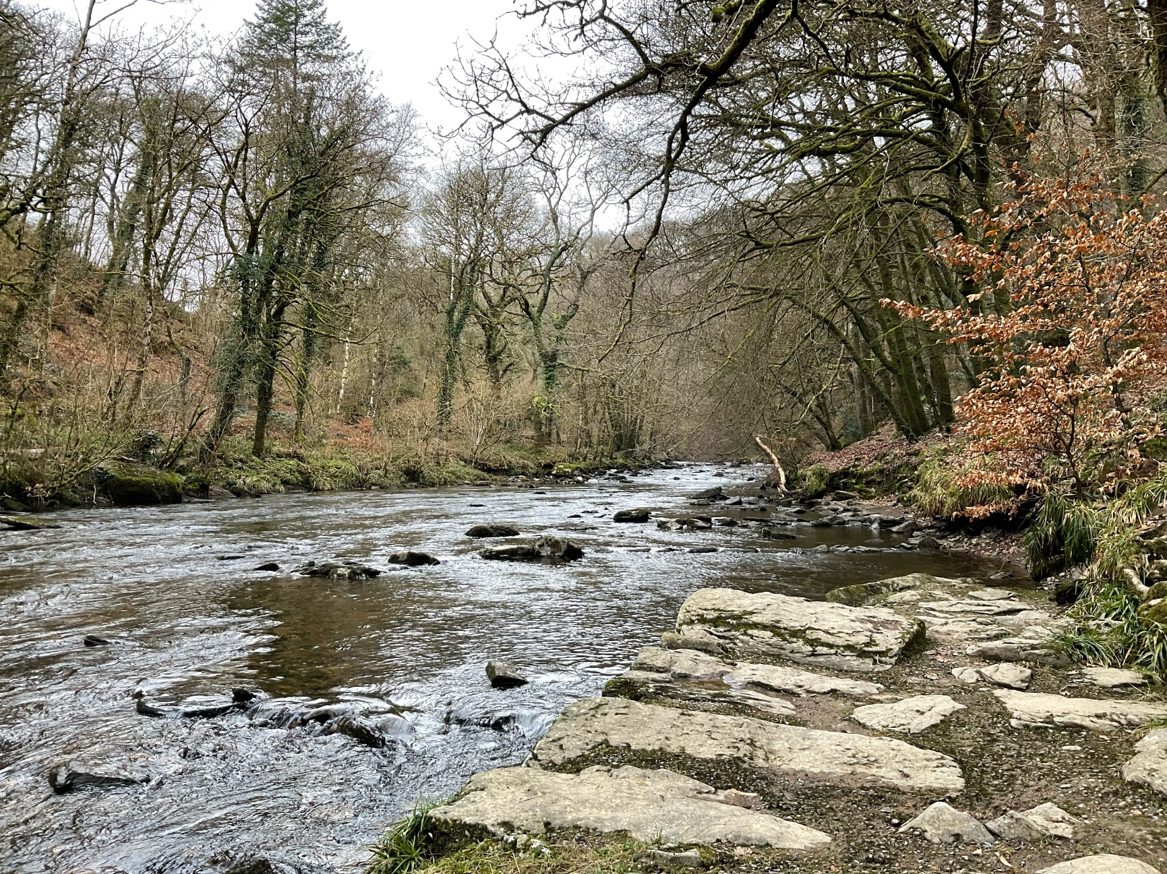
Most of all Tarr Steps is a place where I can enjoy time outdoors

Slide 11
Some additional information for my visit
This Sensory Story starts from Exmoor National Park Tarr Steps pay and display car park TA22 9PY. Note, ignore sat nav directions and approach from the Winsford Hill side (the B3223 between Dulverton and Exford) and follow signs to Tarr Steps
This car park has public toilets
There are refreshments available from Tarr Farm Inn and there is an ice cream van in season

Slide 12
The Tarr Steps Story
Produced For Exmoor National Park by Access & Inclusion UK 2023
www.accessandinclusion.com

