Slide 1

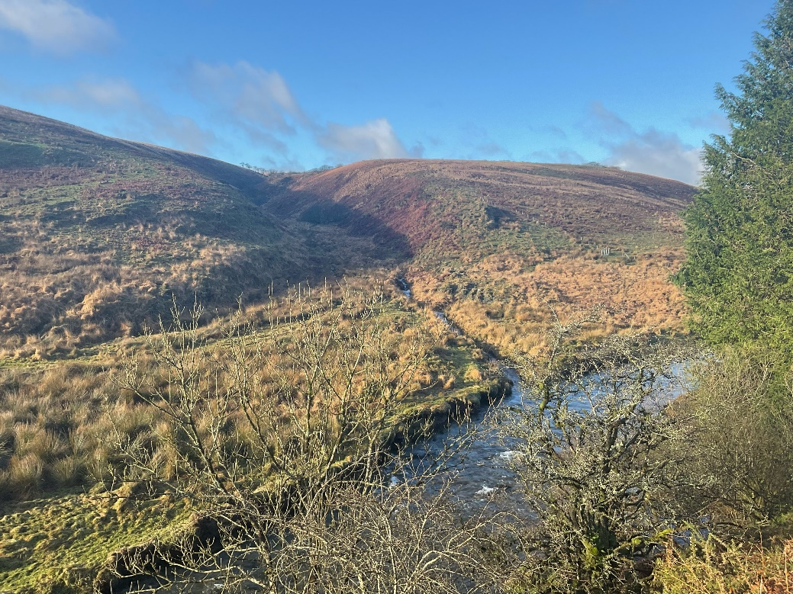
The Simonsbath and Wheal Eliza Story

Slide 2
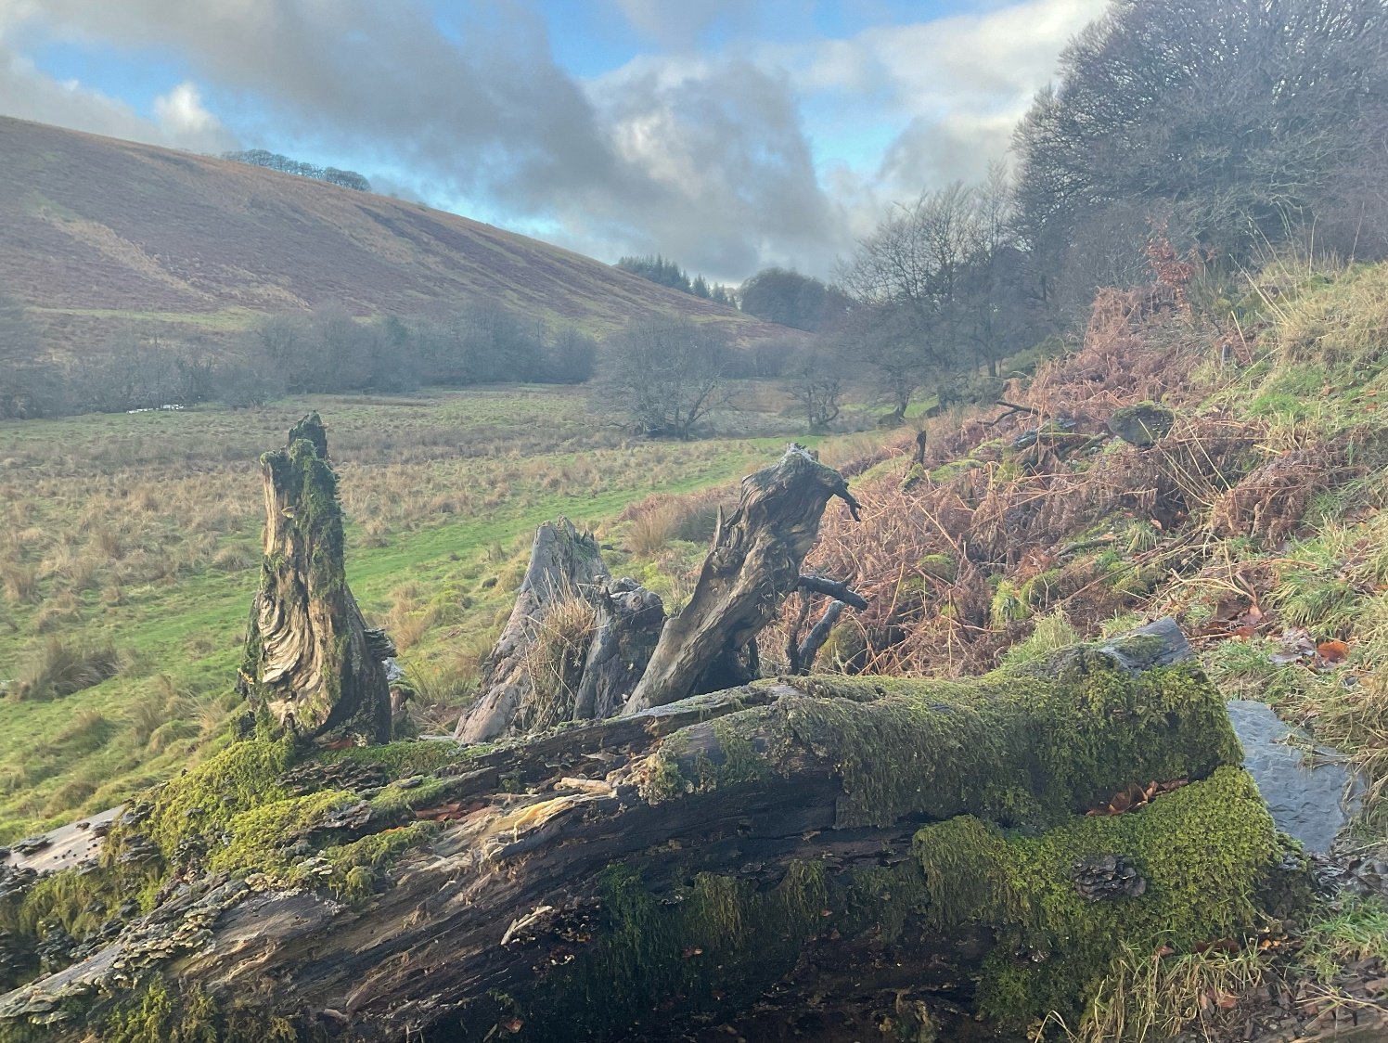
Simonsbath and Wheal Eliza is an outdoor area with a walk along the river to an old mineworks and ruined cottage
This means it is a place where I can spend time in the countryside

Slide 3

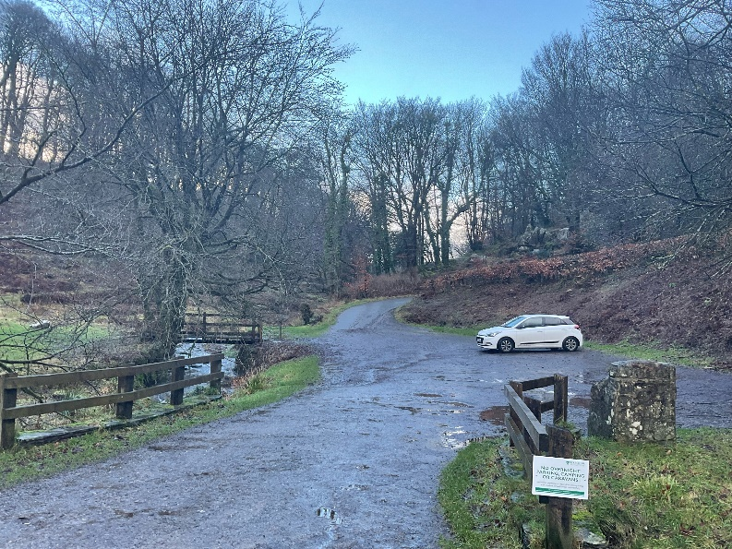
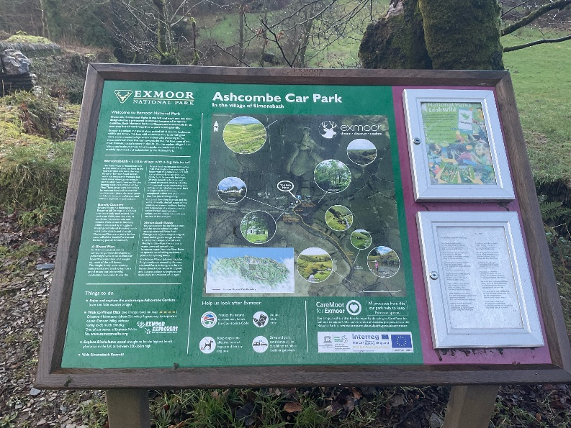
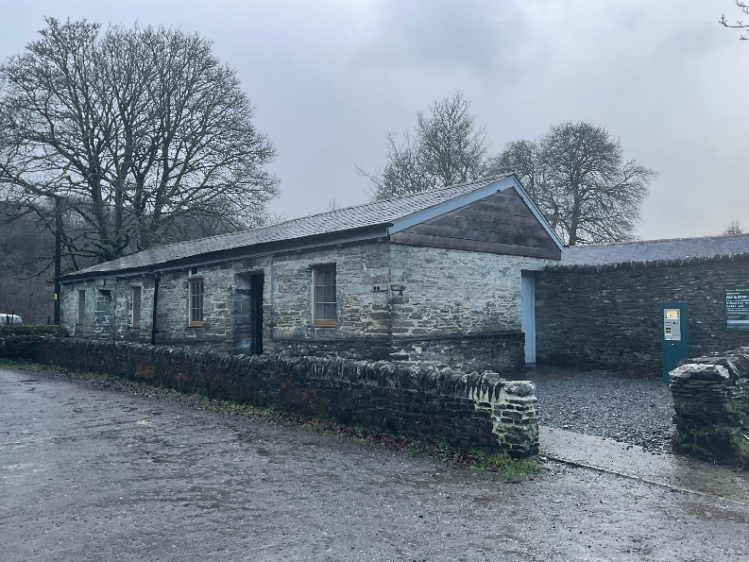
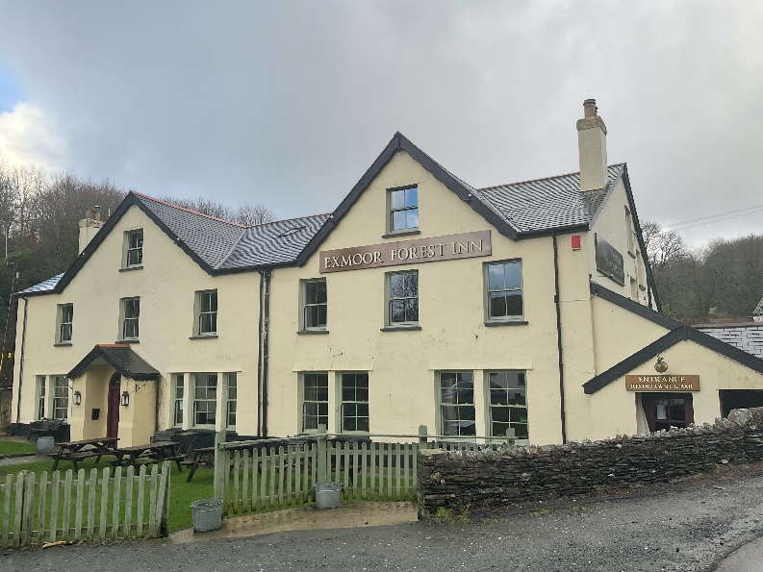
When I arrive to visit Simonsbath and Wheal Eliza
I might see:
The car park
An Exmoor National Park information board
Toilets
A pub called the Exmoor Forest Inn

Slide 4
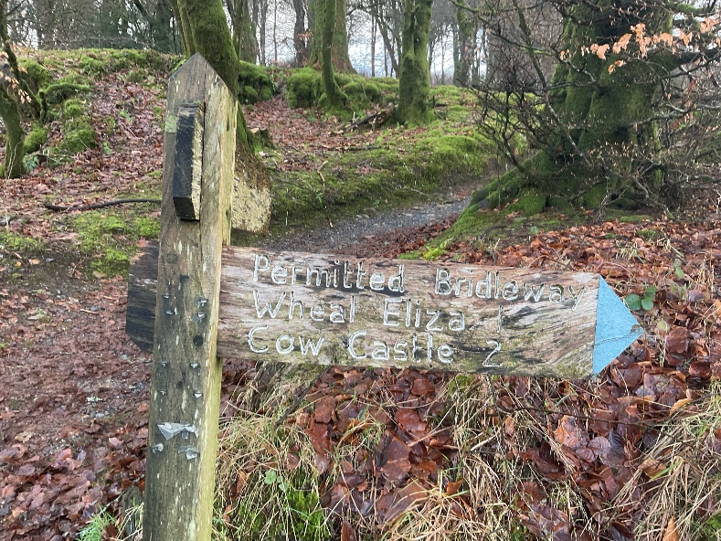
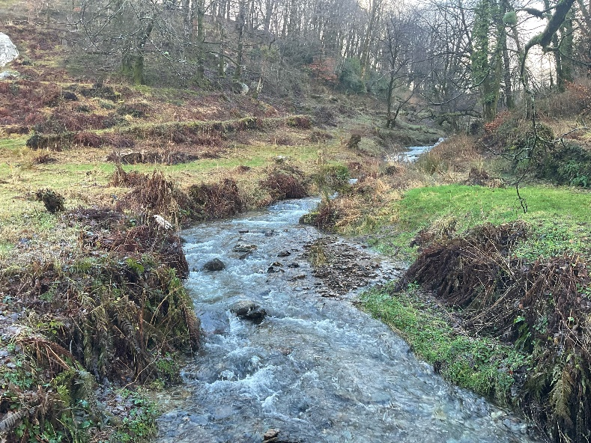
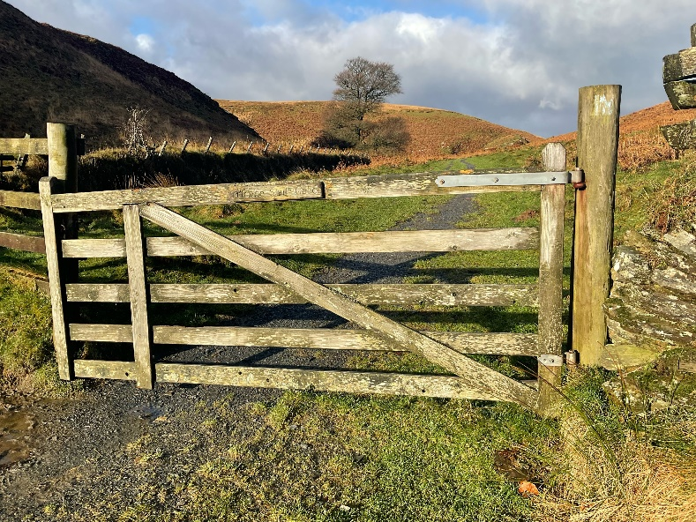
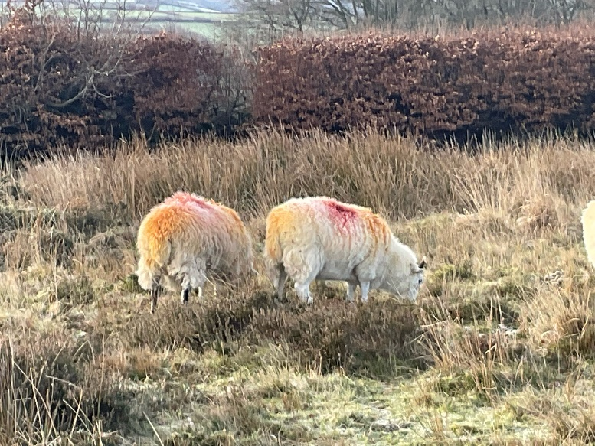
When I visit Simonsbath and Wheal Eliza
I might see:
A wooden signpost
The river
A big wooden gate
Sheep

Slide 5
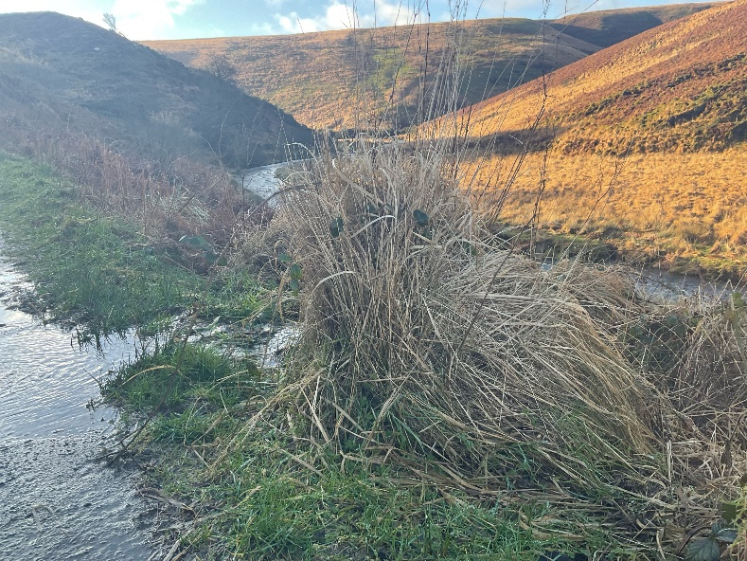
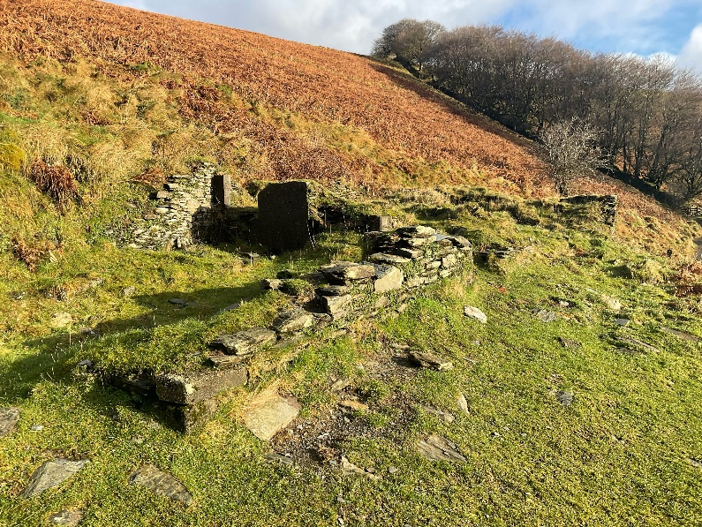
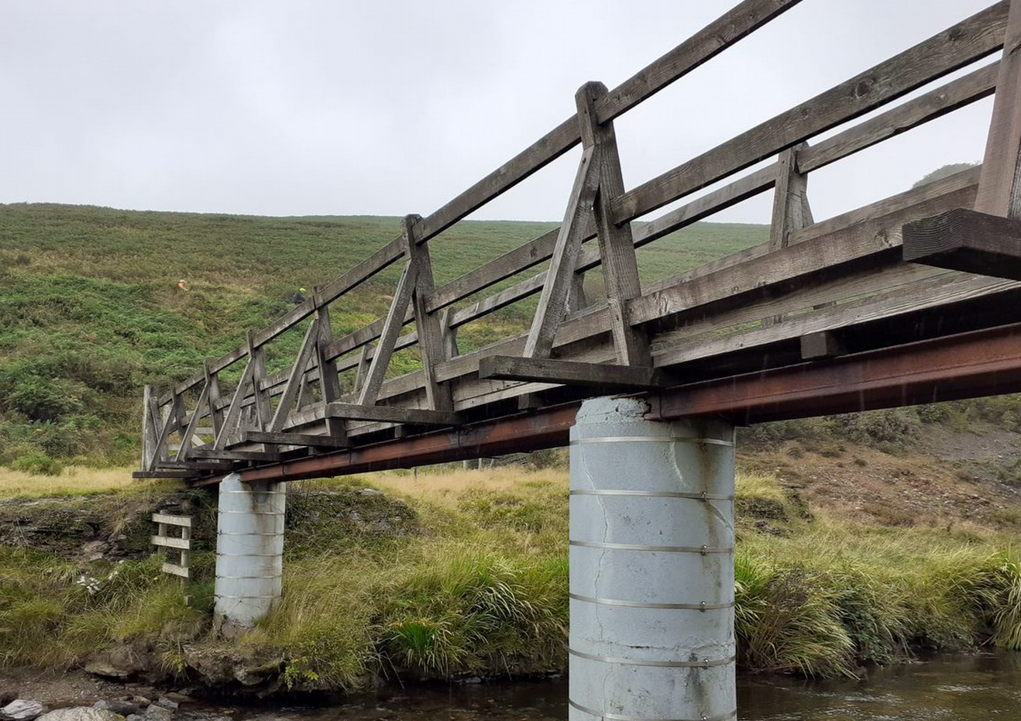
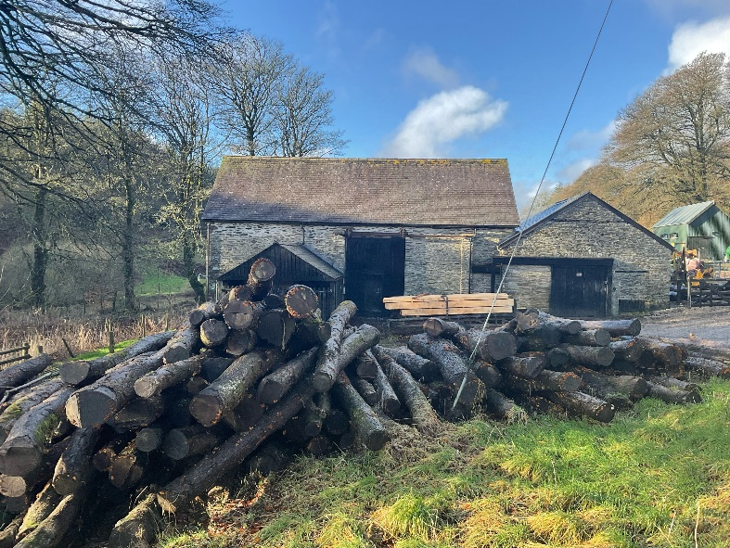
When I visit Simonsbath and Wheal Eliza
I might see:
Tall grass
A ruined cottage
A bridge
A saw mill where trees are sawn into logs

Slide 6

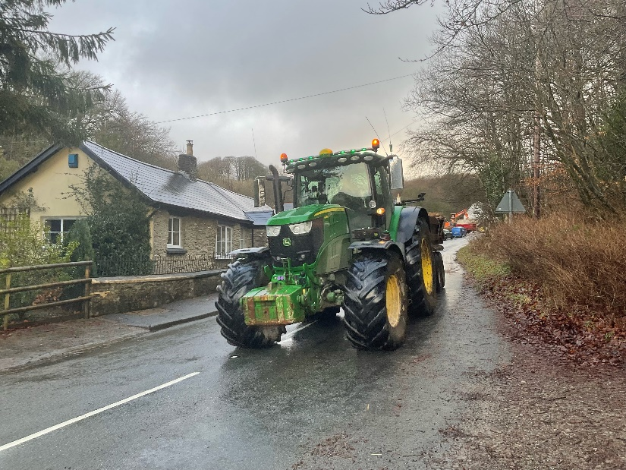
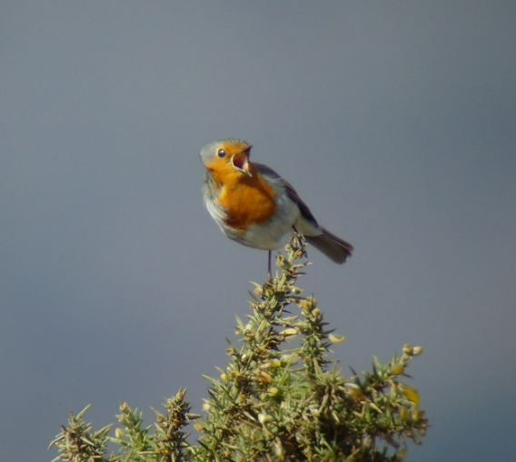
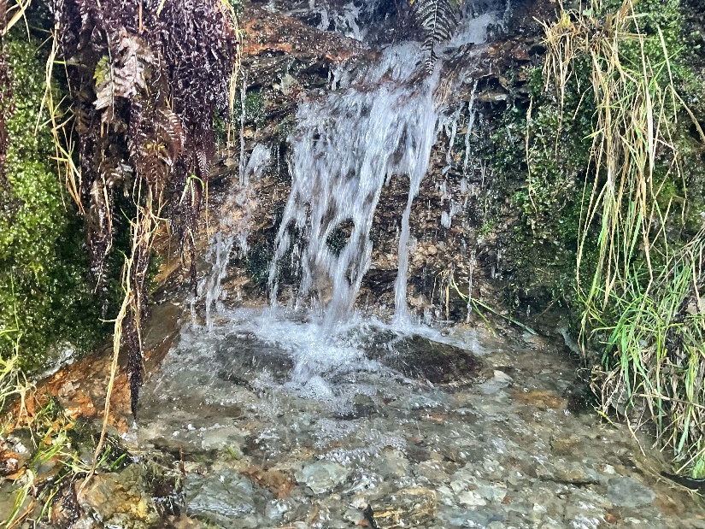
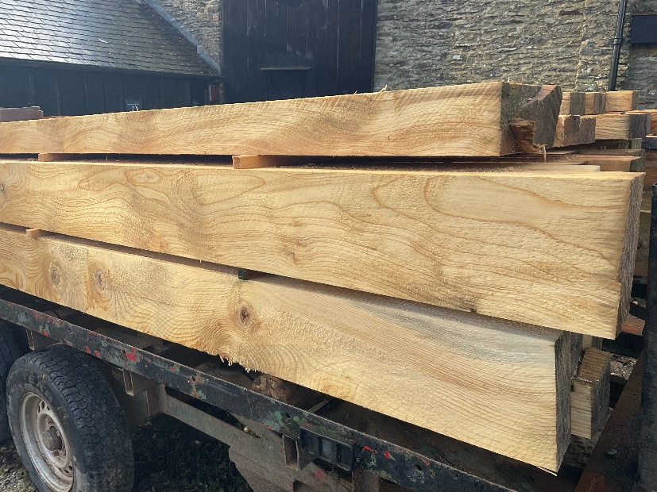
When I visit Simonsbath and Wheal Eliza
I might hear:
A tractor driving past
Birds
Water in the river
Wood being cut
in the saw mill

Slide 7

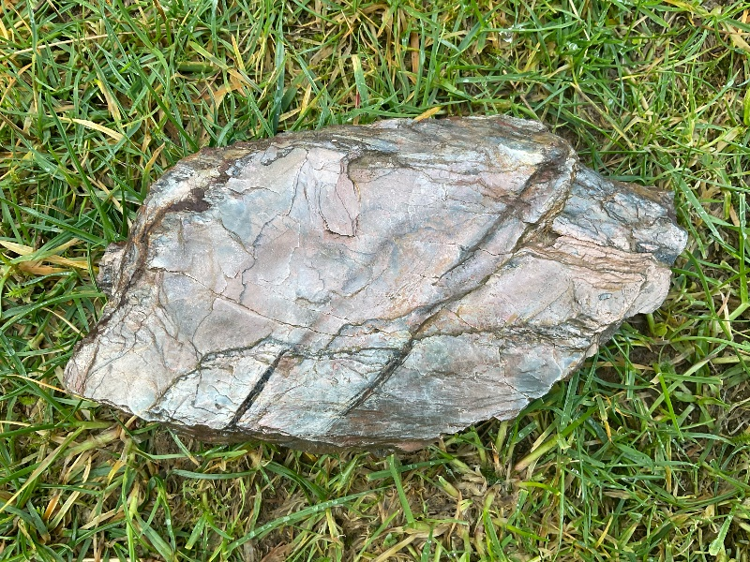
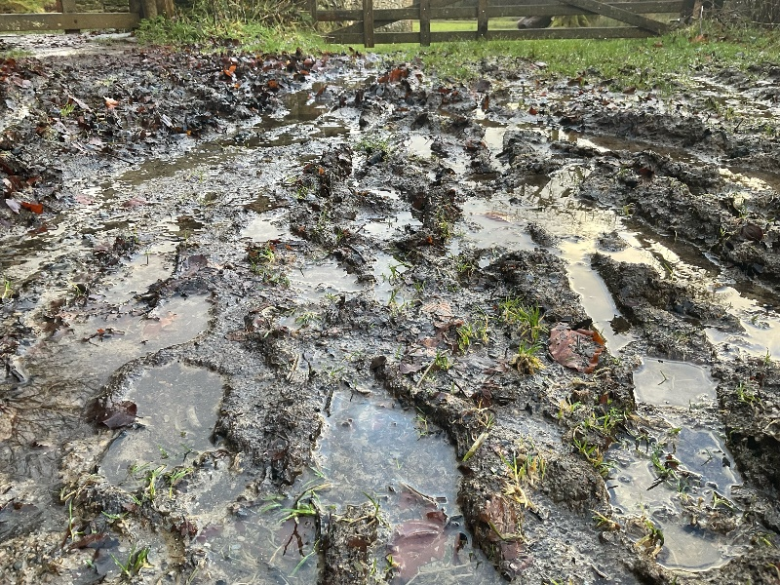
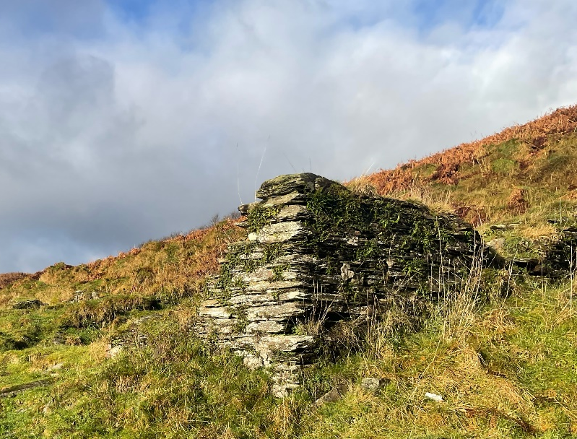
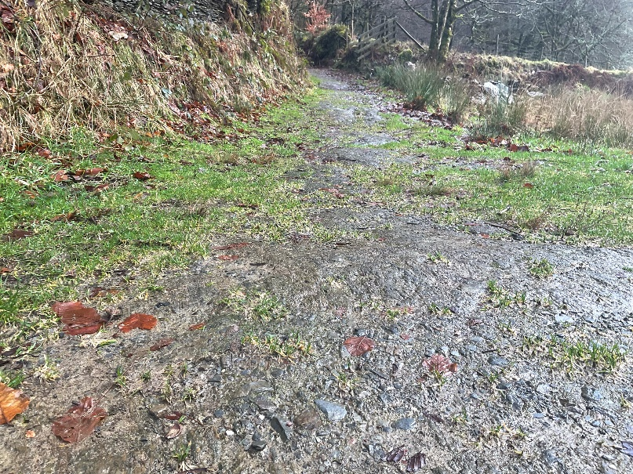
When I visit Simonsbath and Wheal Eliza
I might touch or feel:
Smooth slate
Mud beneath my feet
Stone walls
A stony path

Slide 8

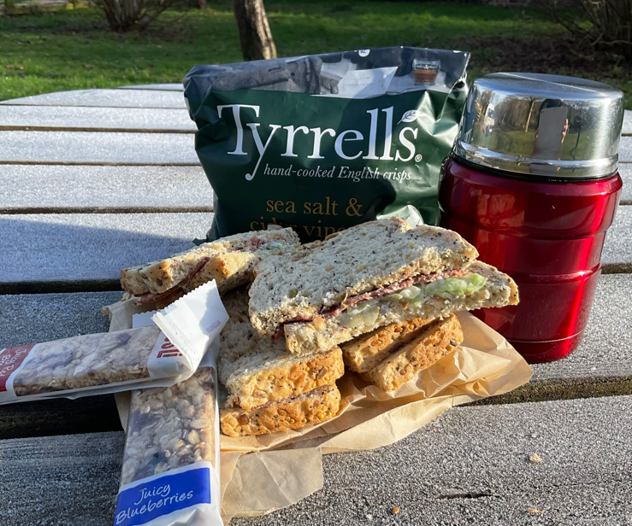
When I visit Simonsbath and Wheal Eliza
I might taste:
Lunch

Slide 9

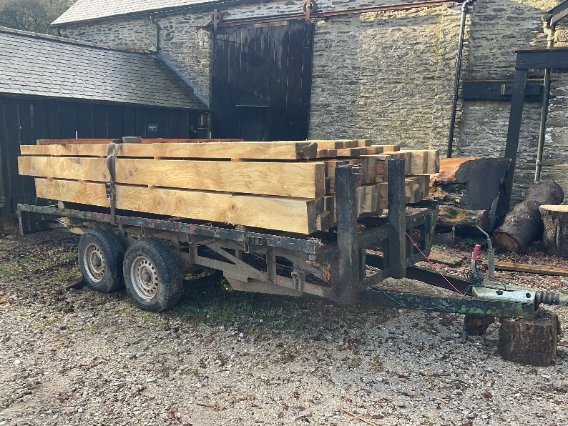
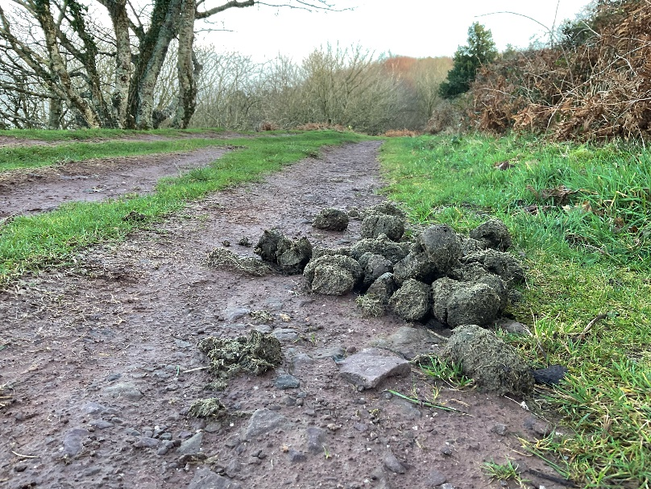
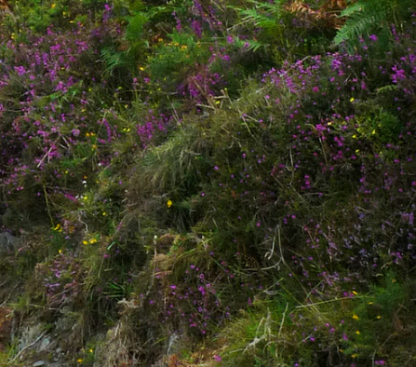
When I visit Simonsbath and Wheal Eliza
I might smell:
Freshly sawn wood
Pony poo
Heather

Slide 10
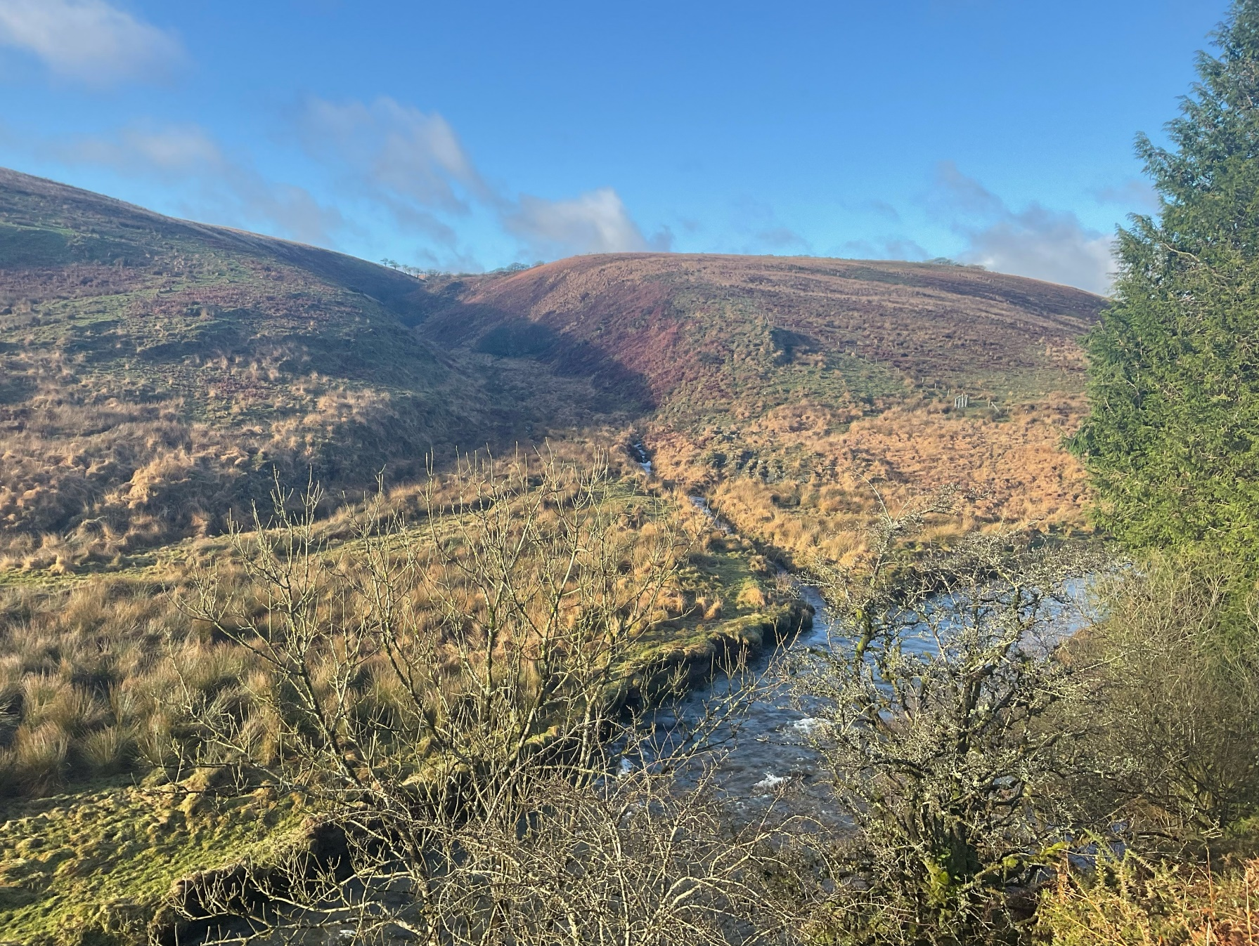
Most of all Simonsbath and Wheal Eliza is a place where I can enjoy time outdoors

Slide 11
Some additional information for my visit
This Sensory Story starts from the Exmoor National Park pay and display car park at Ashcombe TA24 7SH
This car park has public toilets
There is a pub and tea room close to the car park

Slide 12
The Simonsbath and Wheal Eliza Story
Produced For Exmoor National Park by Access & Inclusion UK 2023
www.accessandinclusion.com

