Slide 1

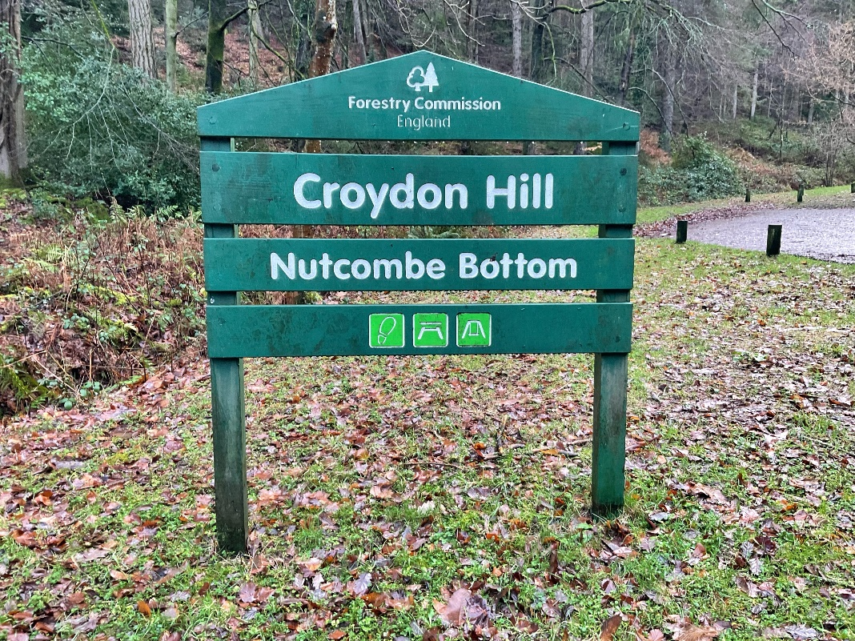
The Nutcombe Bottom Story

Slide 2

Nutcombe Bottom is an outdoor area with forest paths
This means it is a place where I can spend time in the countryside

Slide 3

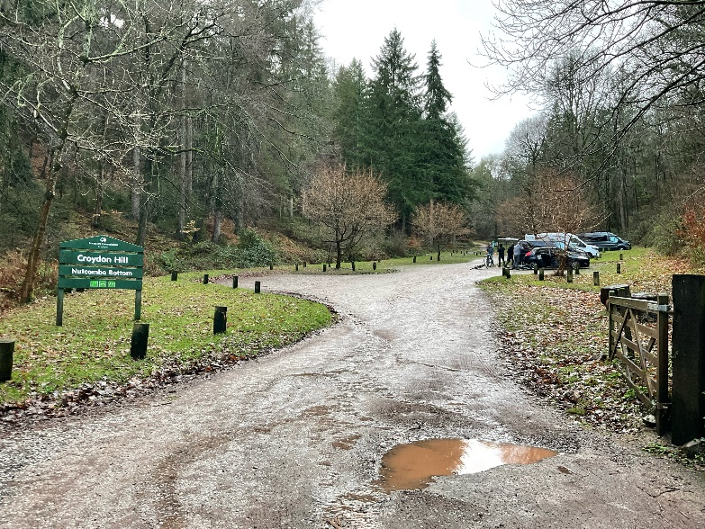
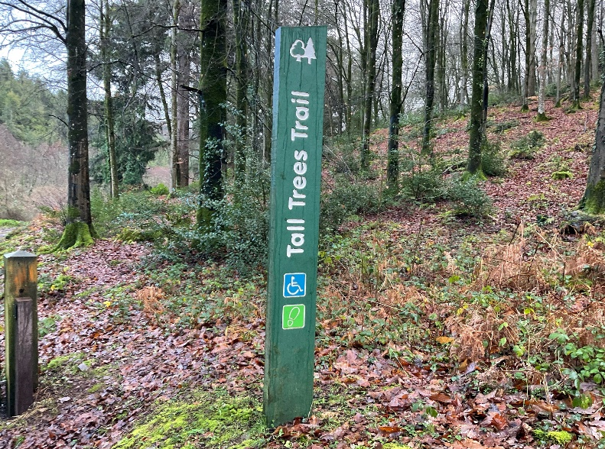
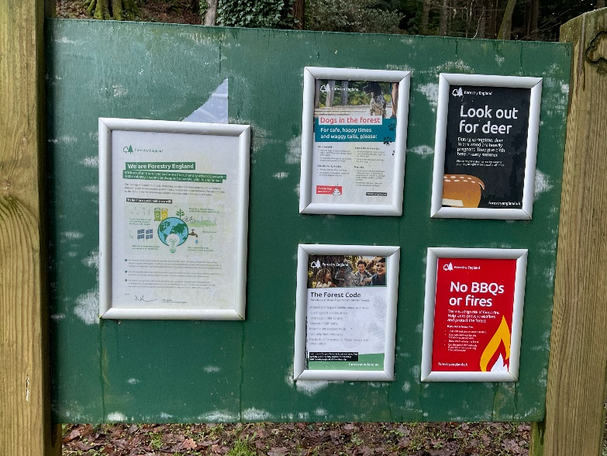
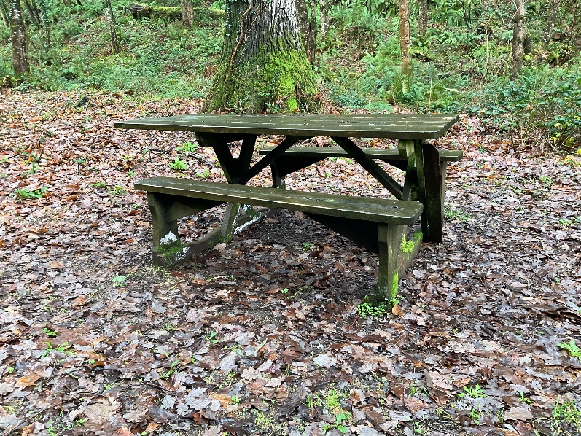
When I arrive to visit Nutcombe Bottom
I might see:
The car park and a sign which says ‘Croydon Hill’ and ‘Nutcombe Bottom’
A signpost for the Trees Trail
An information board
Picnic benches

Slide 4
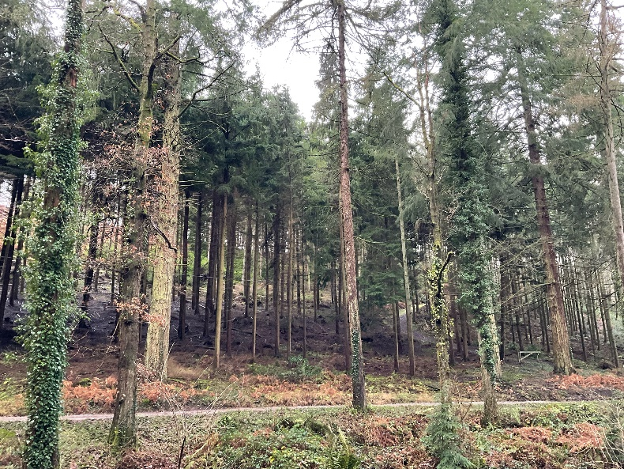
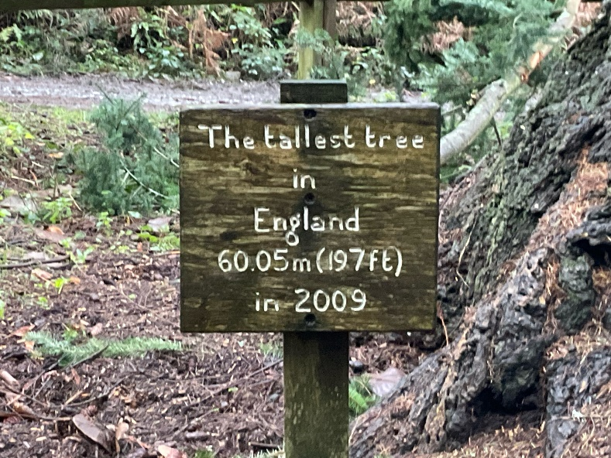
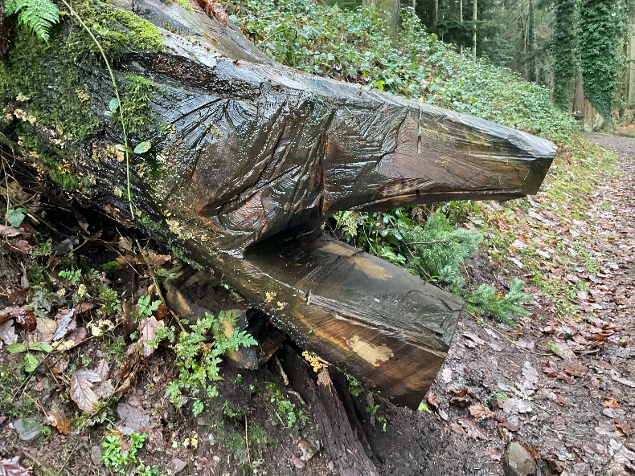
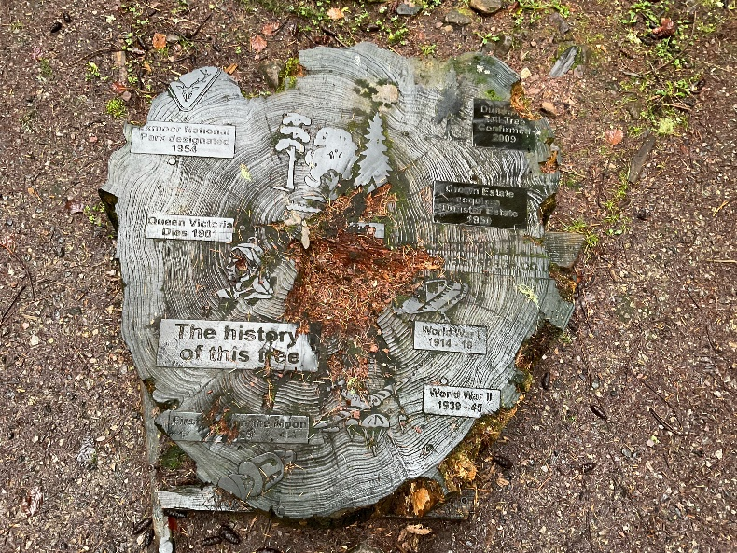
When I visit Nutcombe Bottom
I might see:
Lots of tall trees
The tallest tree in England!
Wood carved into different shapes
Signs made of wood

Slide 5
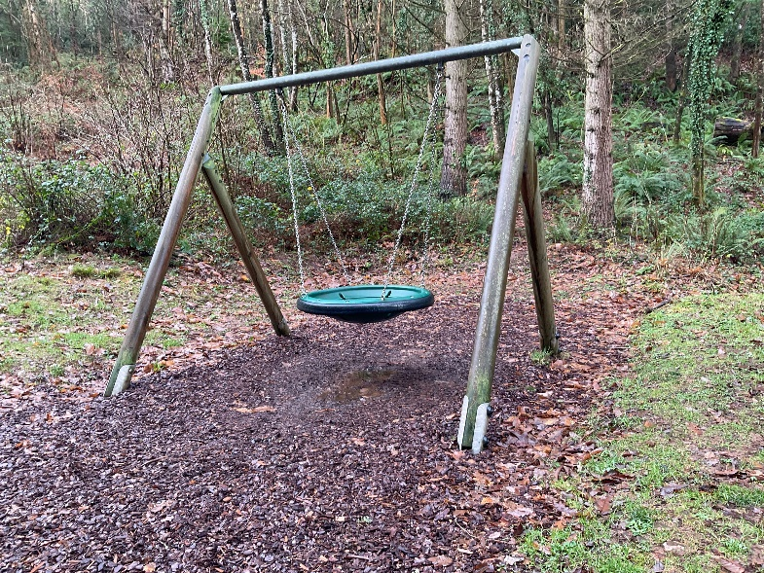
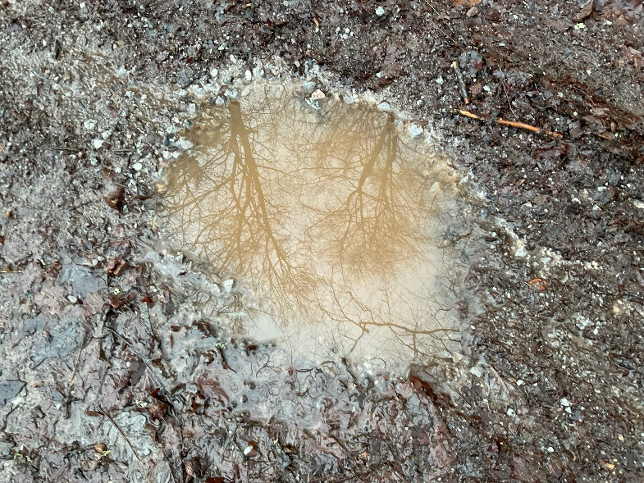
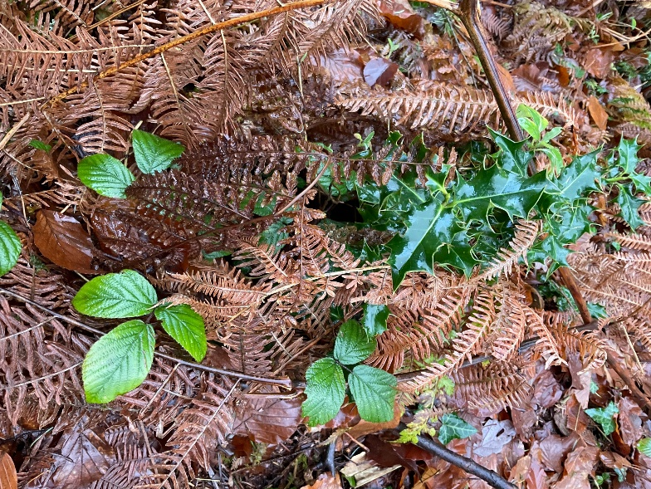
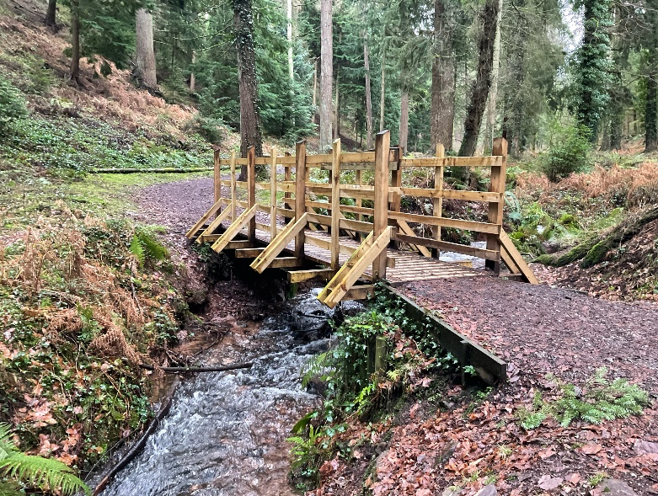
When I visit Nutcombe Bottom
I might see:
A swing
Muddy puddles
Different leaves
A footbridge over a river

Slide 6

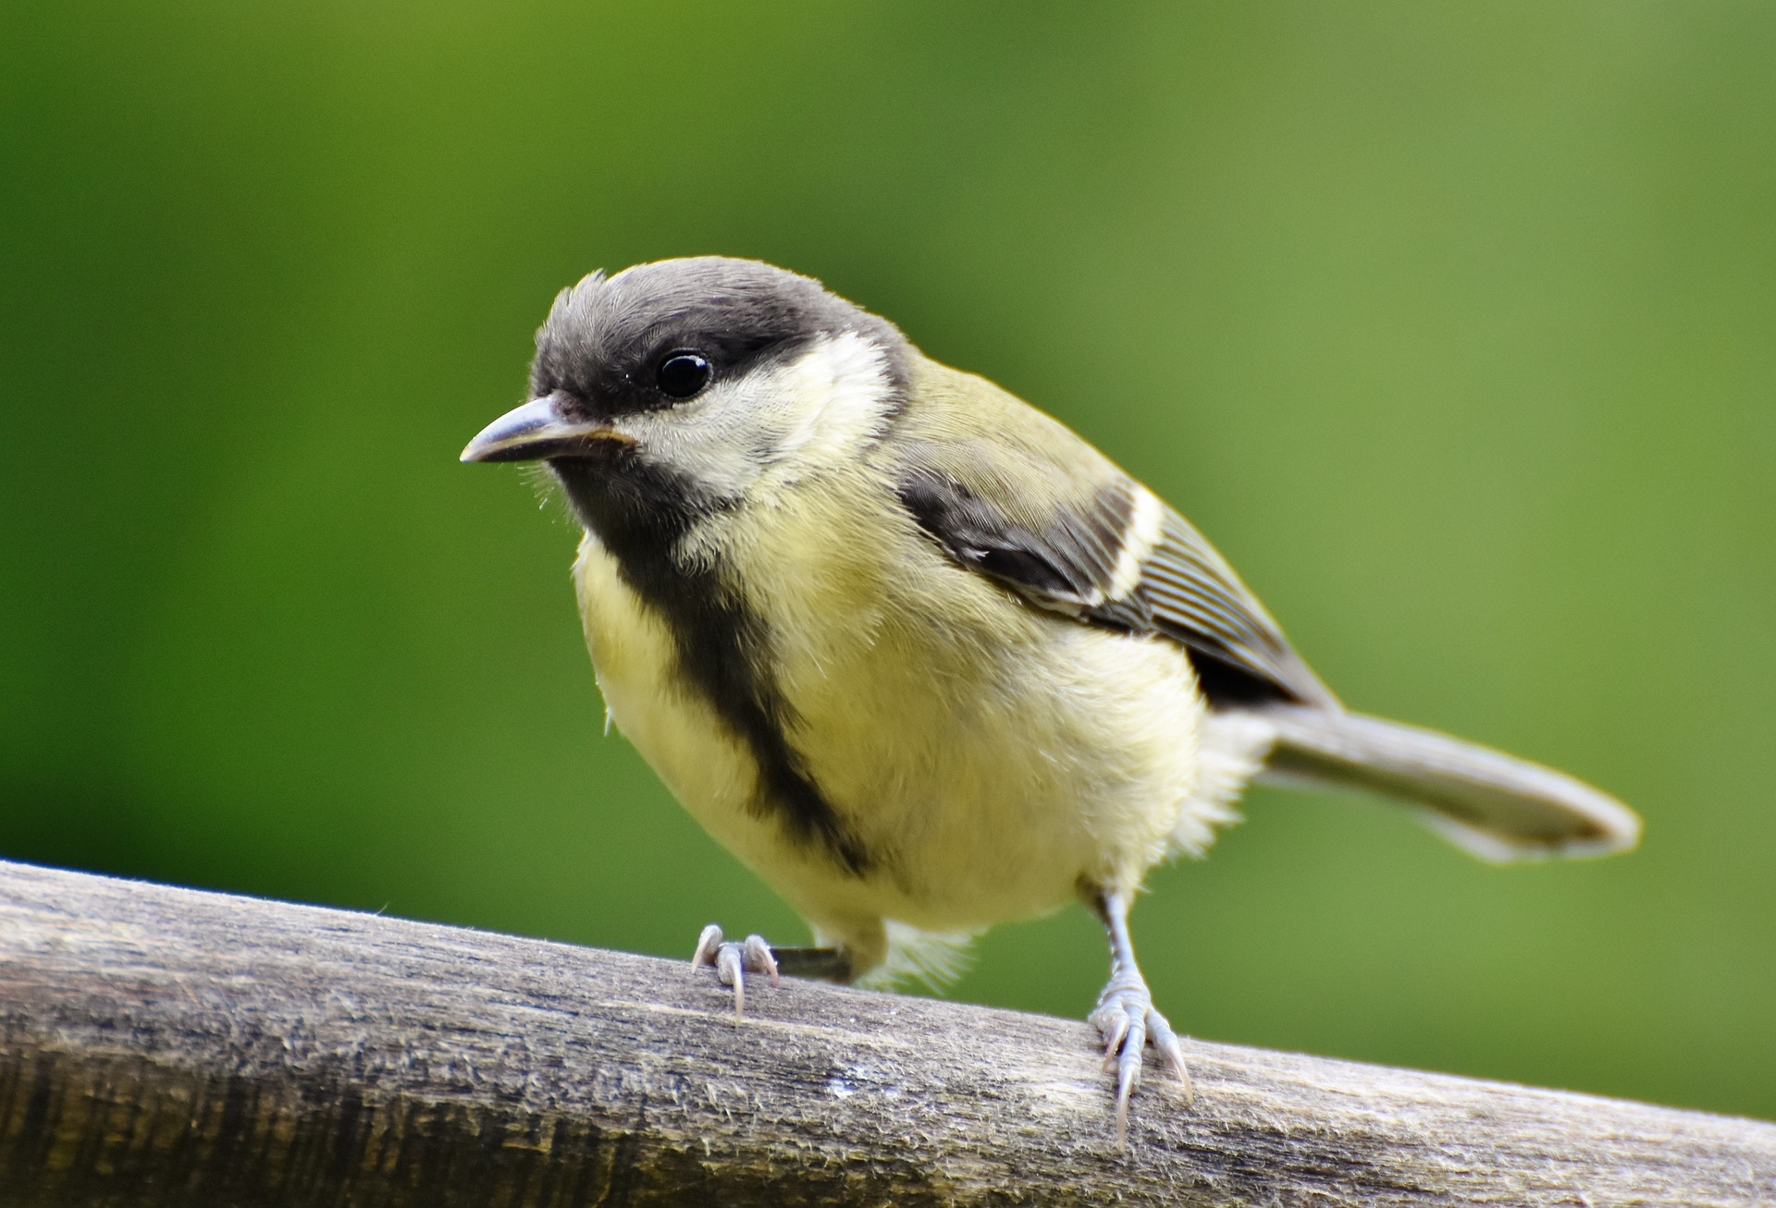
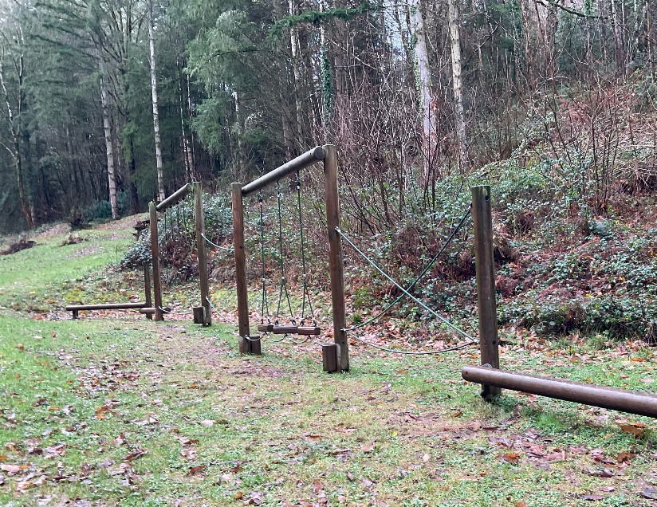
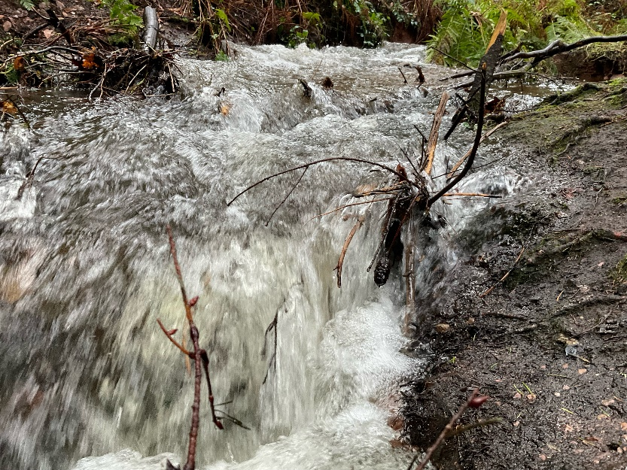
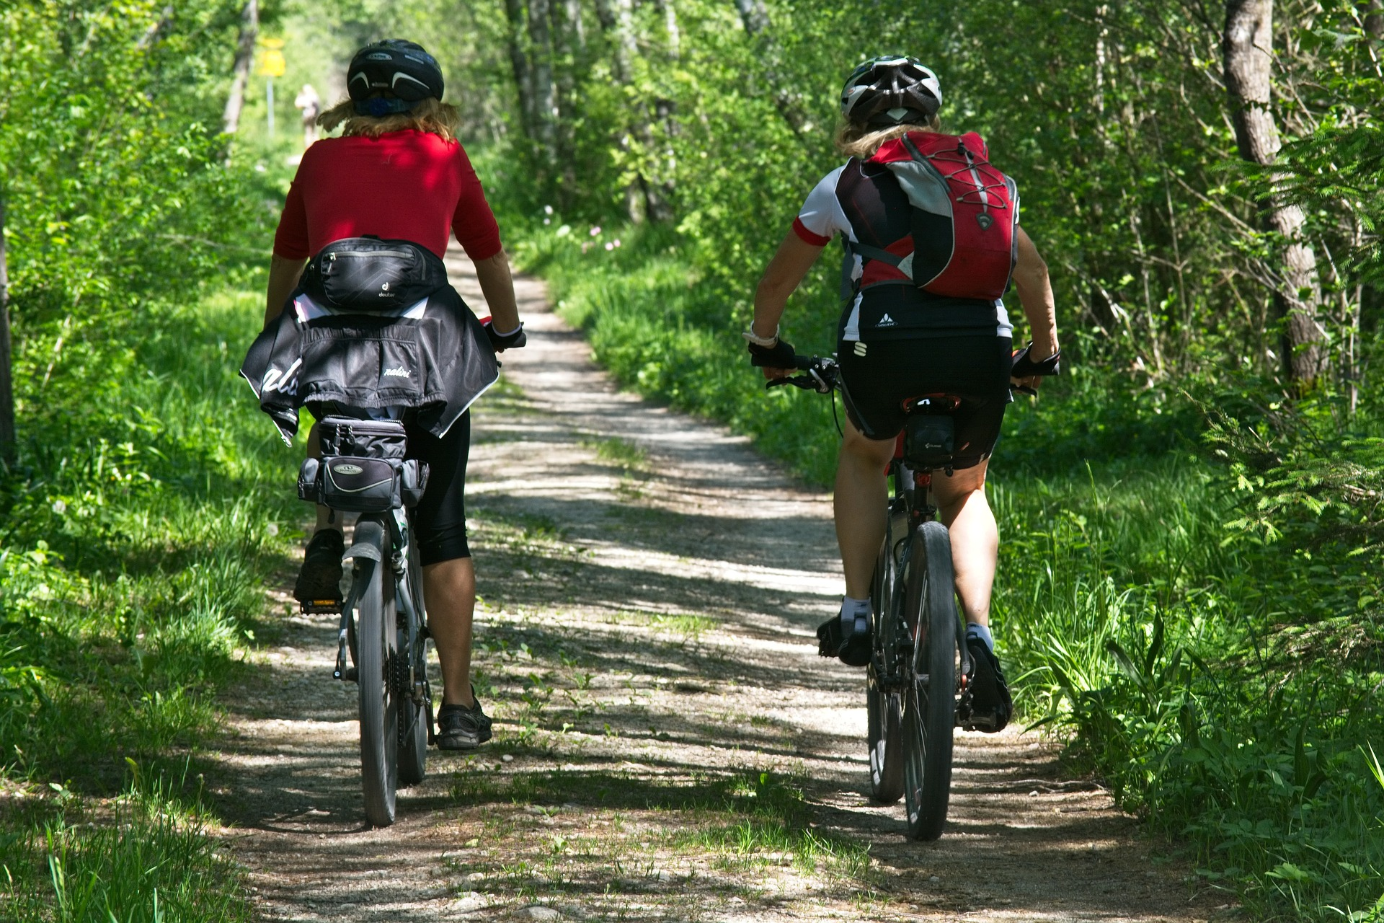
When I visit Nutcombe Bottom
I might hear:
Birds
People playing in the wooden play area
The water in the river
People riding bikes

Slide 7

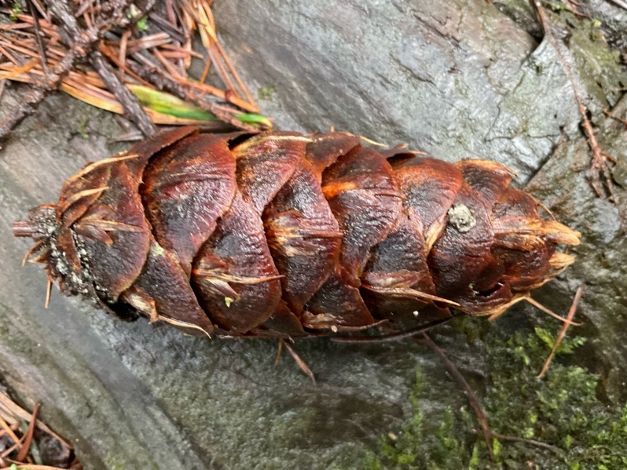
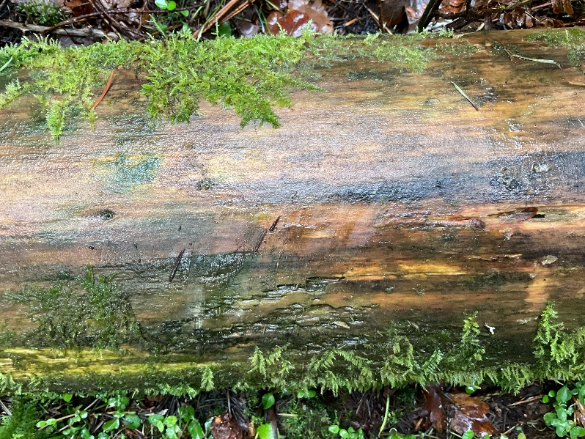
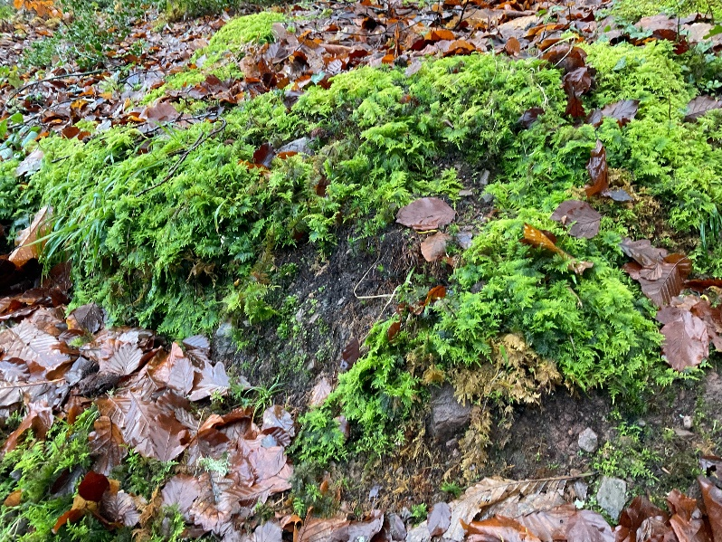
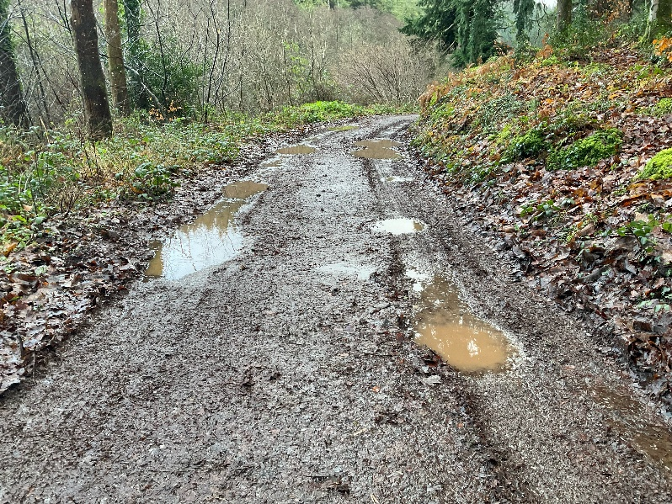
When I visit Nutcombe Bottom
I might touch or feel:
Pine cones
A smooth tree trunk
Moss
Gravel under my feet

Slide 8

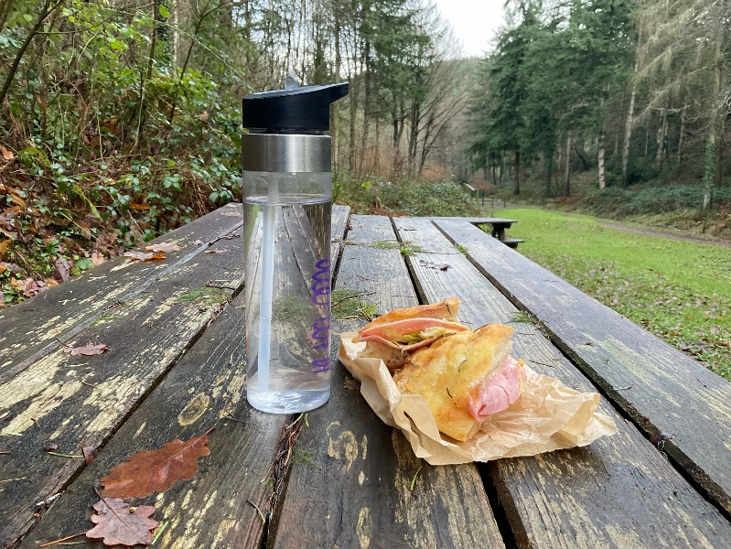
When I visit Nutcombe Bottom
I might taste:
My picnic, if we have taken one with us

Slide 9

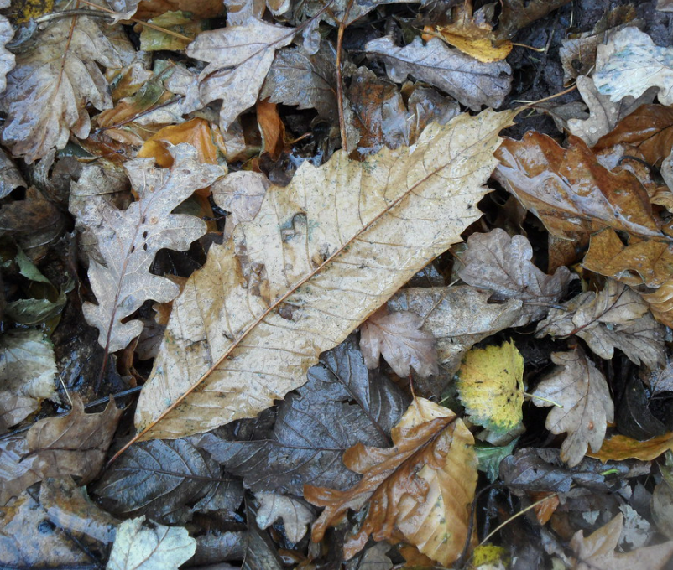
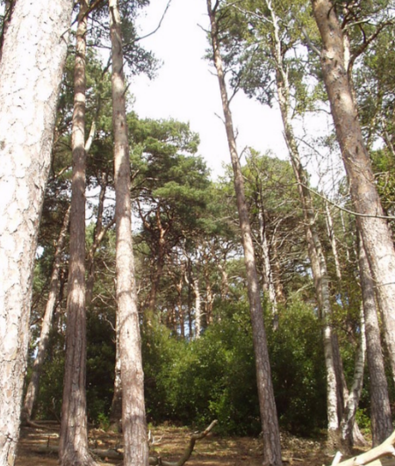
When I visit Nutcombe Bottom
I might smell:
Damp leaves
Pine trees

Slide 10
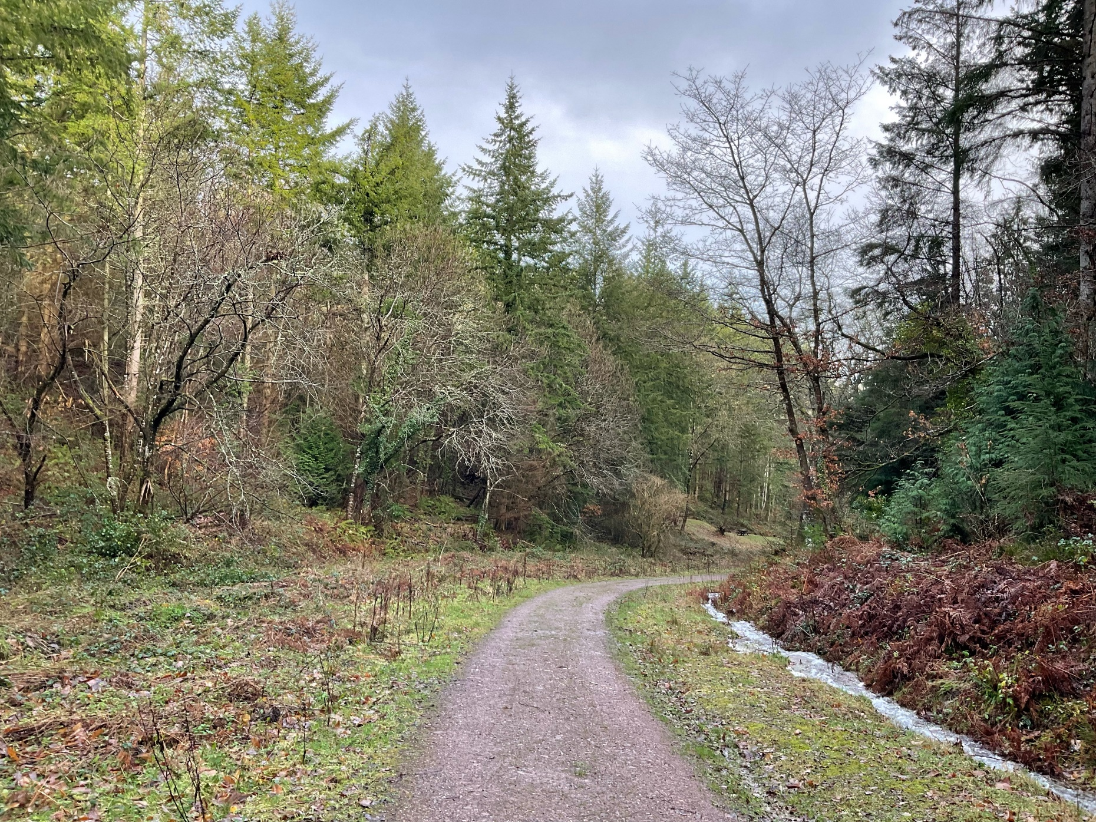
Most of all Nutcombe Bottom is a place where I can enjoy time outdoors

Slide 11
Some additional information for my visit
This Sensory Story starts from Nutcombe Bottom free car park TA24 6TA
This car park has no toilet or café facilities
There are toilets and refreshment opportunities in nearby Dunster

Slide 12
The Nutcombe Bottom Story
Produced For Exmoor National Park by Access & Inclusion UK 2023
www.accessandinclusion.com

