Slide 1

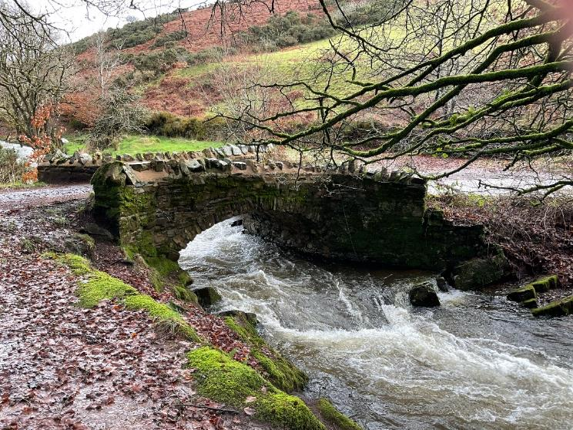
The Robber’s Bridge Story

Slide 2

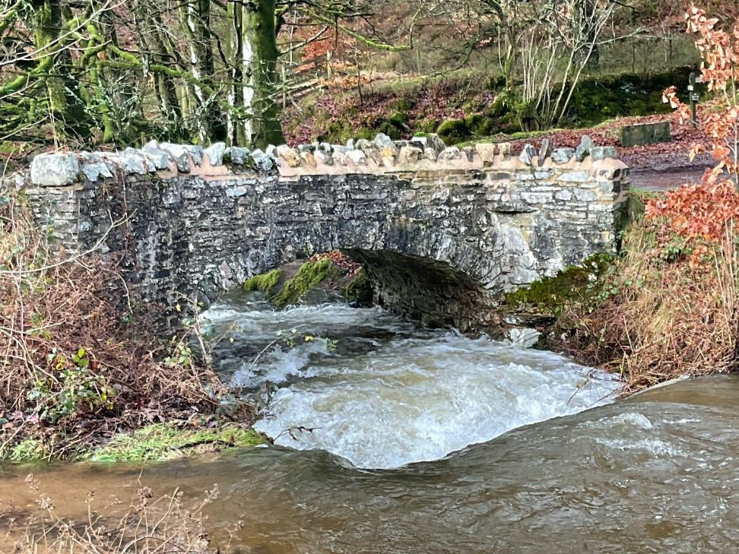
Robber’s Bridge is an outdoor area where a bridge crosses over a river
It is a place where I can spend time in the countryside

Slide 3

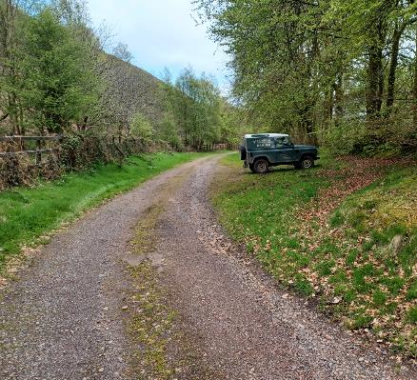
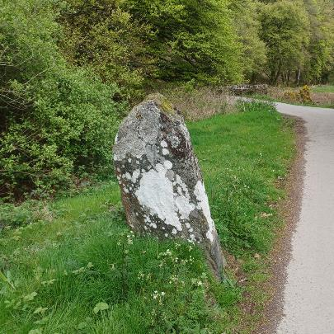
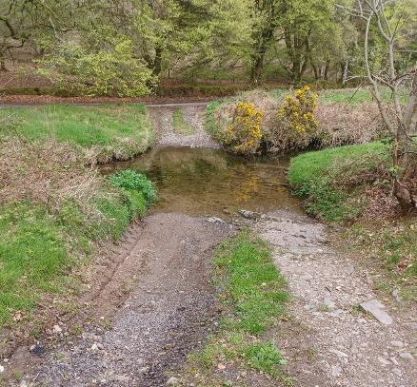
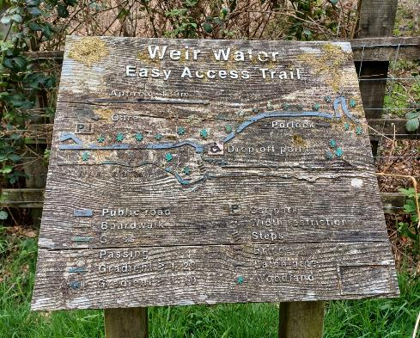
When I arrive to visit Robber’s Bridge
I might see:
The car park
Old boundary stones
A ford
A sign

Slide 4
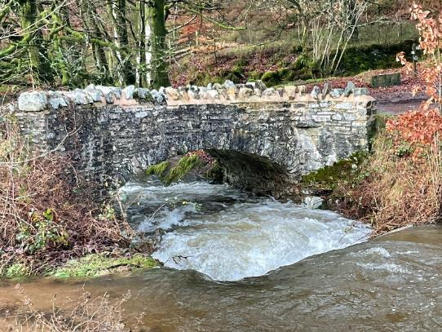
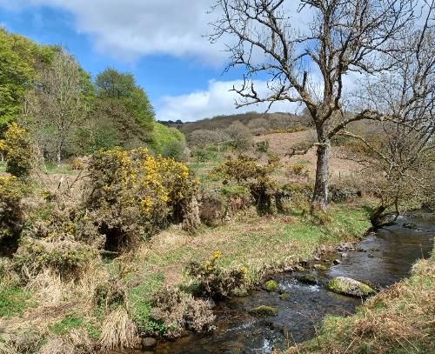
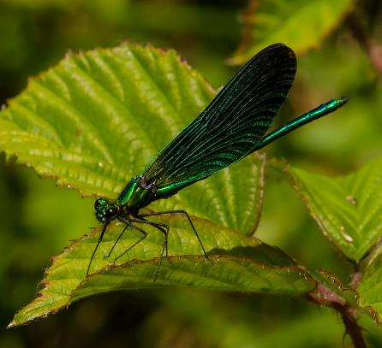
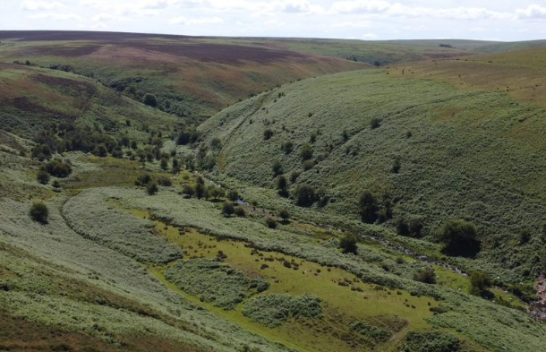
When I visit Robber’s Bridge
I might see:
The bridge over the river
A river called Weir Water
Damselflies
A valley

Slide 5

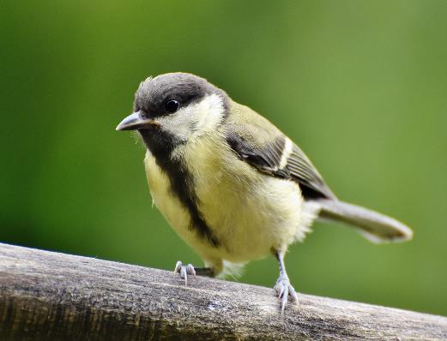
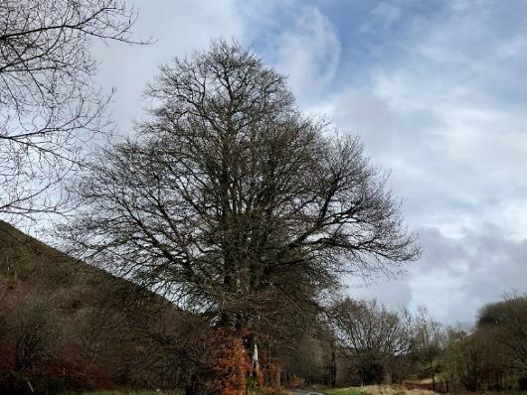
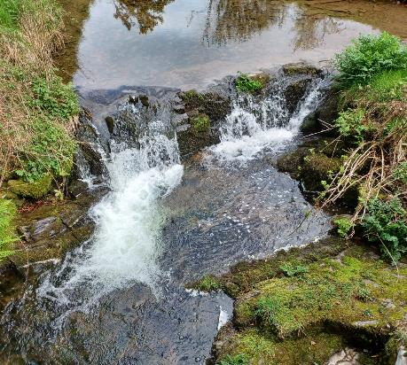
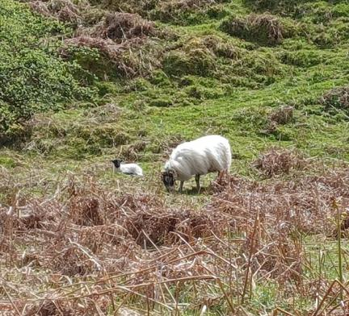
When I visit Robber’s Bridge
I might hear:
Birds
The wind blowing through the trees
The water in the river
Sheep

Slide 6

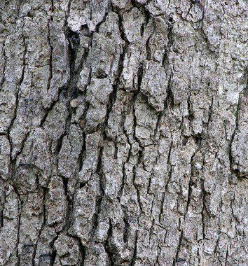
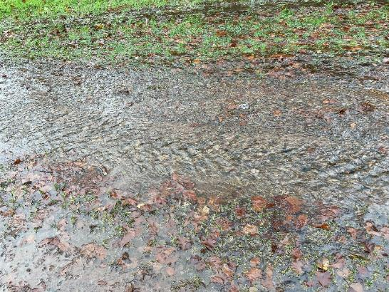
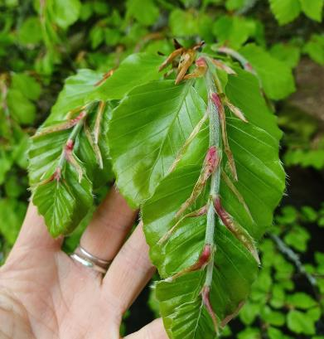
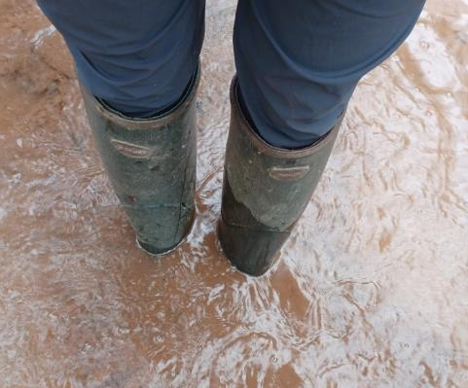
When I visit Robber’s Bridge
I might touch or feel:
Tree bark
Mud
Fuzzy leaves
The water

Slide 7

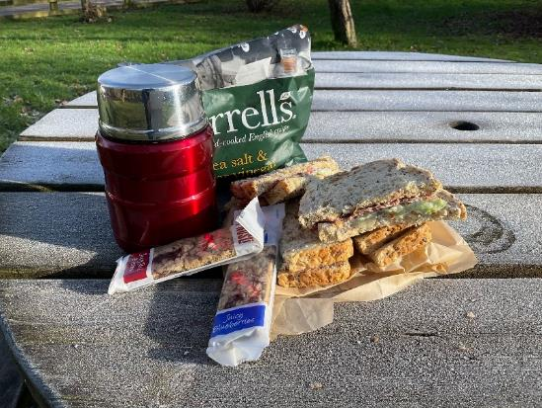
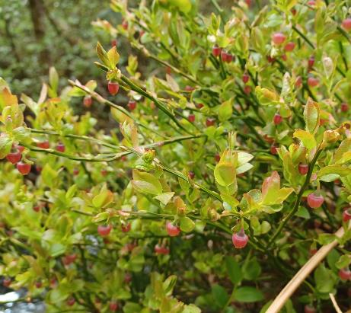
When I visit Robber’s Bridge
I might taste:
My picnic if we have taken one with us
Whortleberries

Slide 8

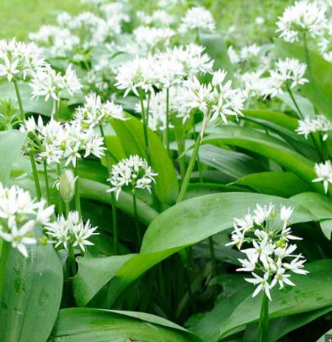
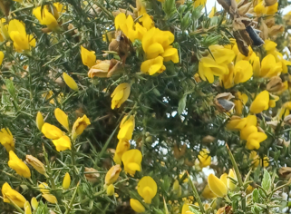
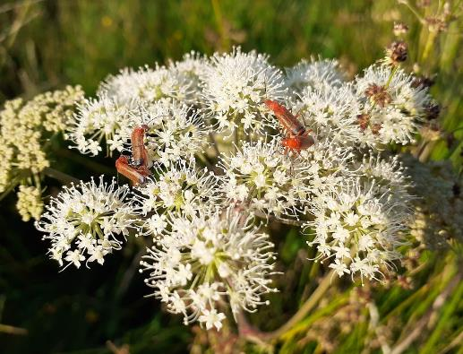
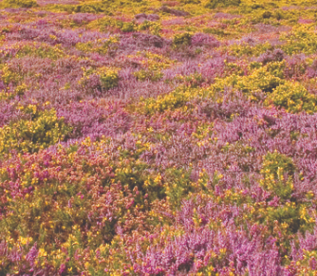
When I visit Robber’s Bridge
I might smell:
Wild garlic
Gorse
Flowers in the meadow
Heather

Slide 9

Most of all Robber’s Bridge is a place where I can enjoy time outdoors

Slide 10
Some additional information for my visit
This Sensory Story starts from the Exmor National Park free car park at Robber’s Bridge. It is reached via a narrow road from Oare.
Nearby public toilets can be found nearby (open all year) EX35 6NU
There is a National Trust café found near the toilets. Open in season

Slide 11
The Robber’s Bridge Story
Produced For Exmoor National Park by Access & Inclusion UK 2023
www.accessandinclusion.com

