Slide 1

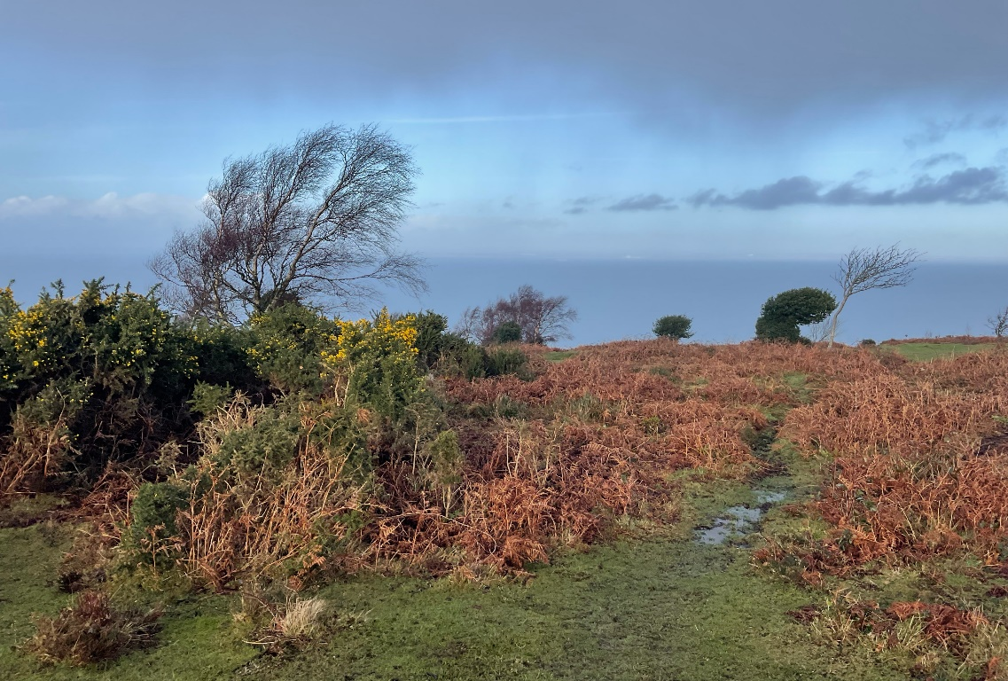
The North Hill Story

Slide 2

North Hill is an outdoor area with heathland and woods
This means it is a place where I can spend time in the countryside

Slide 3

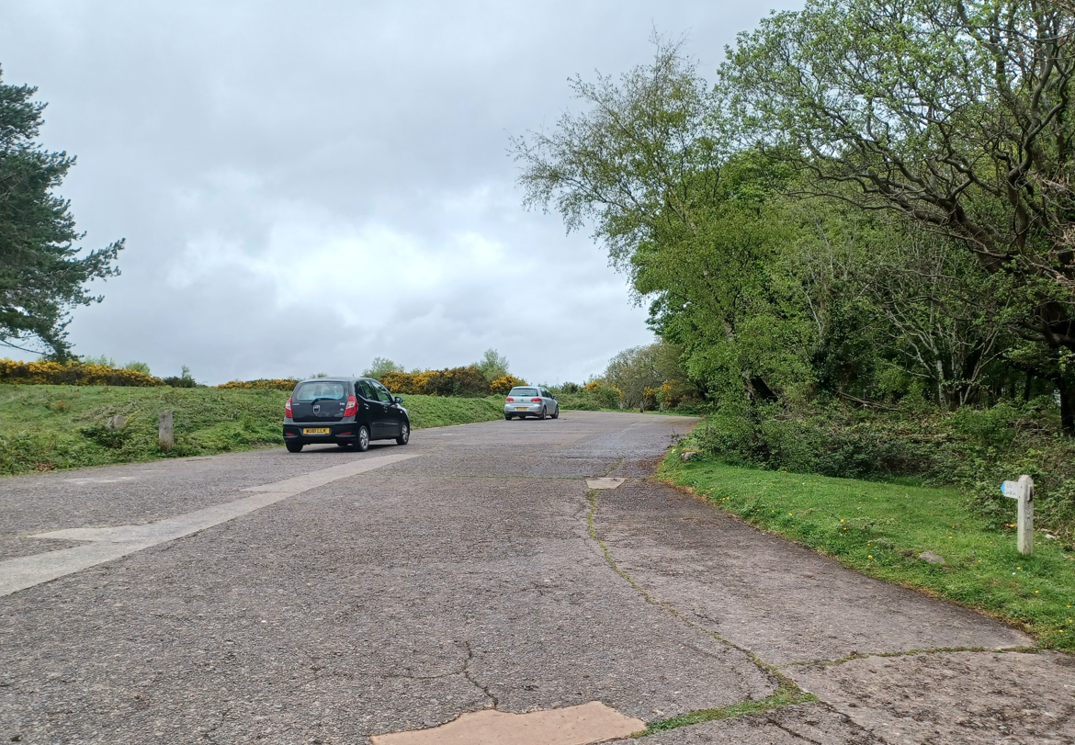
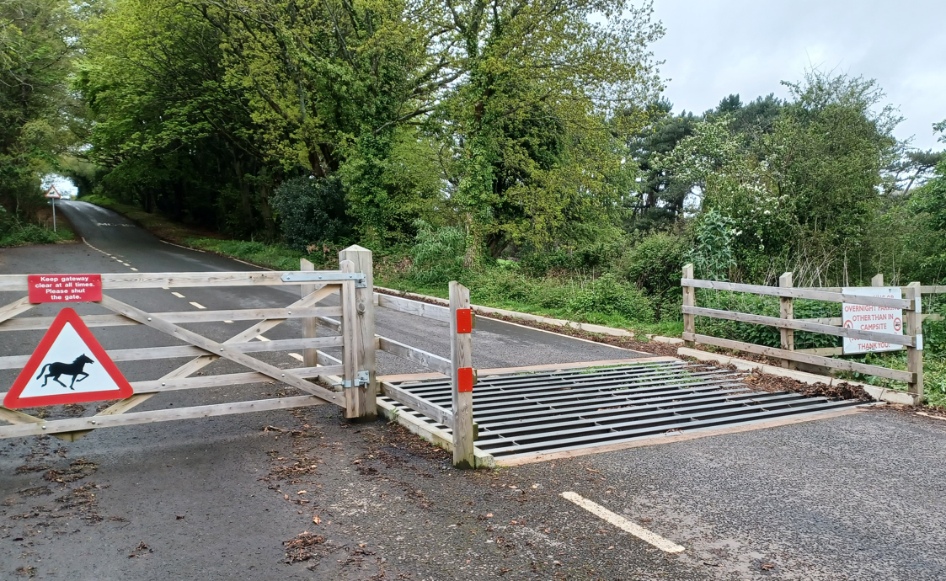
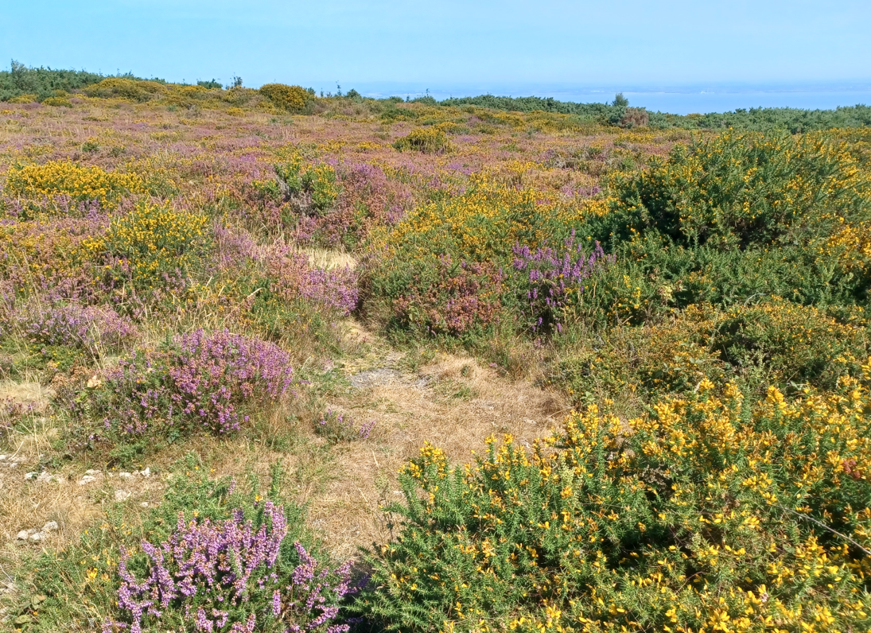
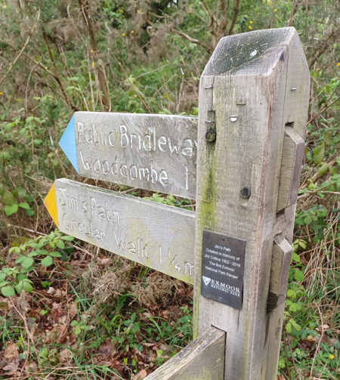
When I arrive to visit North Hill
I might see:
The car park
A cattle grid
Heather, gorse and the Bristol Channel beyond
Signs

Slide 4
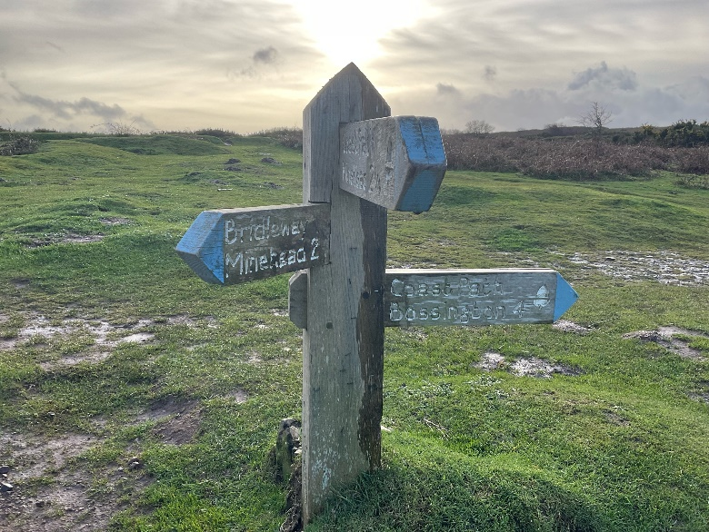
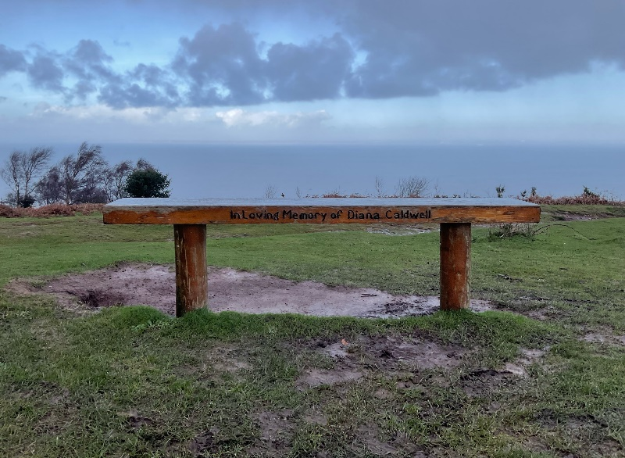
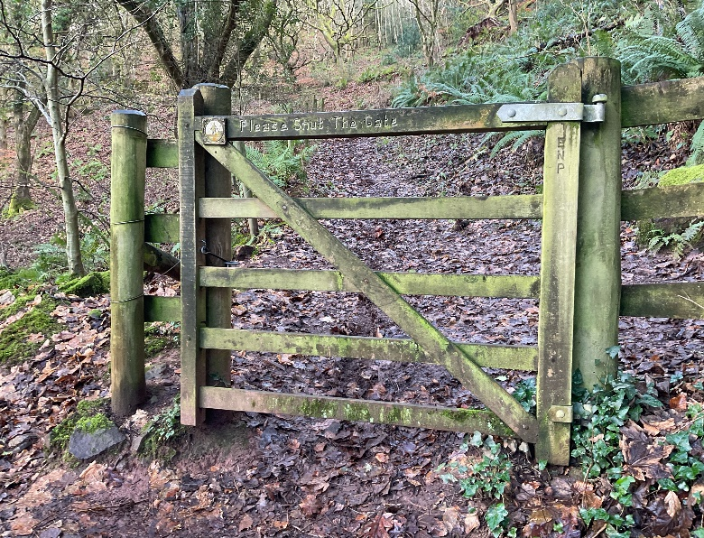
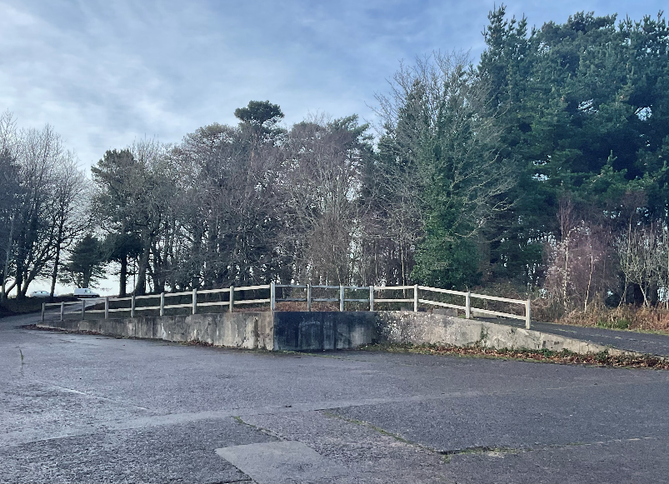
When I visit North Hill
I might see:
A wooden signpost
A bench where I can sit and look at the sea
A wooden gate
A concrete ramp which army tanks used to use a long time ago

Slide 5
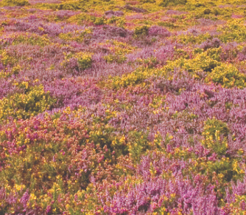
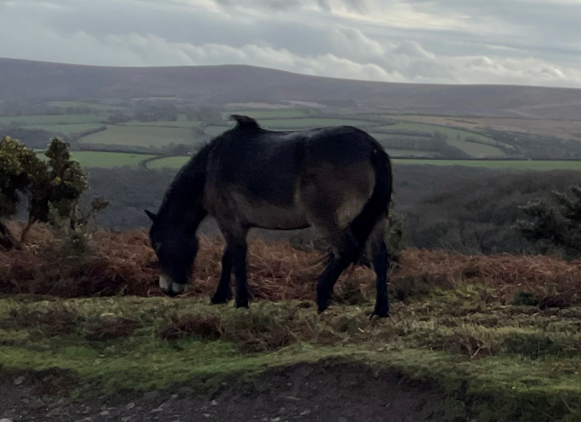
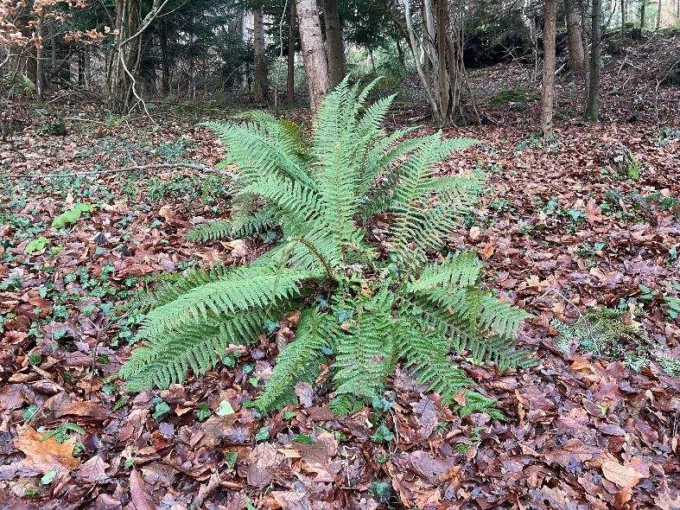
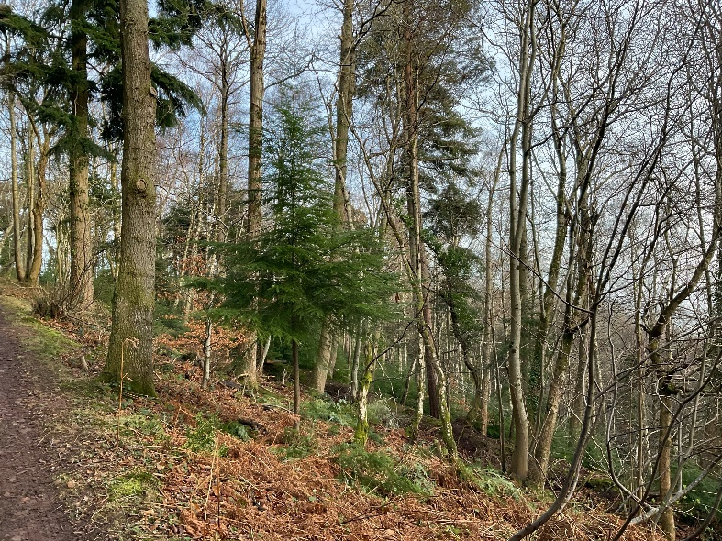
When I visit North Hill
I might see:
Heather
Ponies. They are special ponies called Exmoor Ponies
Bracken, which have lots of pointed leaves
Trees of different shapes and sizes

Slide 6

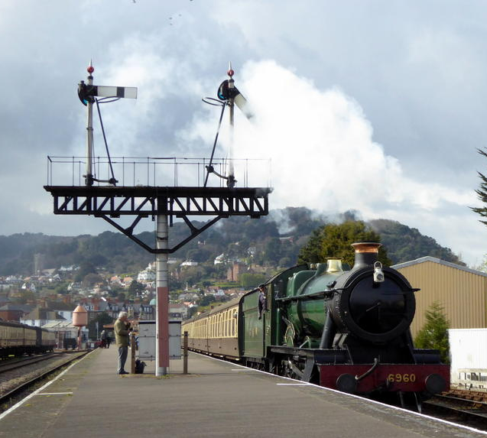
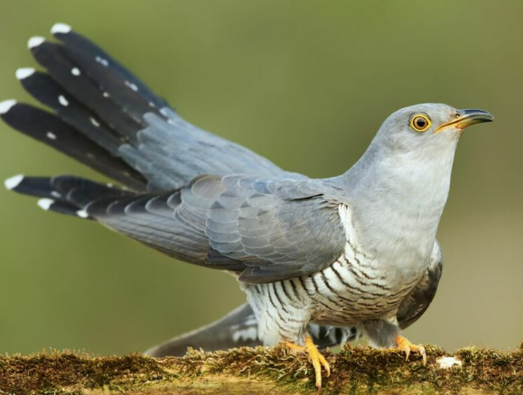
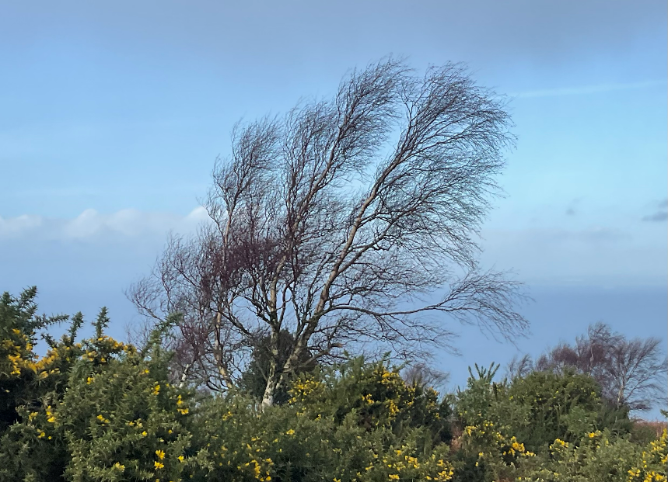
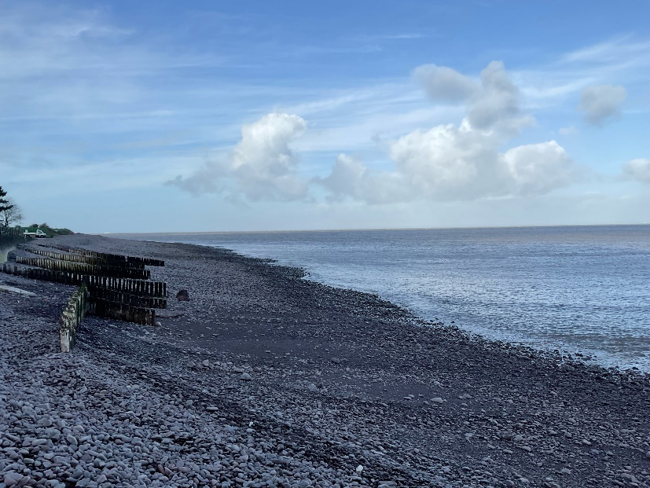
When I visit North Hill
I might hear:
The peep of a nearby steam train
Birds like cuckoo and chiff chaff
The wind blowing
Waves crashing

Slide 7

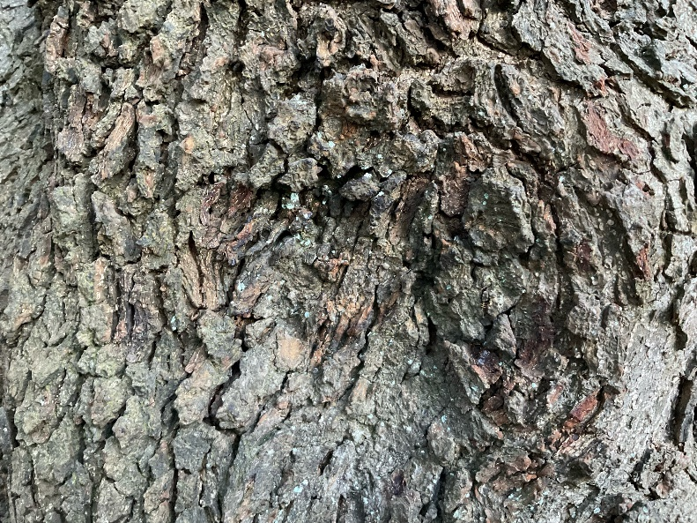
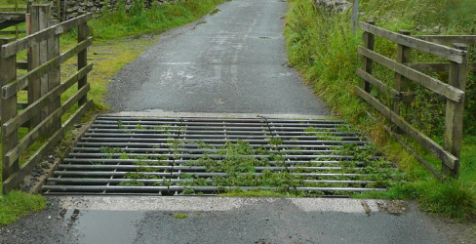
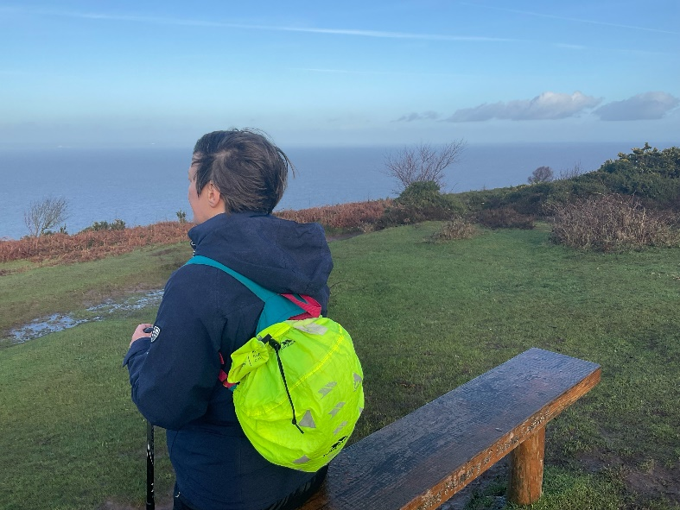
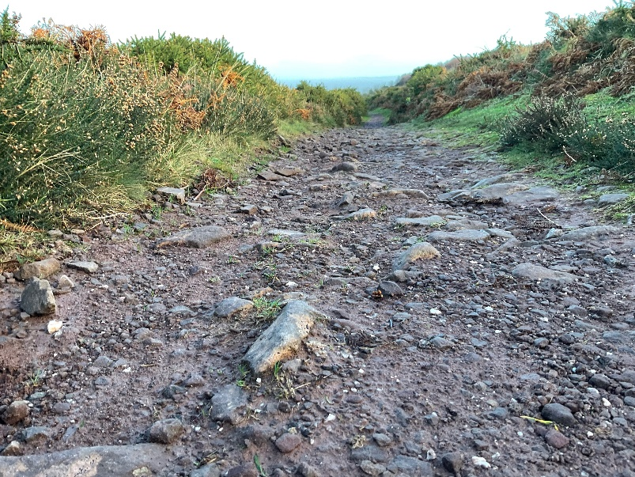
When I visit North Hill
I might touch or feel:
Rough bark on trees or logs
The bump of the car going over the cattle grid
The wind blowing through my hair
A stony path under my feet

Slide 8

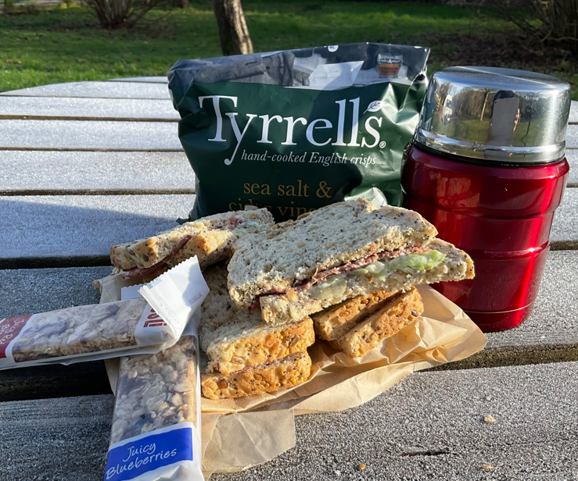
When I visit North Hill
I might taste:
Food

Slide 9

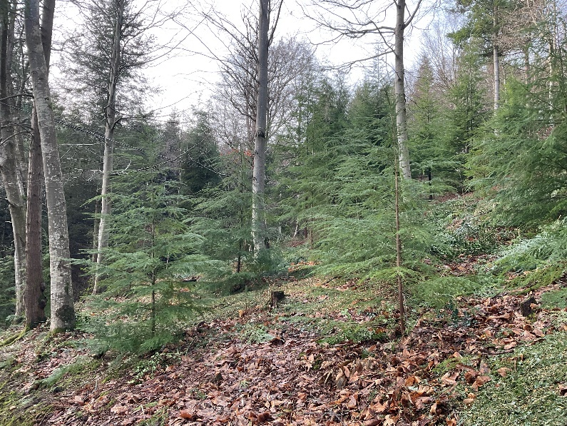
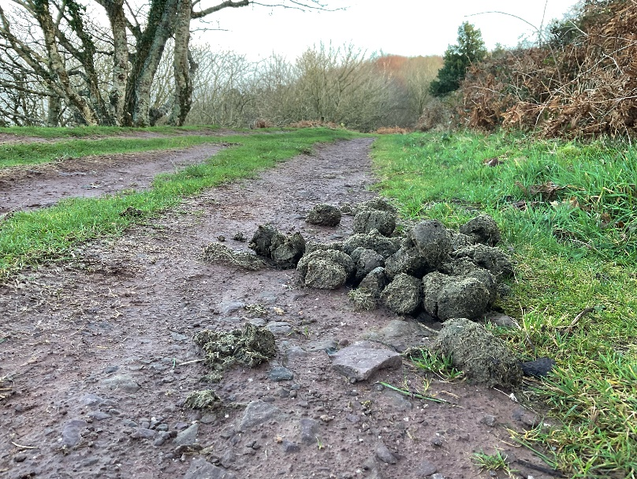
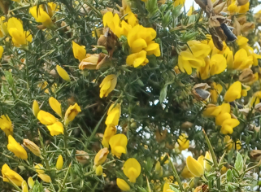
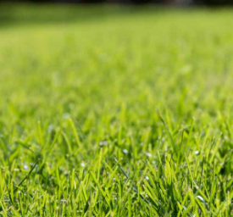
When I visit North Hill
I might smell:
Pine trees
Pony poo
Gorse flowers
Grass

Slide 10
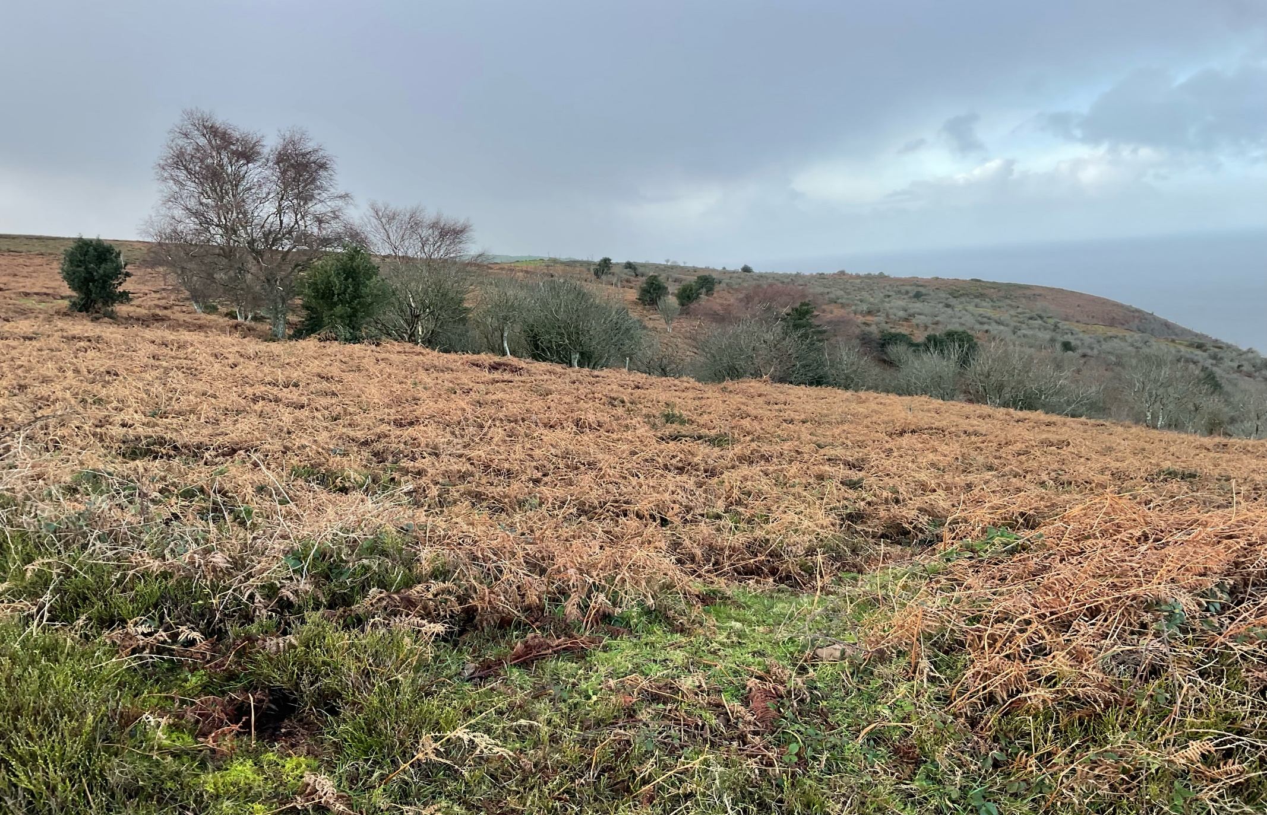
Most of all North Hill is a place where I can enjoy time outdoors

Slide 11
Some additional information for my visit
This Sensory Story starts from Exmoor National Park free car park at North Hill tank grounds TA24 5LB
There are no toilets available but public toilets can be found at Quay West
There are refreshment stops in nearby Minehead and a seasonal food truck at North Hill

Slide 12
The North Hill Story
Produced For Exmoor National Park by Access & Inclusion UK 2023
www.accessandinclusion.com

