Slide 1
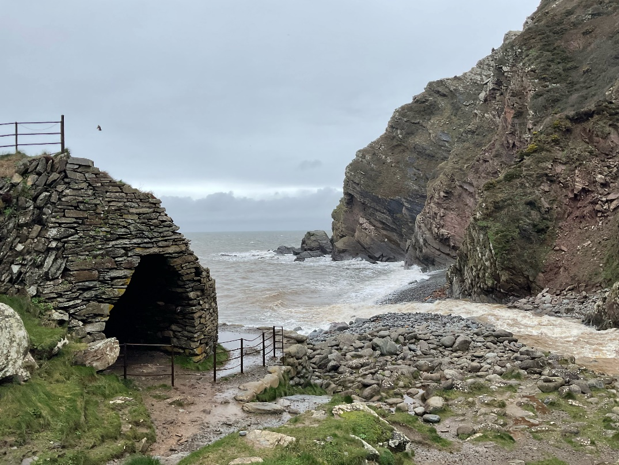
The Heddon’s Mouth Story

Slide 2
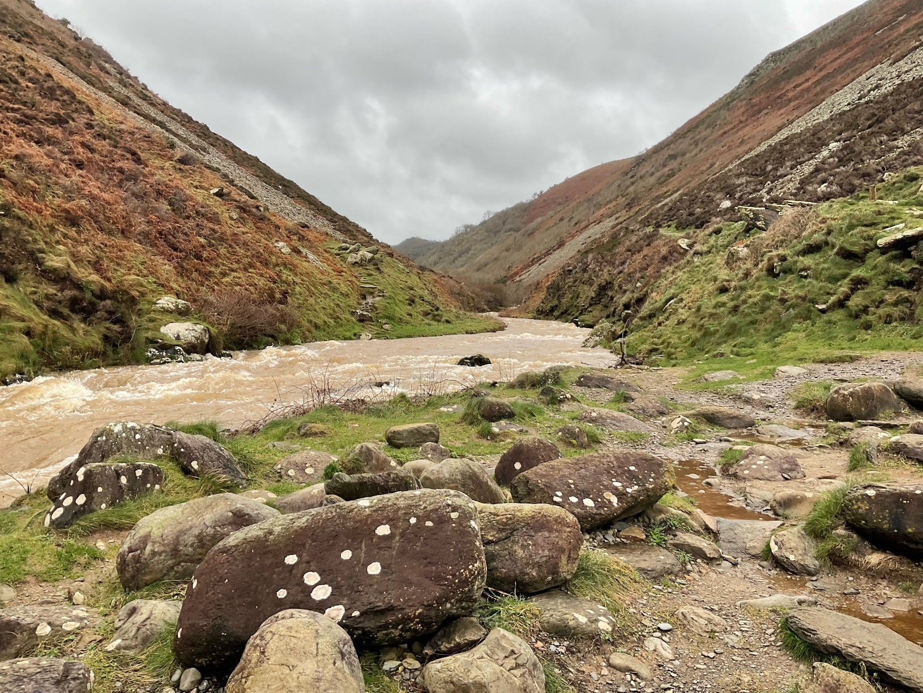
Heddon’s Mouth is an outdoor area where the river runs out to the sea This means it is a place where I can spend time in the countryside

Slide 3
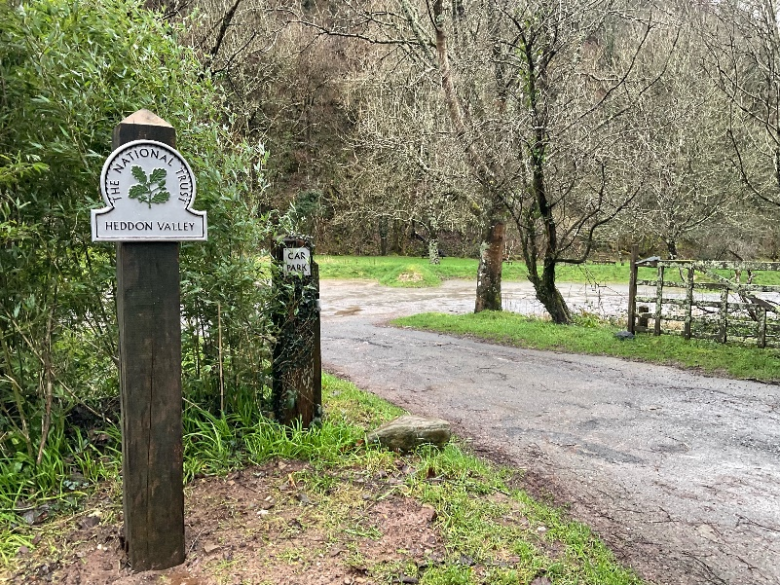
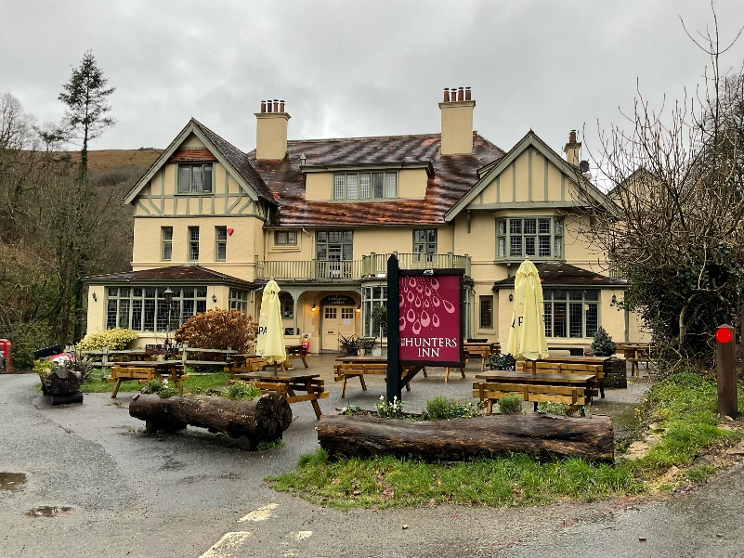
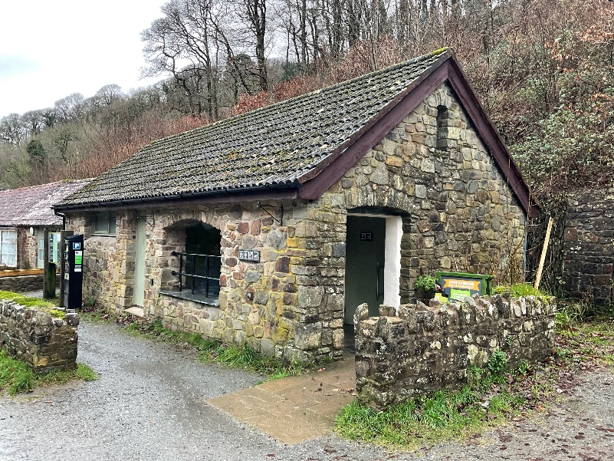
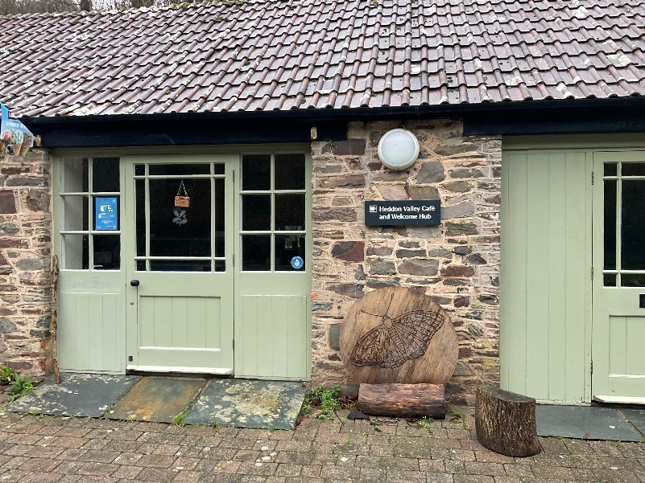
When I arrive to visit Heddon’s Mouth I might see:
The car park and the National Trust ‘Heddon Valley’ sign
A pub called The Hunters Inn
A stone building with toilet inside
A cafe

Slide 4
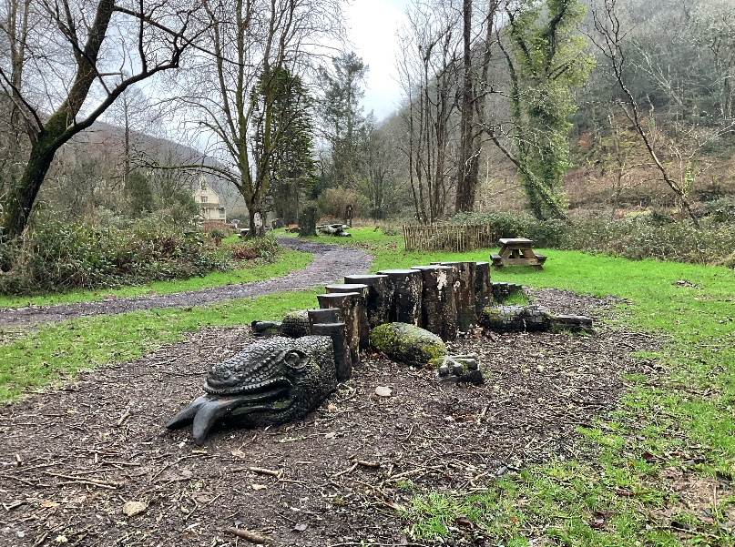
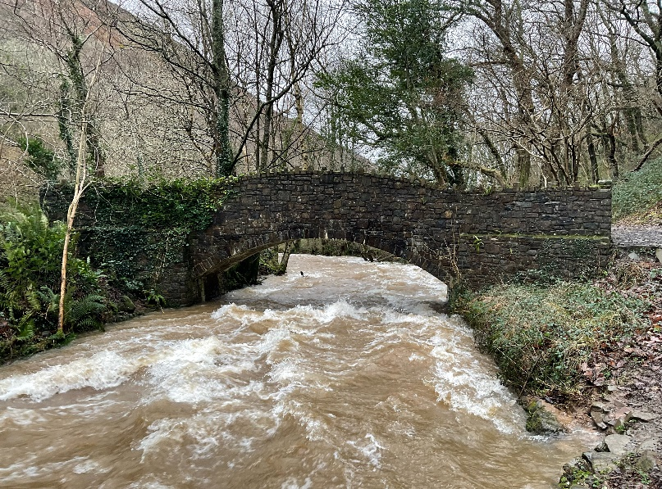
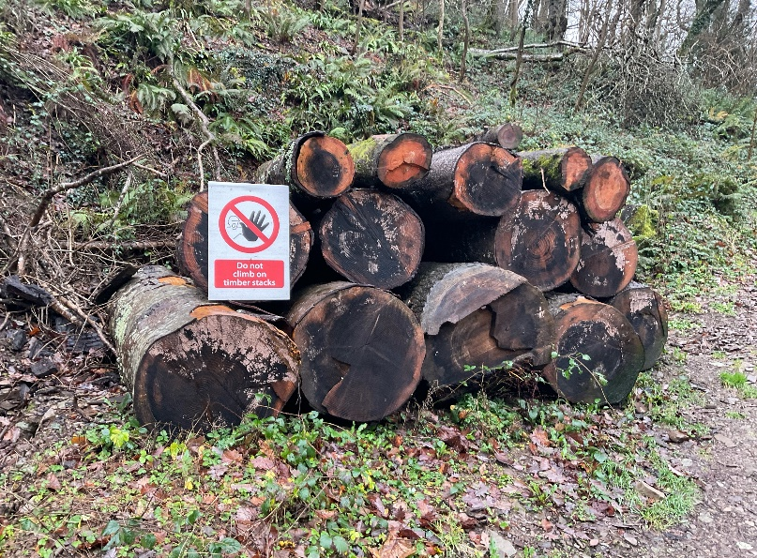
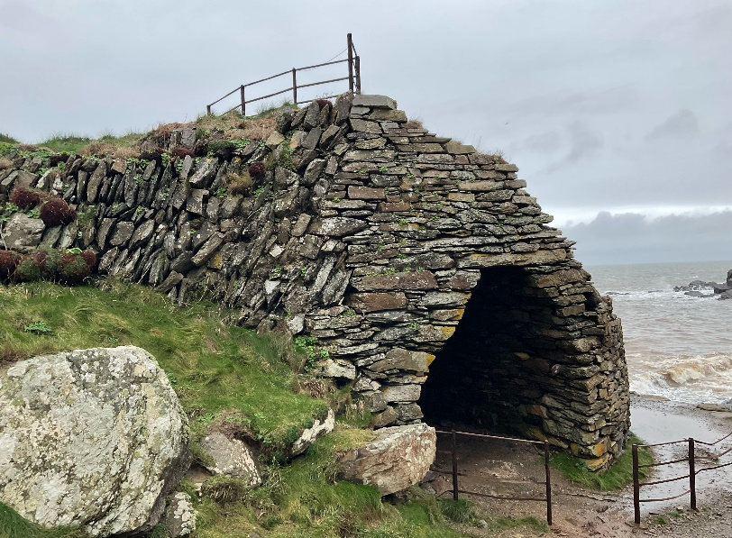
When I visit Heddon’s Mouth I might see:
A play area with a crocodile made of wood
A bridge over the river
A pile of logs
A stone archway which is something called a ‘lime kiln’

Slide 5
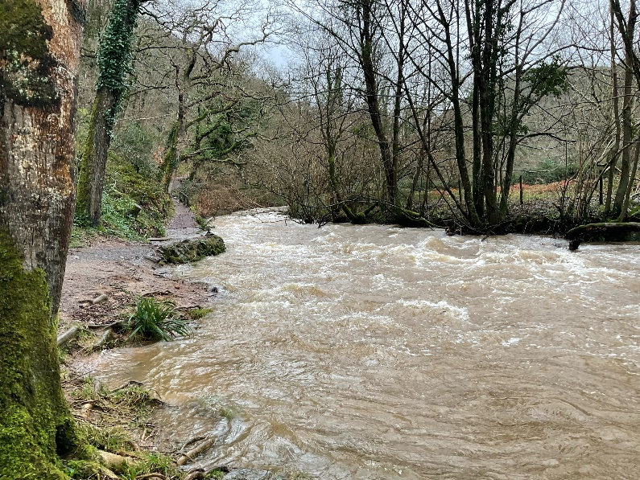
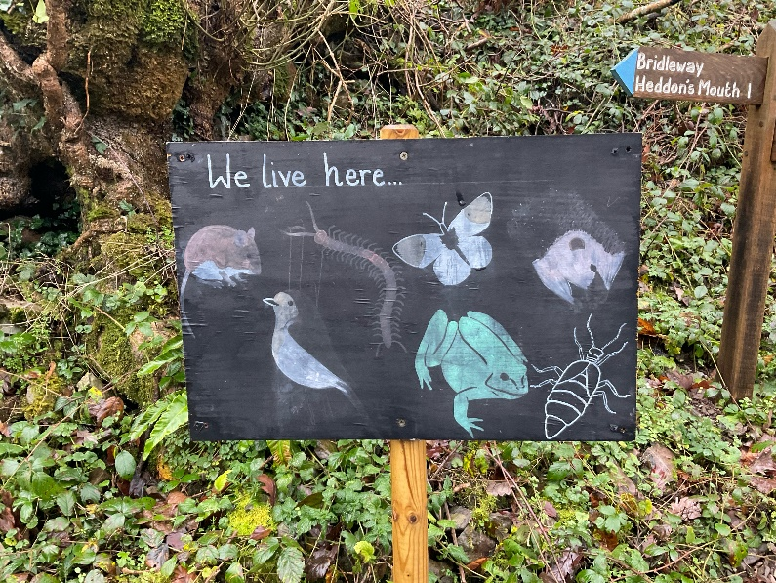
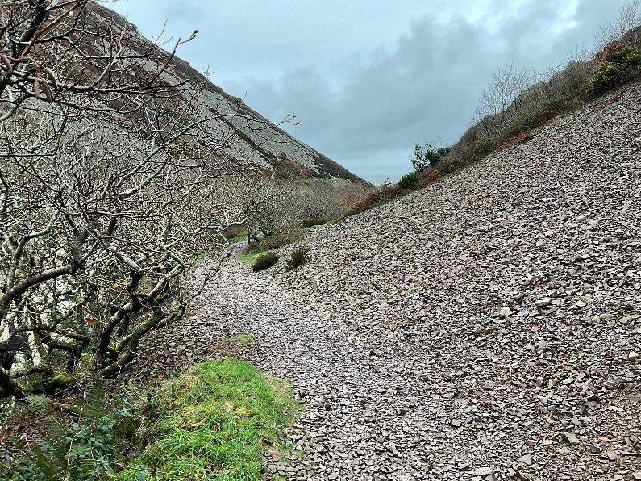
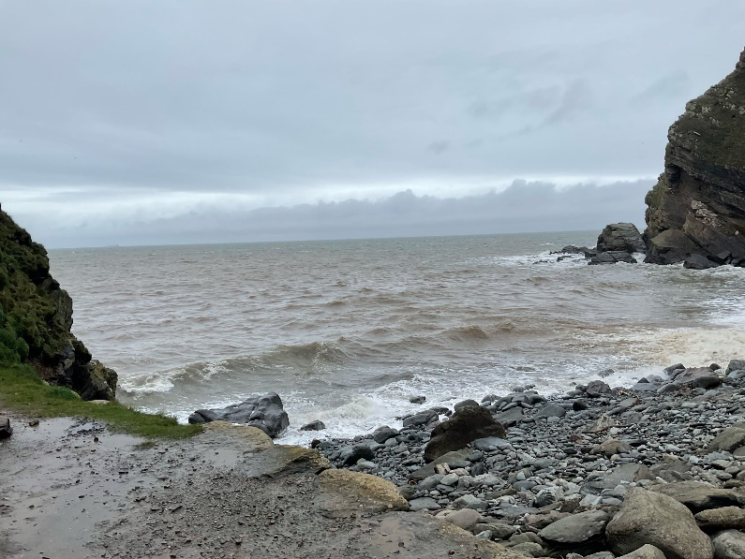
When I visit Heddon’s Mouth I might see:
A river
Animals and birds. There is a board which shows some of the ones I might see.
A big slope made of loose stones. This is called a ‘scree’ slope.
The sea

Slide 6
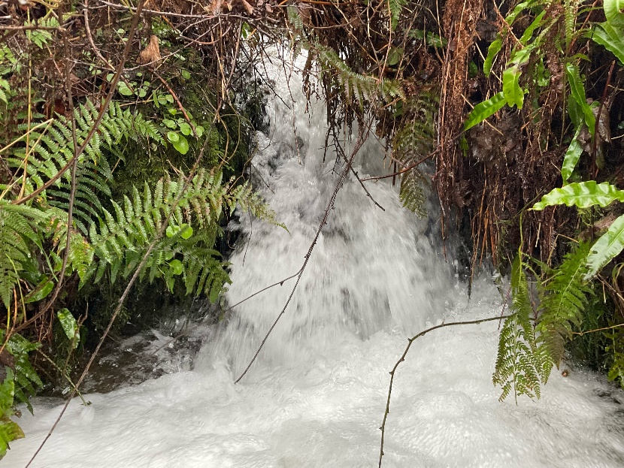
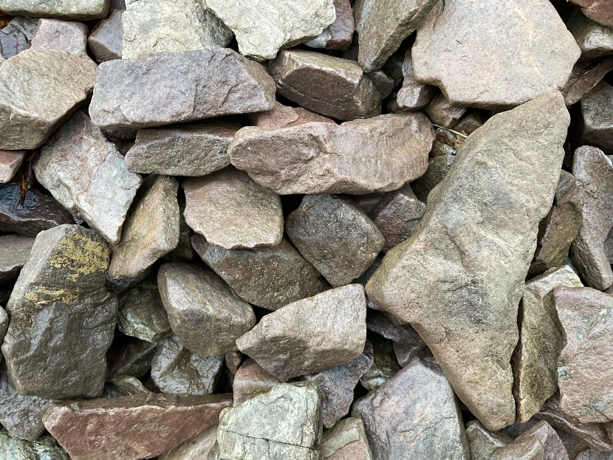
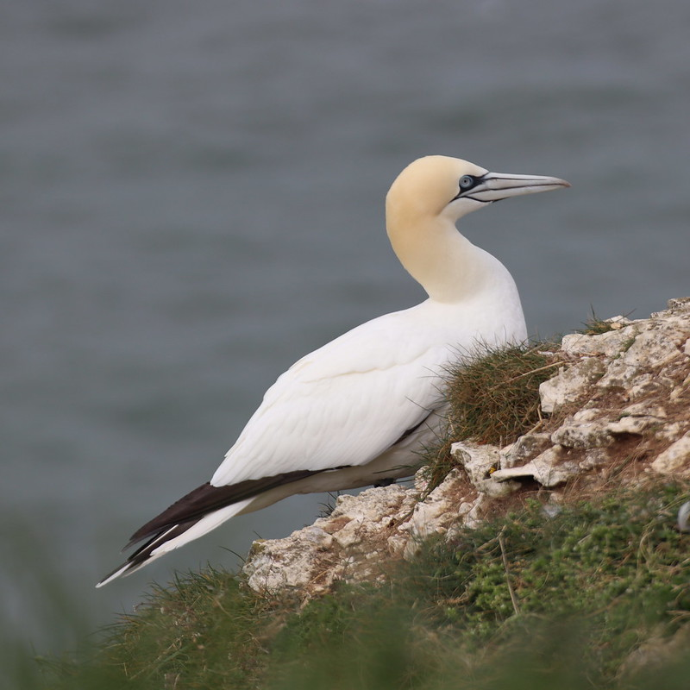
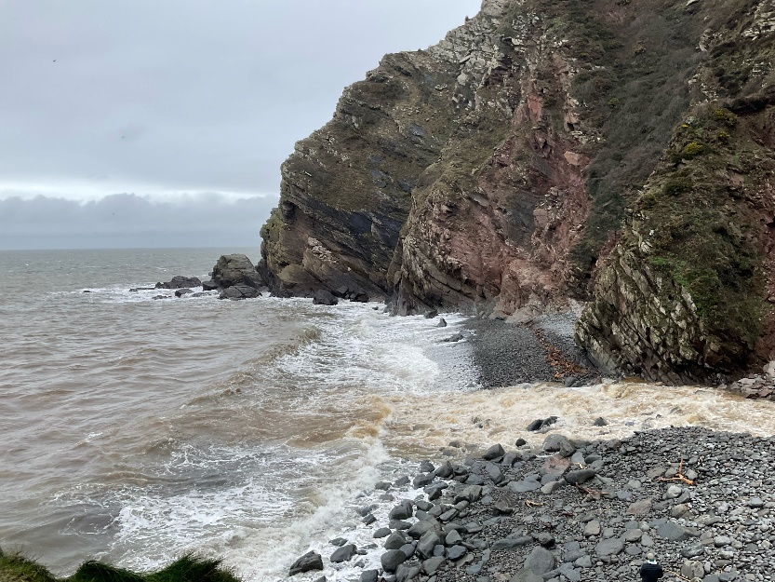
When I visit Heddon’s Mouth I might hear:
Water splashing
Stones knocking together
Birds
Waves crashing onto the beach

Slide 7
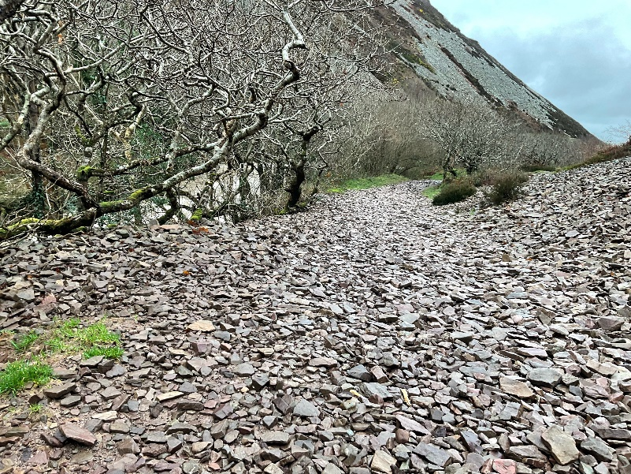
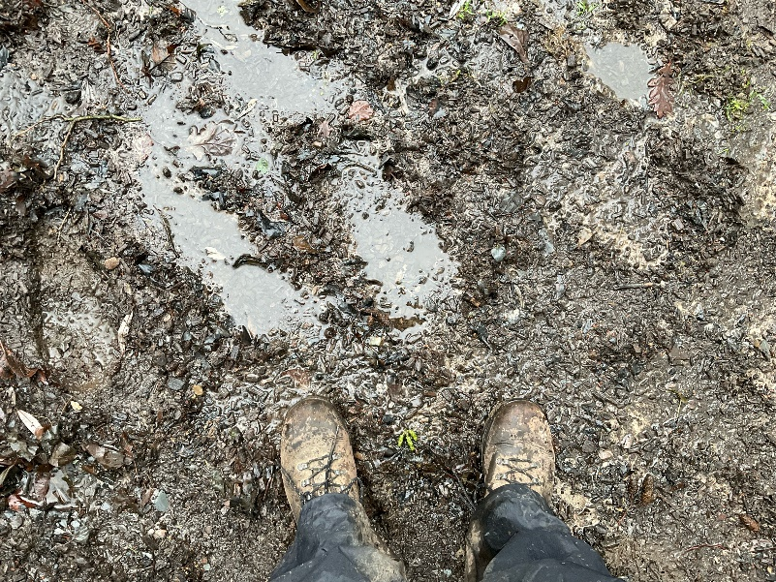
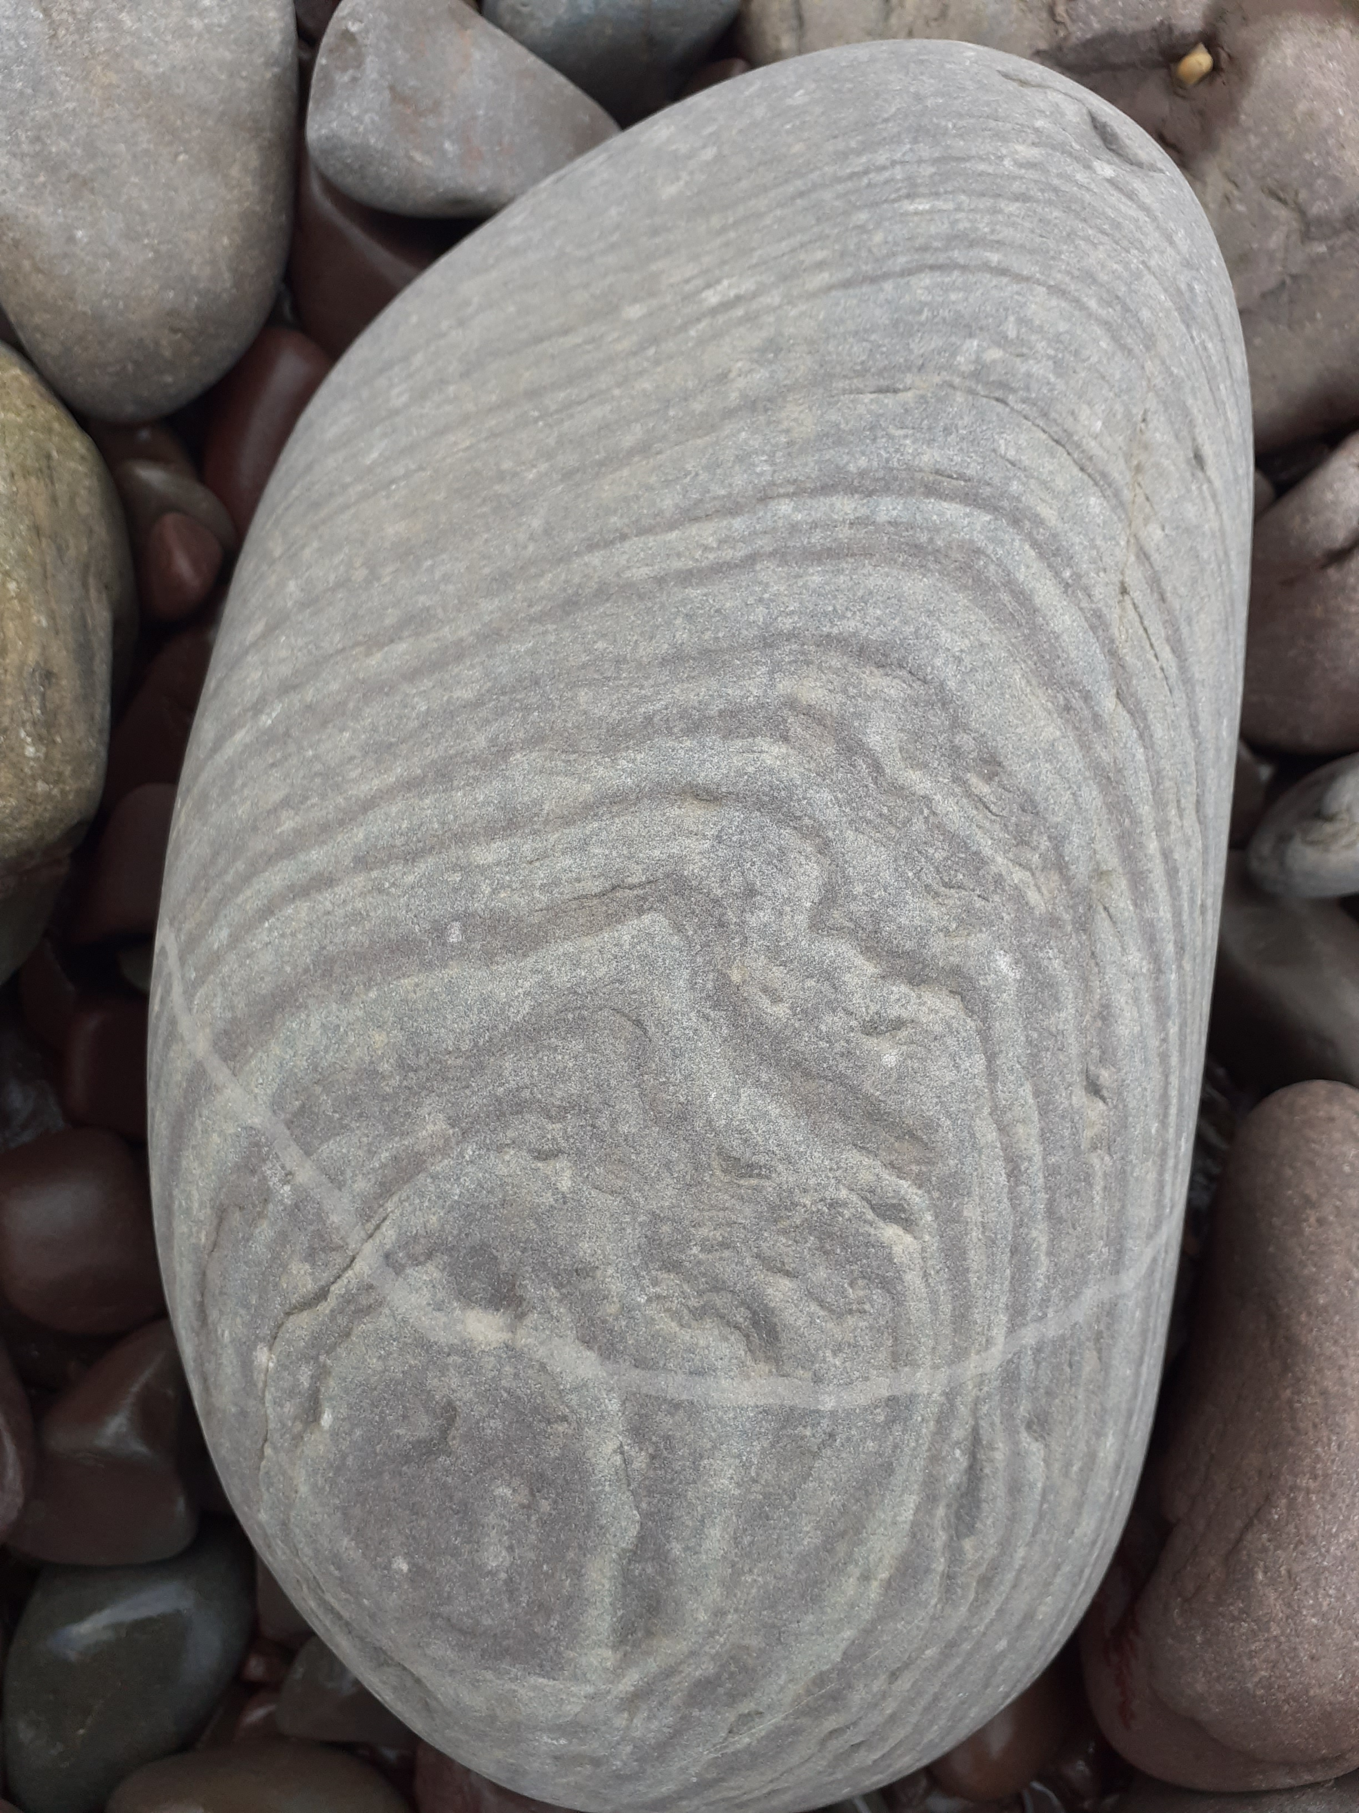
When I visit Heddon’s Mouth I might touch or feel:
A stony path under my feet
Mud
Smooth boulders
Water droplets splashing up from the sea

Slide 8
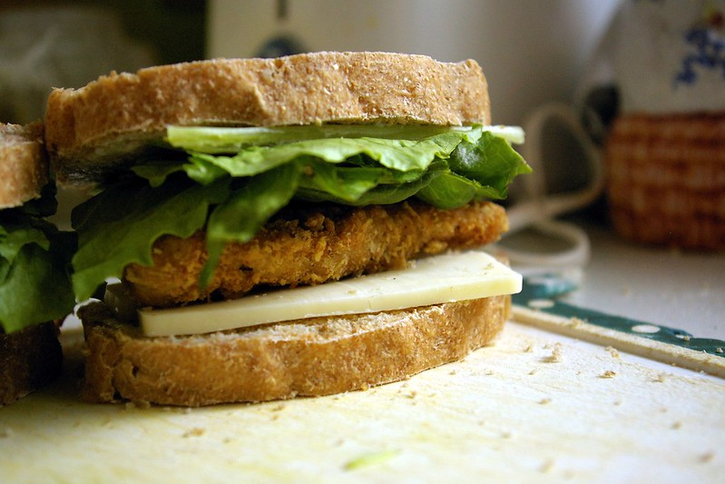
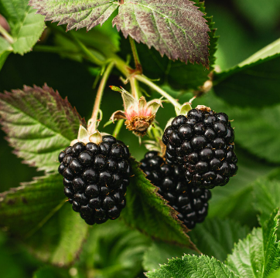
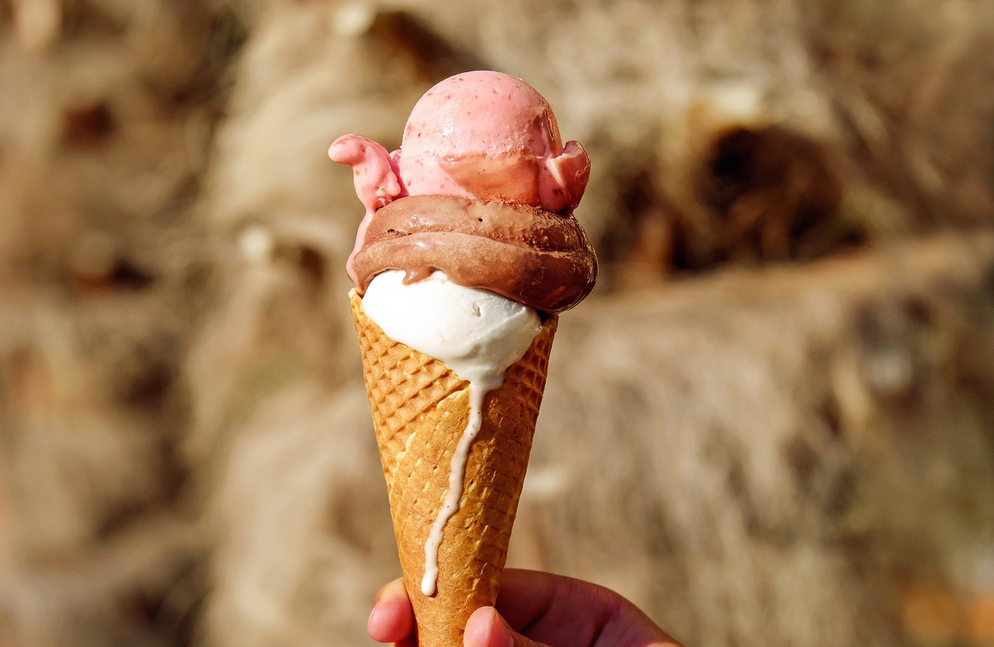
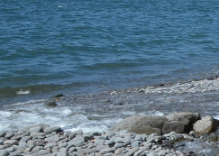
When I visit Heddon’s Mouth I might taste:
Food and drink in the café or pub
Blackberries
Ice cream
Salt spray from the sea

Slide 9
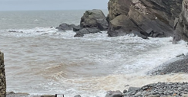
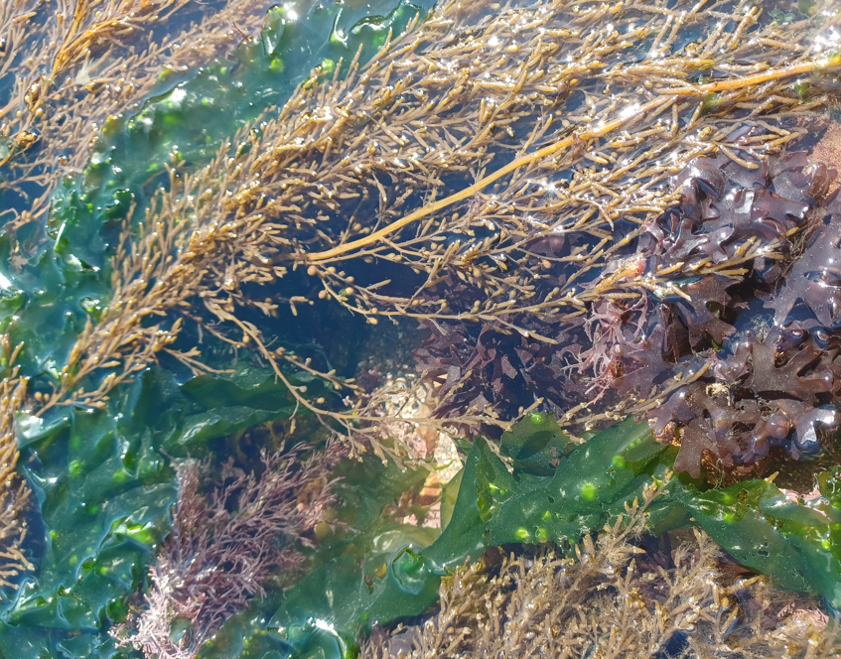
When I visit Heddon’s Mouth I might smell:
The sea
Seaweed

Slide 10
Most of all Heddon’s Mouth is a place where I can enjoy time outdoors

Slide 11
Some additional information for my visit
This Sensory Story starts from the National Trust pay and display car park at The Hunter’s Inn EX31 4PY
This car park has public toilets open daily
There is a National Trust cafe next to the car park (open in season) and a pub open all year round

Slide 12
The Heddon’s Mouth Story
Produced For Exmoor National Park by Access & Inclusion UK 2023
www.accessandinclusion.com

