Slide 1
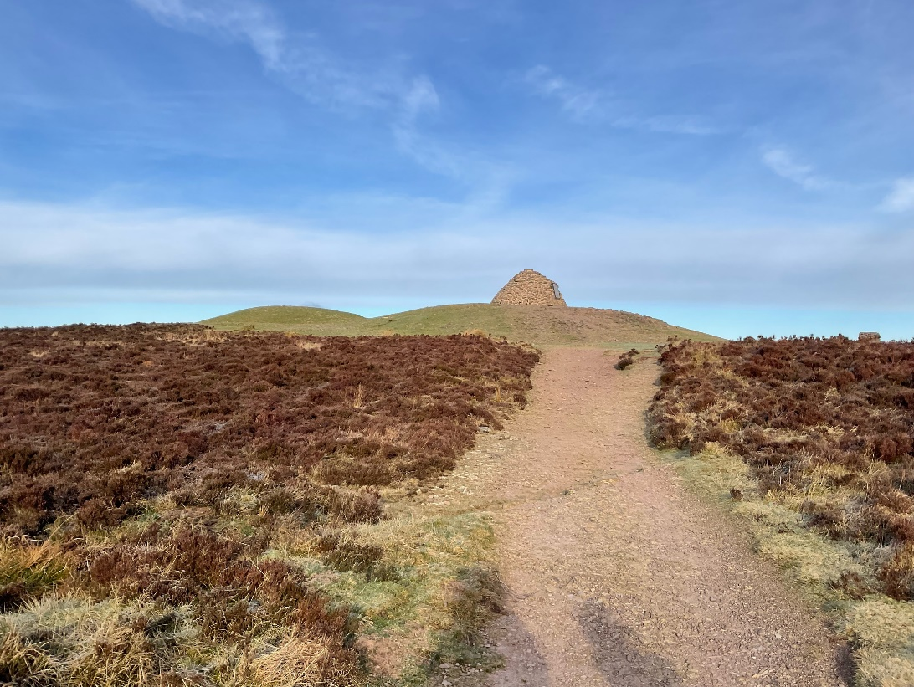
The Dunkery Beacon Story

Slide 2
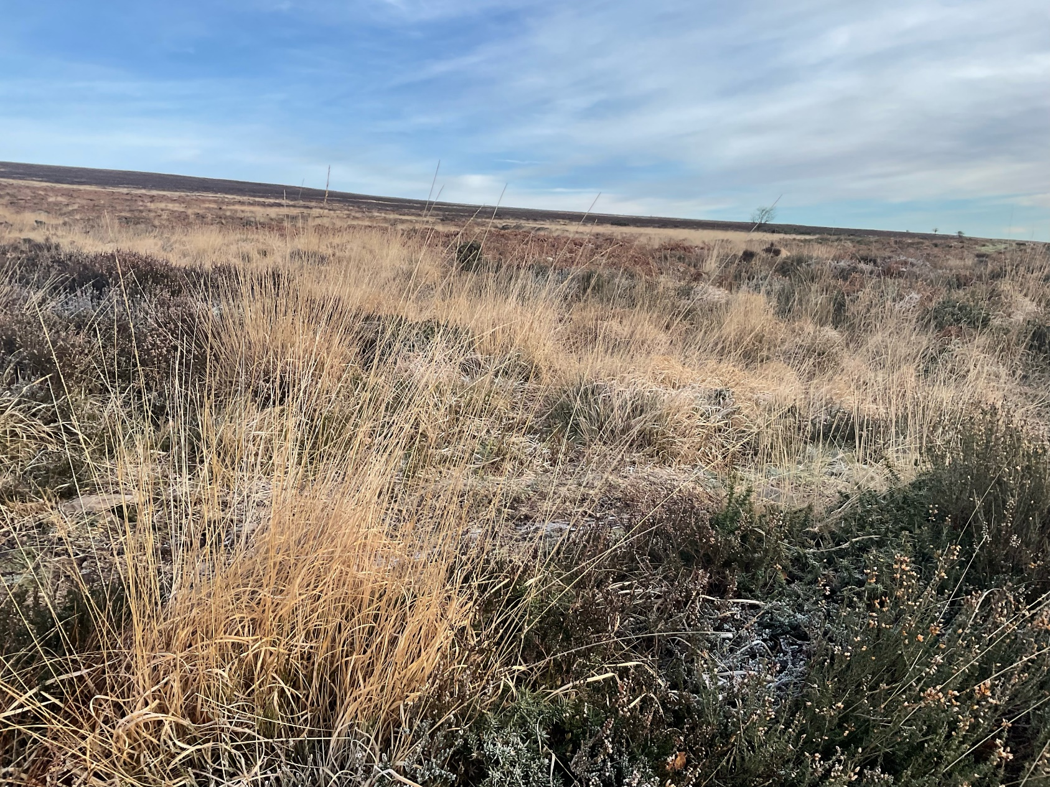
Dunkery Beacon is an outdoor area of heather, moorland and a hill with a view of countryside and the sea. It is the highest point on Exmoor. This means it is a place where I can spend time in the countryside.

Slide 3
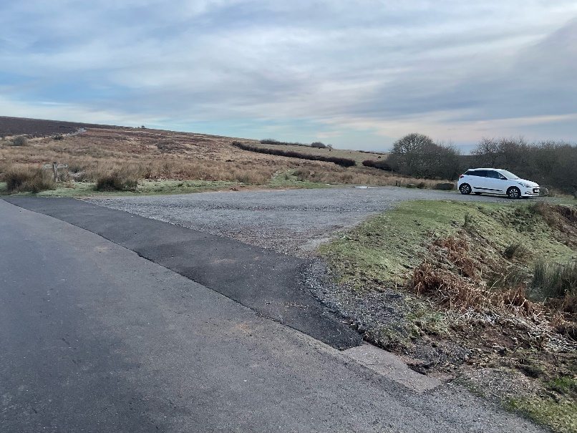
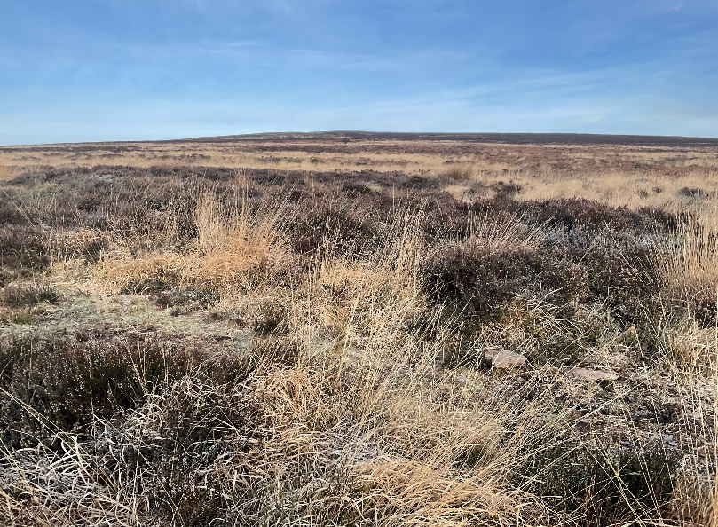
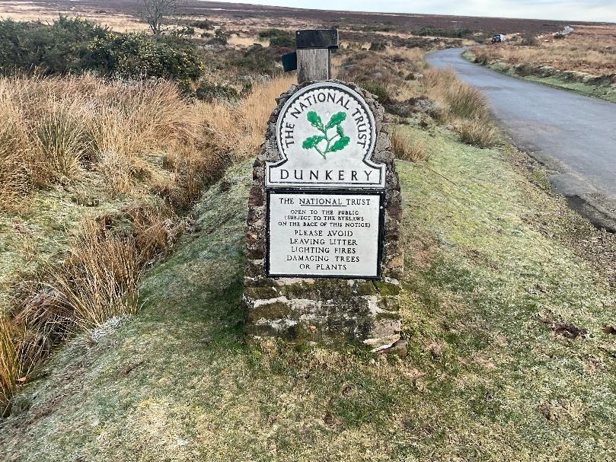
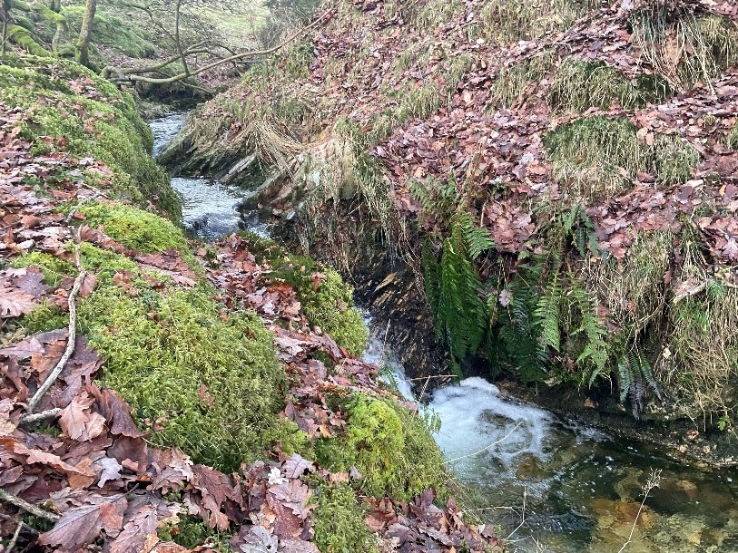
When I arrive to visit Dunkery Beacon I might see:
The car park
Heather moorland
The National Trust ‘Dunkery’
Sign
Running water in the stream

Slide 4
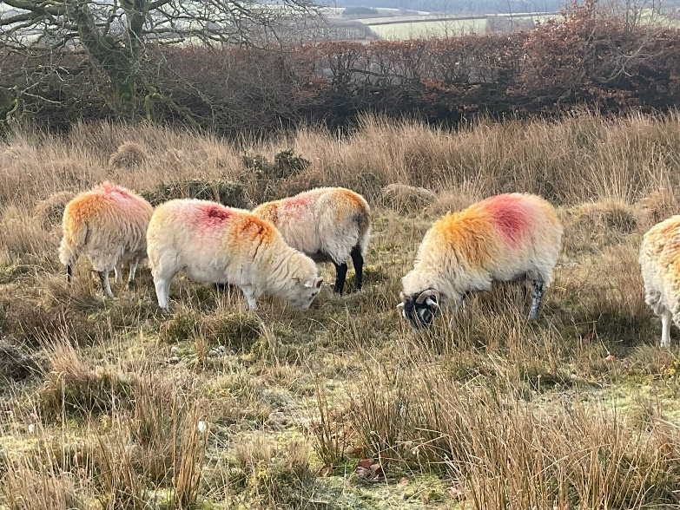
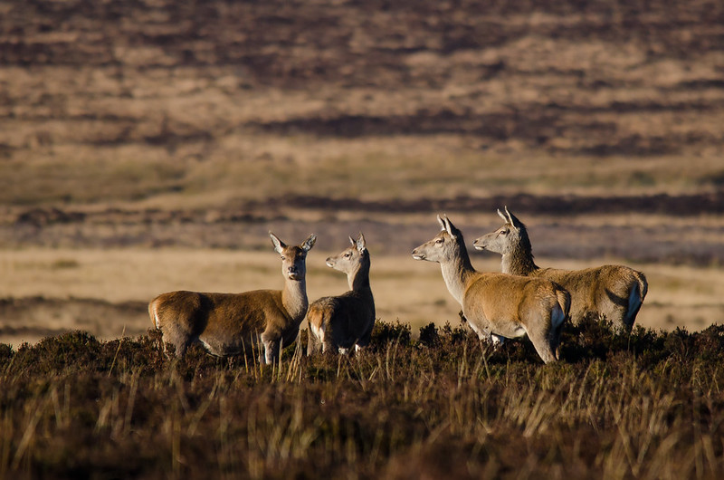
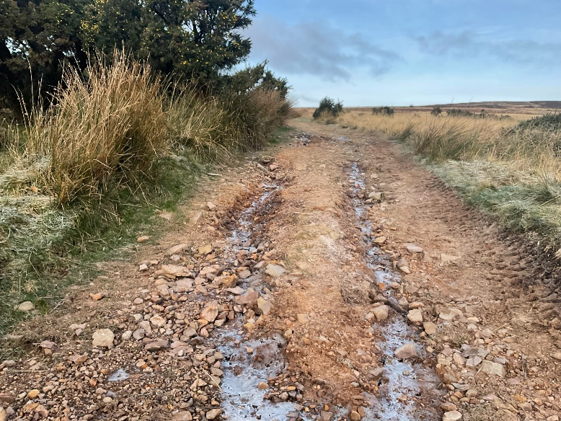
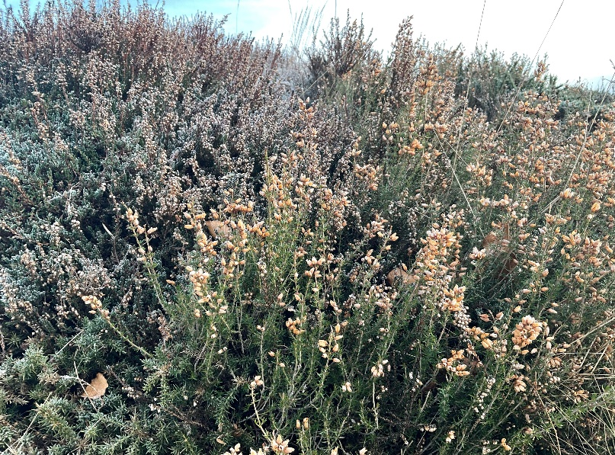
When I visit Dunkery Beacon I might see:
Sheep grazing
Deer
A stony path
Heather

Slide 5
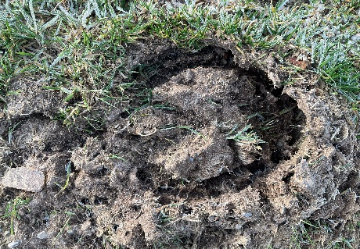
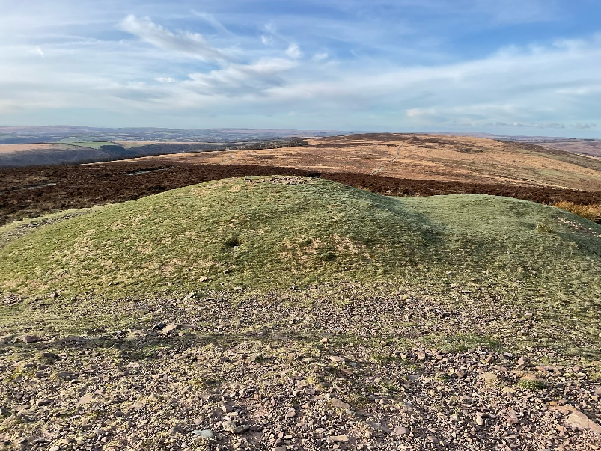
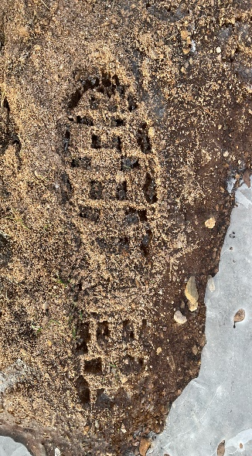
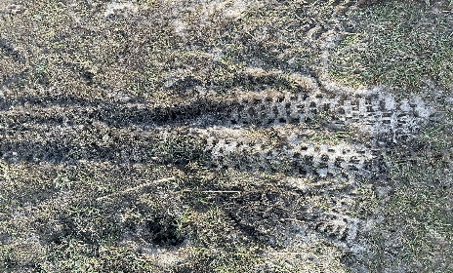
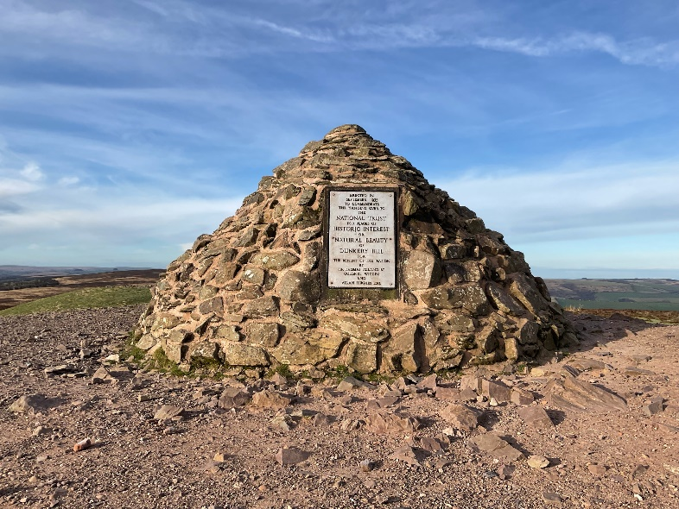
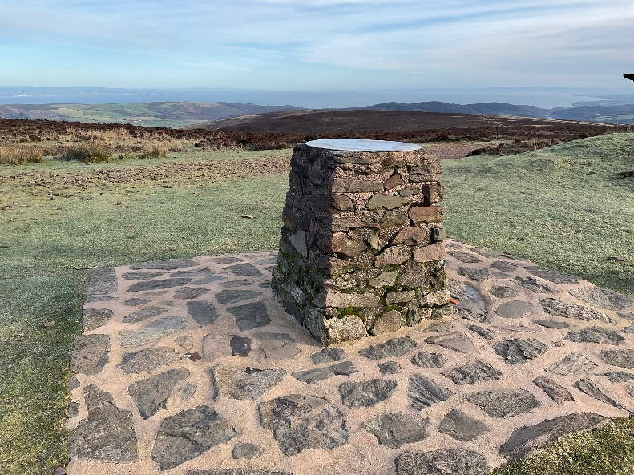
When I visit Dunkery Beacon I might see:
Prints in the mud
A small hill, sometimes
called a ‘barrow’
Stones piled into a shape, sometimes called a ‘cairn’ at the top of the hill
A sign with information on it

Slide 6
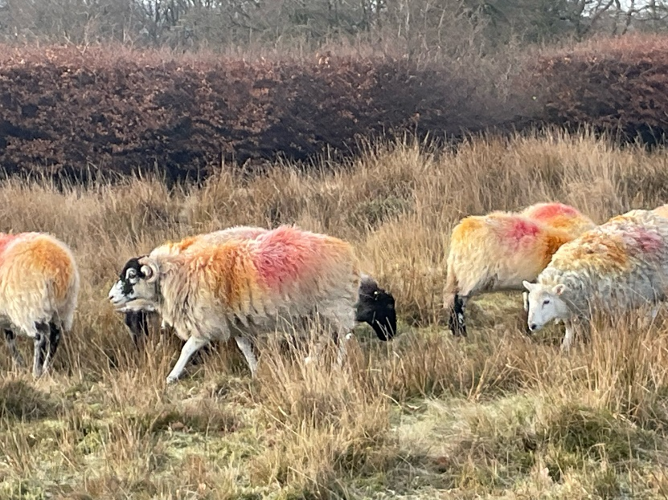
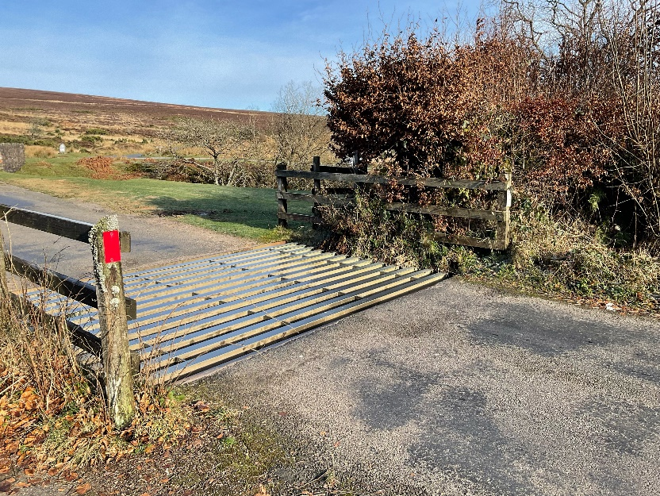
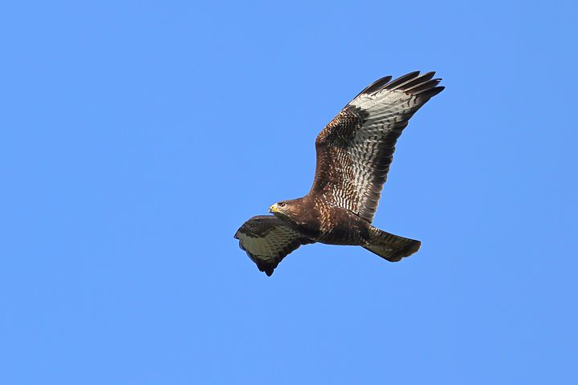
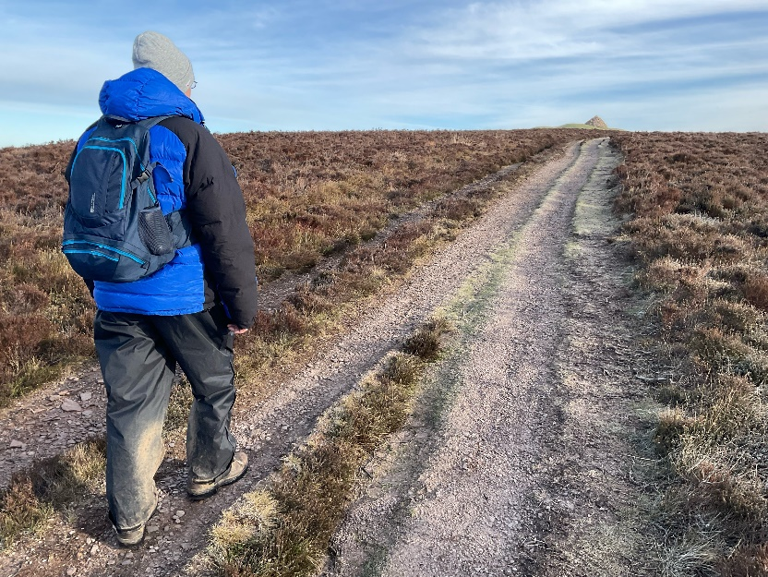
When I visit Dunkery Beacon I might hear:
Sheep making a noise
Cars going over the cattle grid
The birds in the sky or the trees
My breath as I walk up the hill

Slide 7
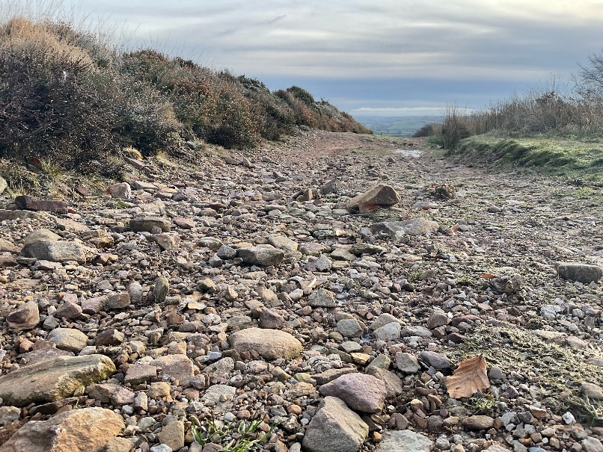
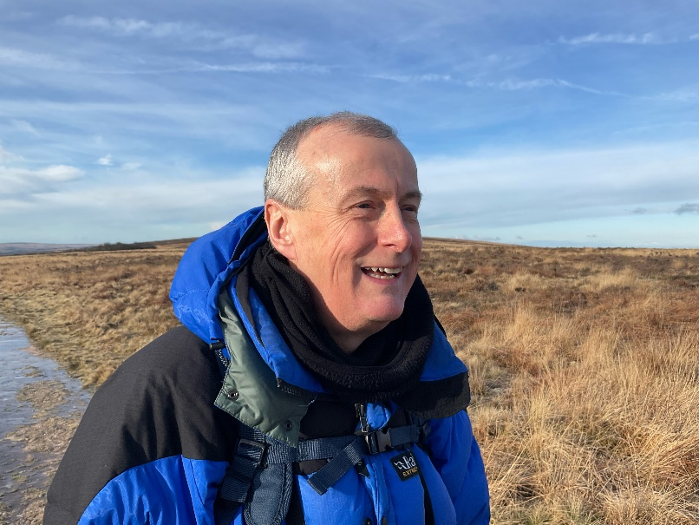
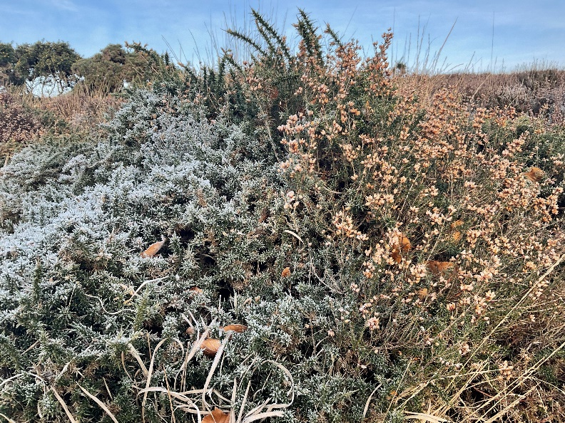
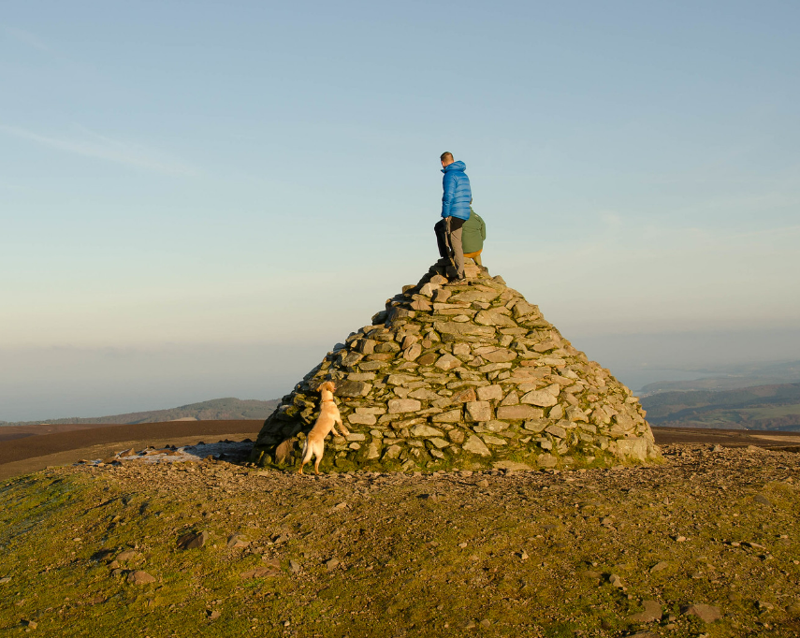
When I visit Dunkery Beacon I might touch or feel:
Stones on the path under my feet
The sun on my face
Heather
Wind rushing around me

Slide 8
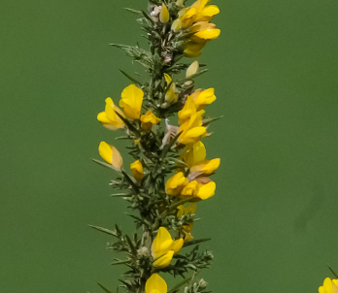
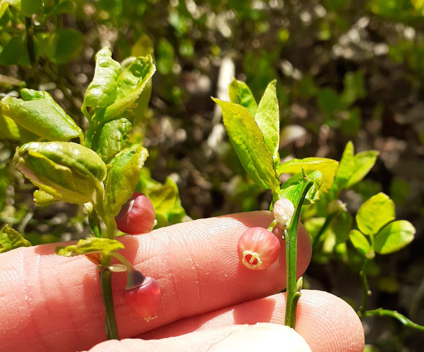
When I visit Dunkery Beacon I might taste:
Gorse flowers
Whortleberries

Slide 9
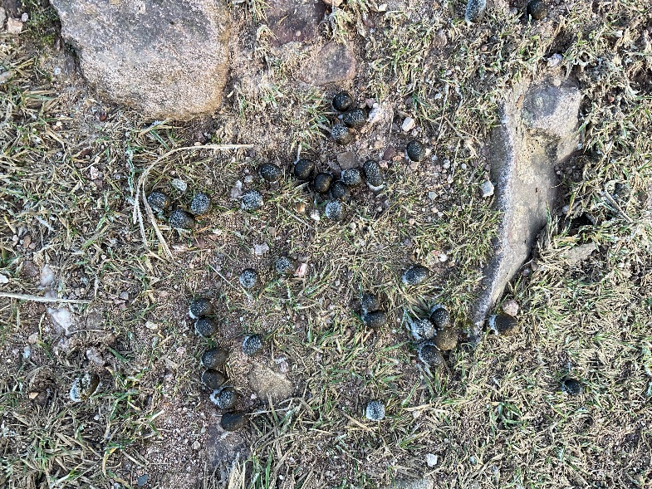
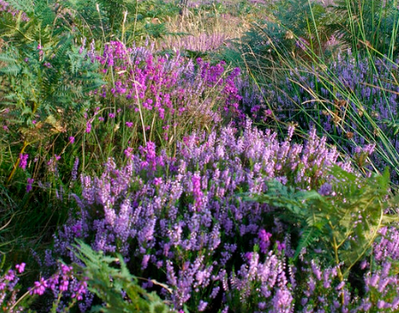
When I visit Dunkery Beacon I might smell:
Sheep poo
Heather

Slide 10
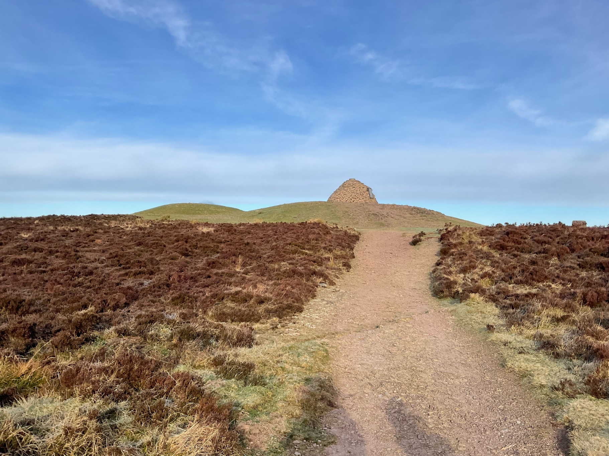
Most of all Dunkery Beacon is a place where I can enjoy time outdoors

Slide 11
Some additional information for my visit
This Sensory Story starts from the free National Trust car park at Dunkery Bridge TA24 7AT
This car park has no facilities
There are toilets and refreshment options at nearby Wheddon Cross
The route climbs to the top of Dunkery Beacon which is Exmoor’s highest point

Slide 12
The Dunkery Beacon Story
Produced For Exmoor National Park by Access & Inclusion UK 2023
www.accessandinclusion.com

