Slide 1
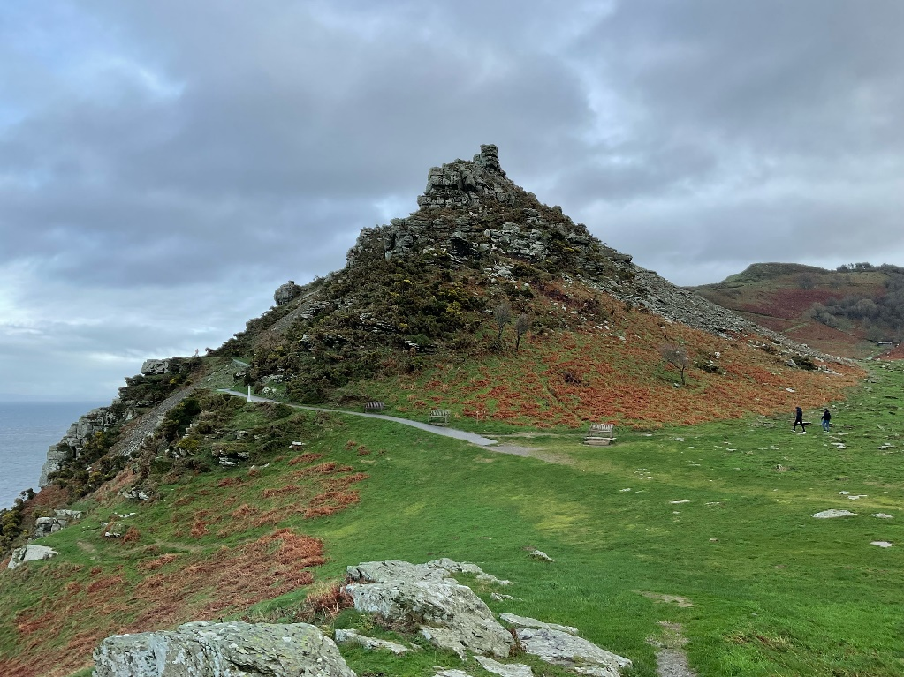
The Valley of Rocks Story

Slide 2
The Valley of Rocks is an outdoor area with cliffs and rock formations This means it is a place where I can spend time in the countryside

Slide 3
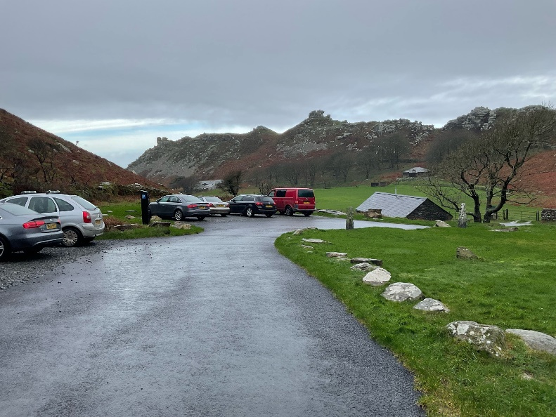
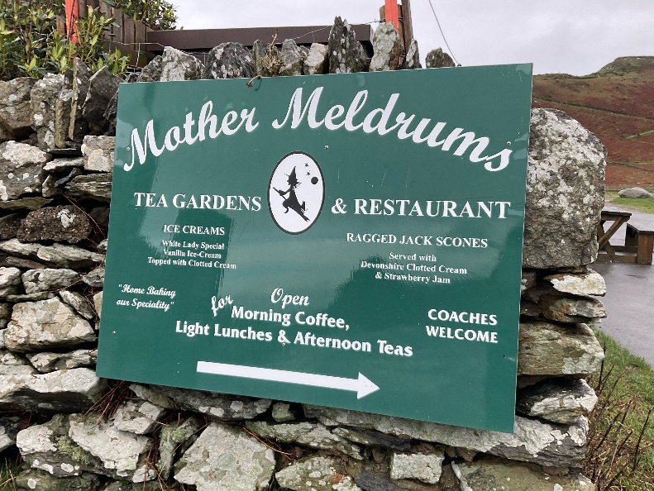
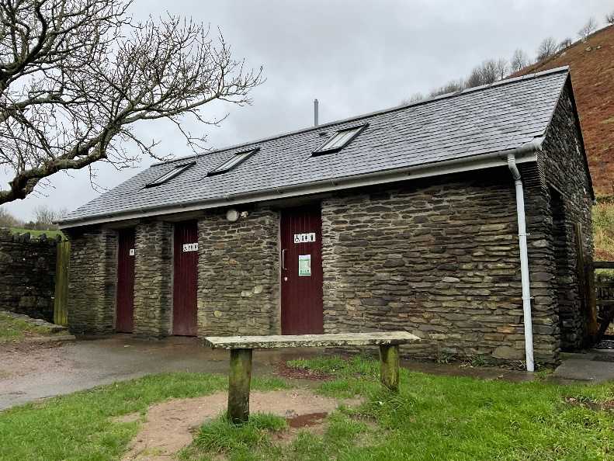
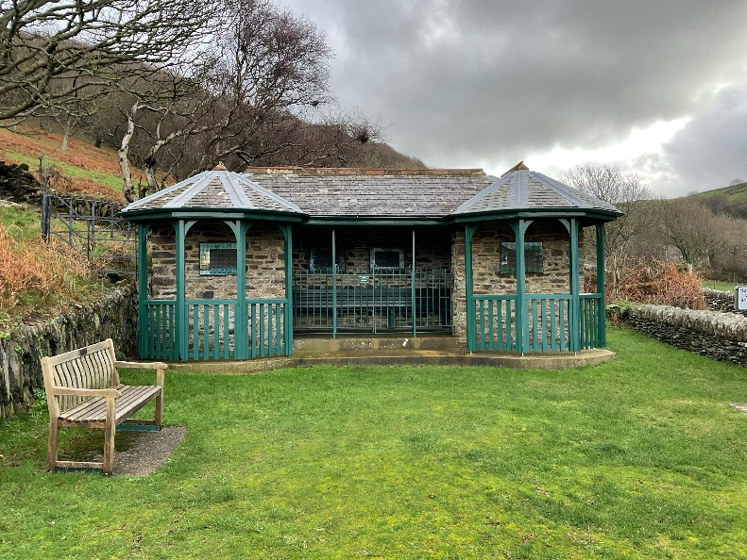
When I arrive to visit the Valley of Rocks I might see:
The car park
A sign for the cafe
A stone building with toilets inside
A wooden shelter painted green

Slide 4
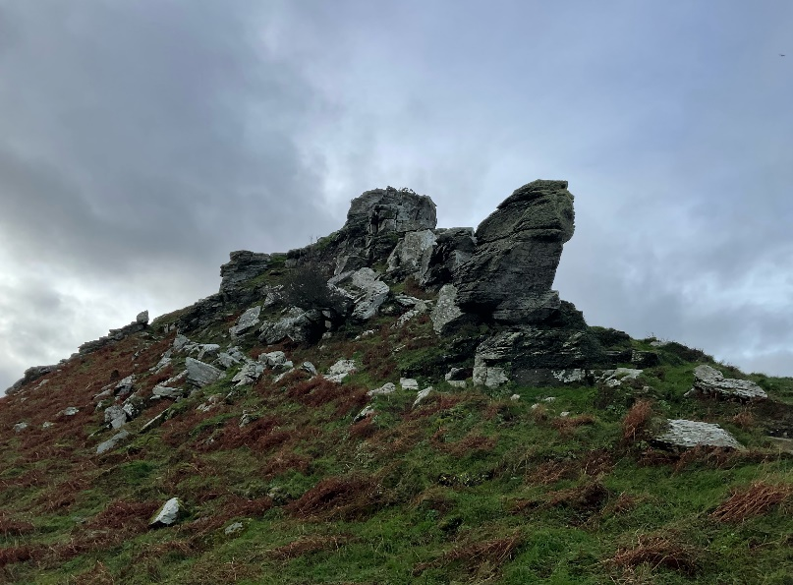
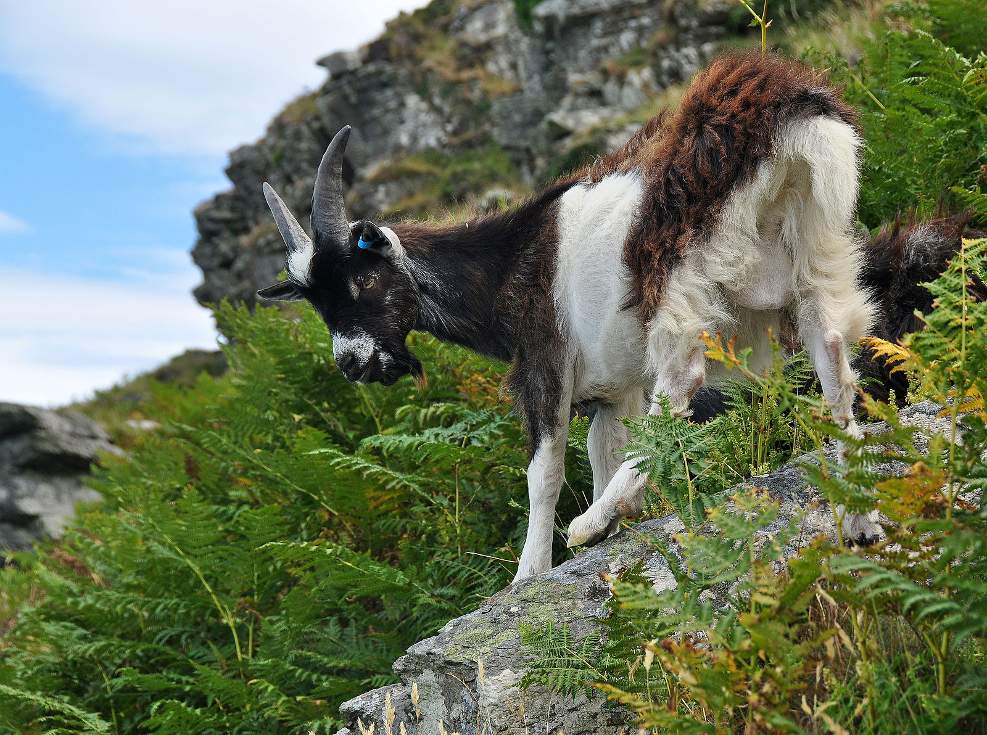
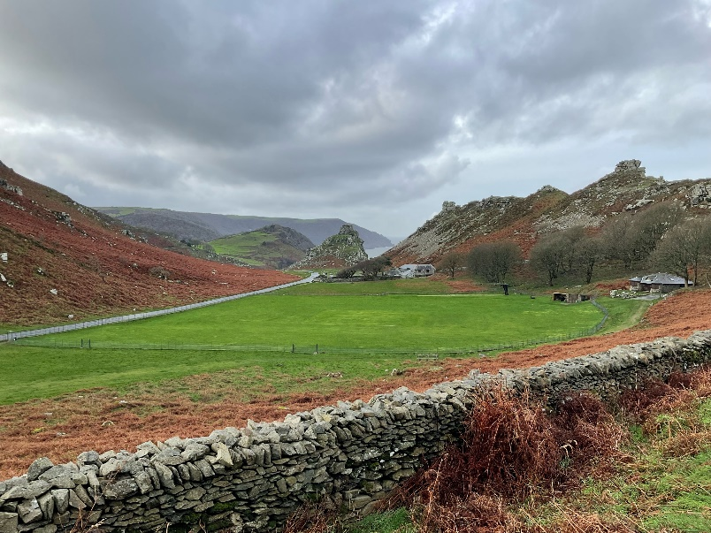
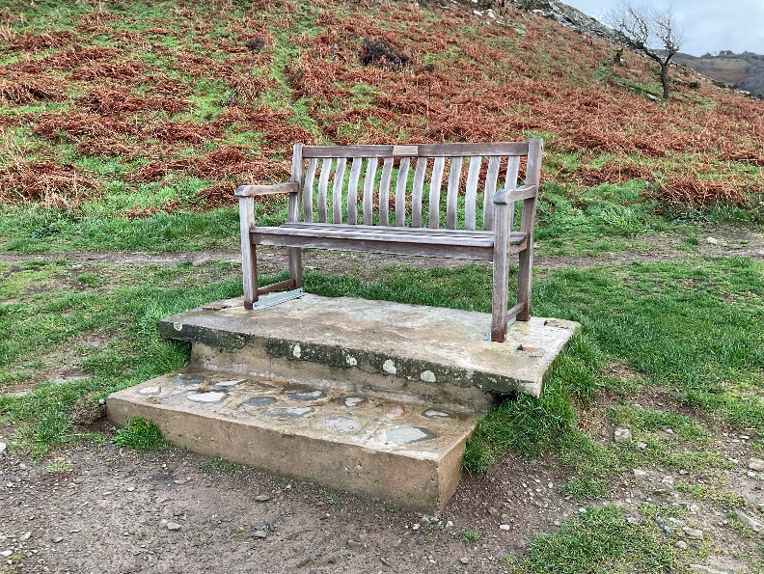
When I visit the Valley of Rocks I might see:
Large groups of rocks
Goats
A cricket pitch
A wooden bench

Slide 5
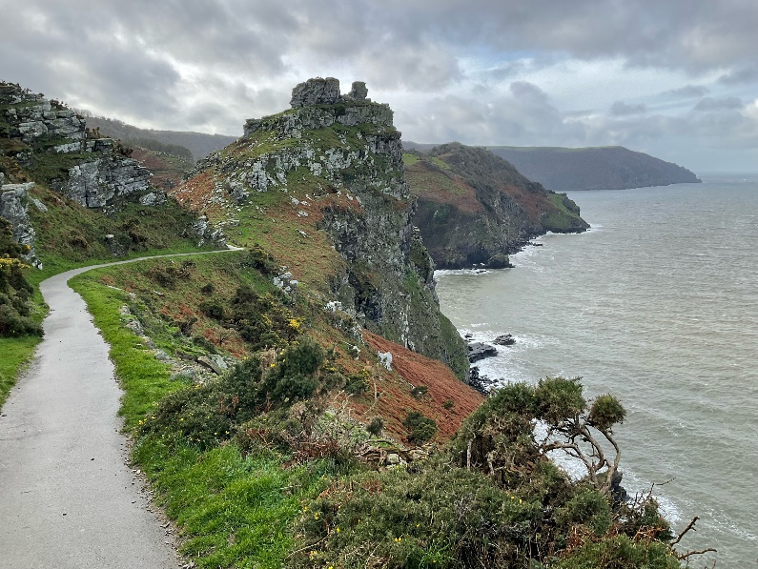
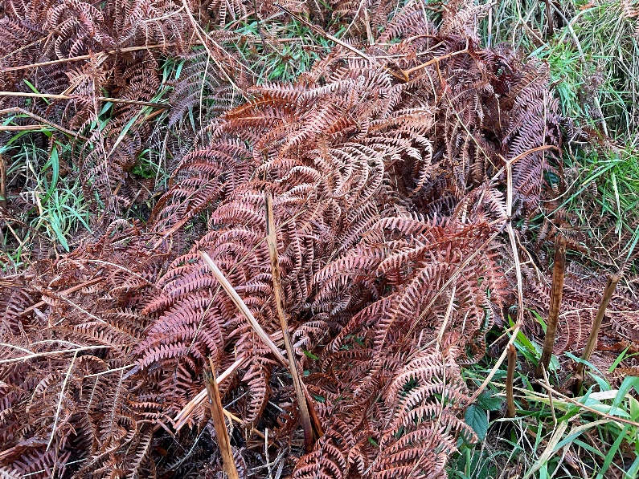
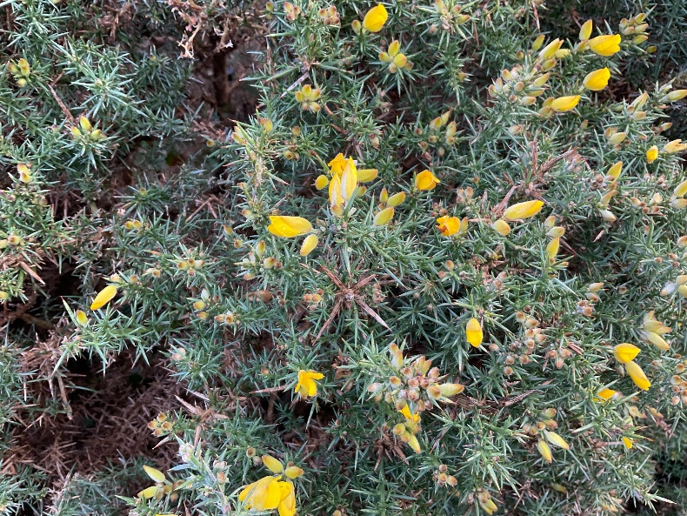
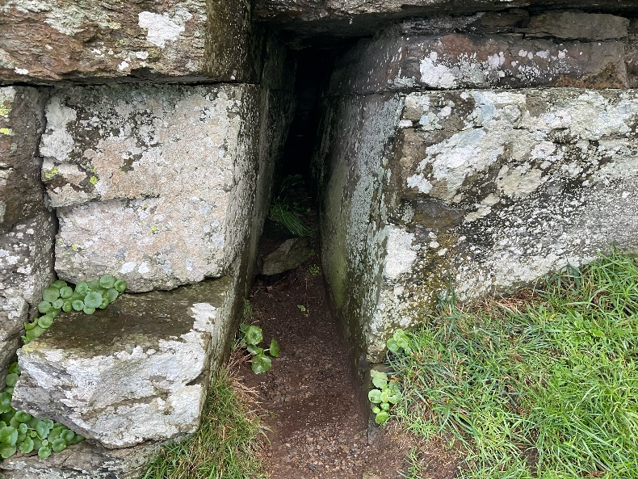
When I visit the Valley of Rocks I might see:
The sea
Bracken
Flowers like gorse
Gaps between the rocks

Slide 6
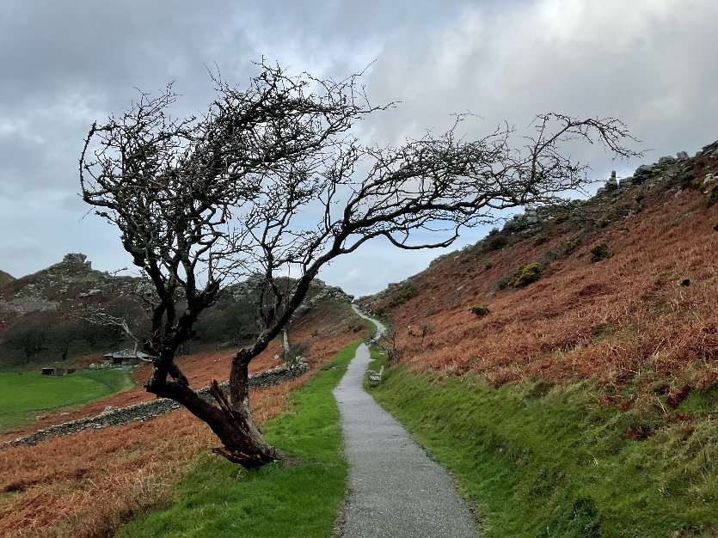
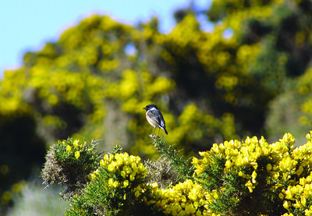
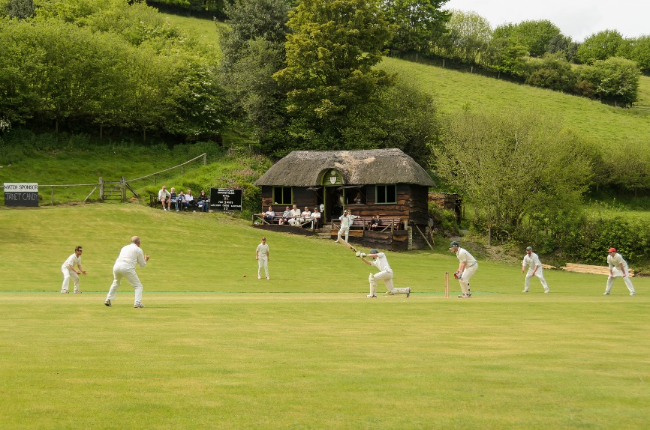
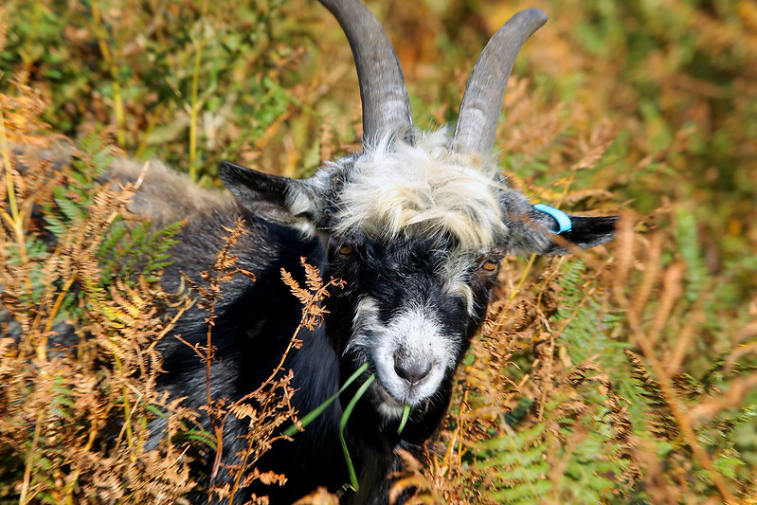
When I visit the Valley of Rocks I might hear:
The wind blowing
Stonechat bird ‘song’ – like 2 stones being knocked together
People playing cricket
Goats bleating

Slide 7
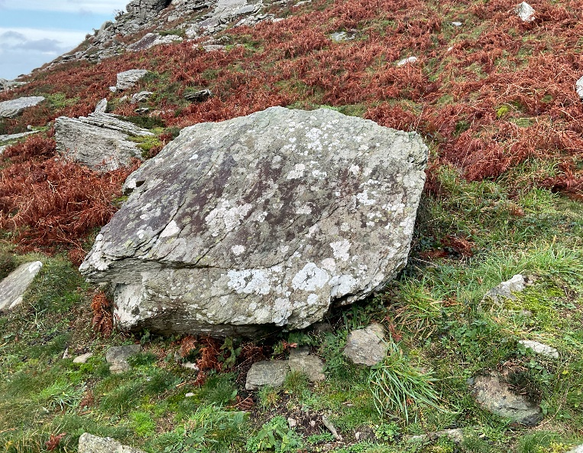
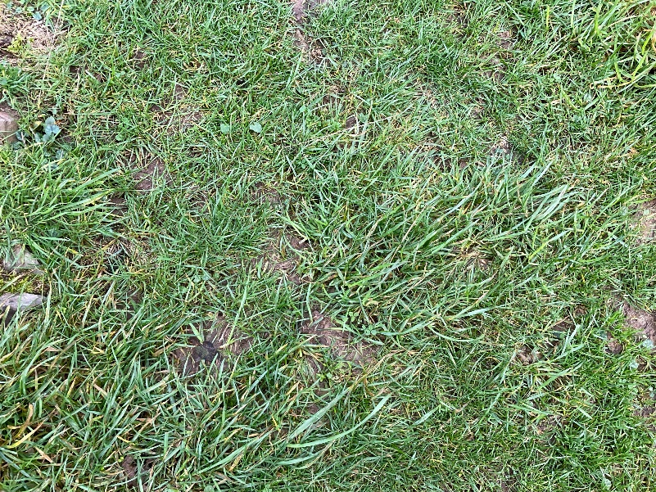
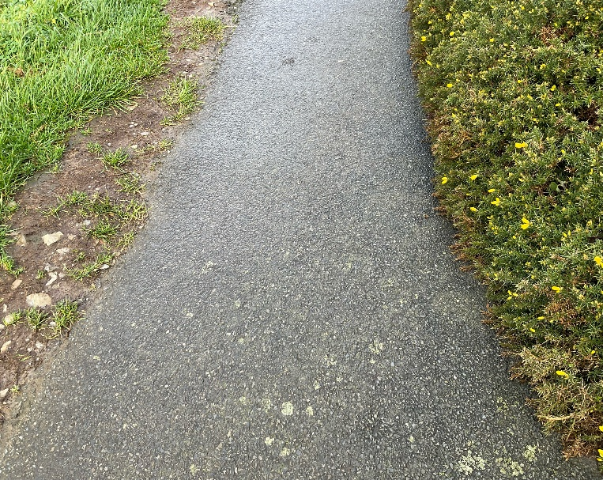
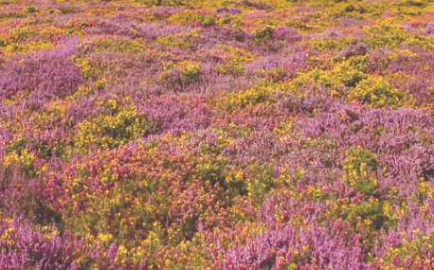
When I visit the Valley of Rocks I might touch or feel:
Large boulders
Soft grass
The tarmac path
Heather

Slide 8
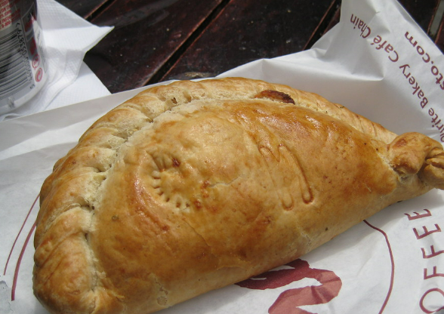
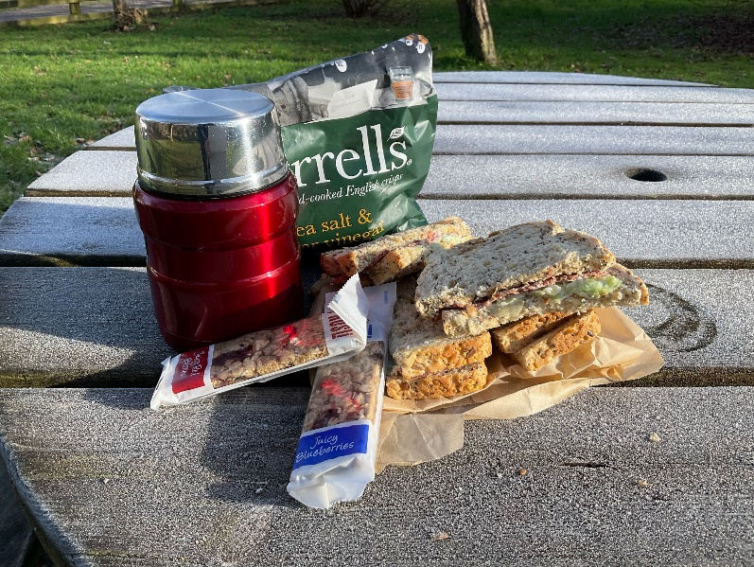
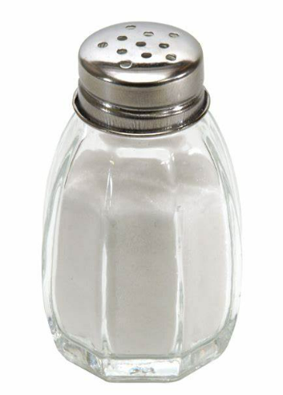
When I visit the Valley of Rocks I might taste:
Food and drink in the cafe
My picnic if we have brought one.
Salty air

Slide 9
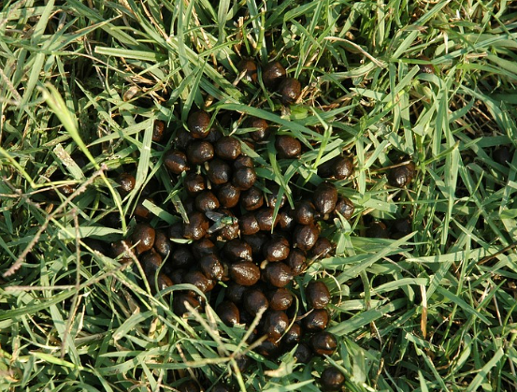
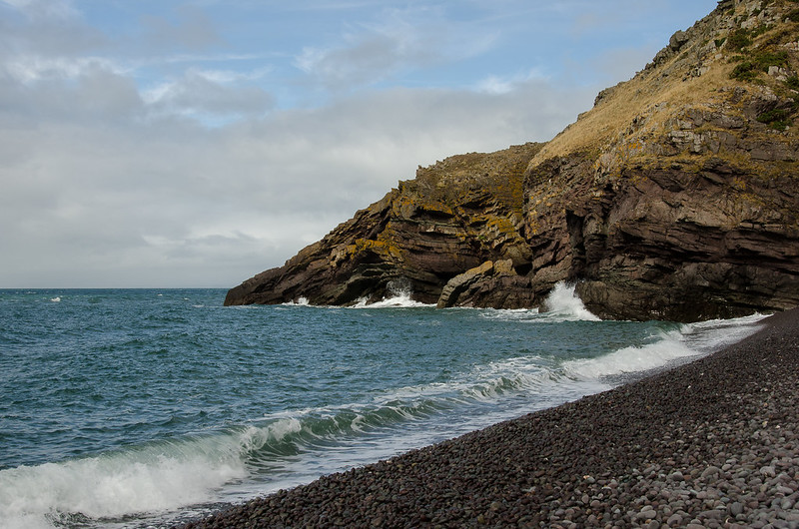
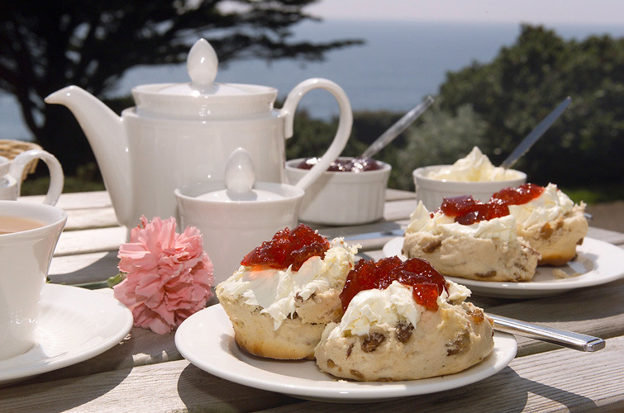
When I visit the Valley of Rocks I might smell:
Goat poo
The sea
Food from the cafe

Slide 10
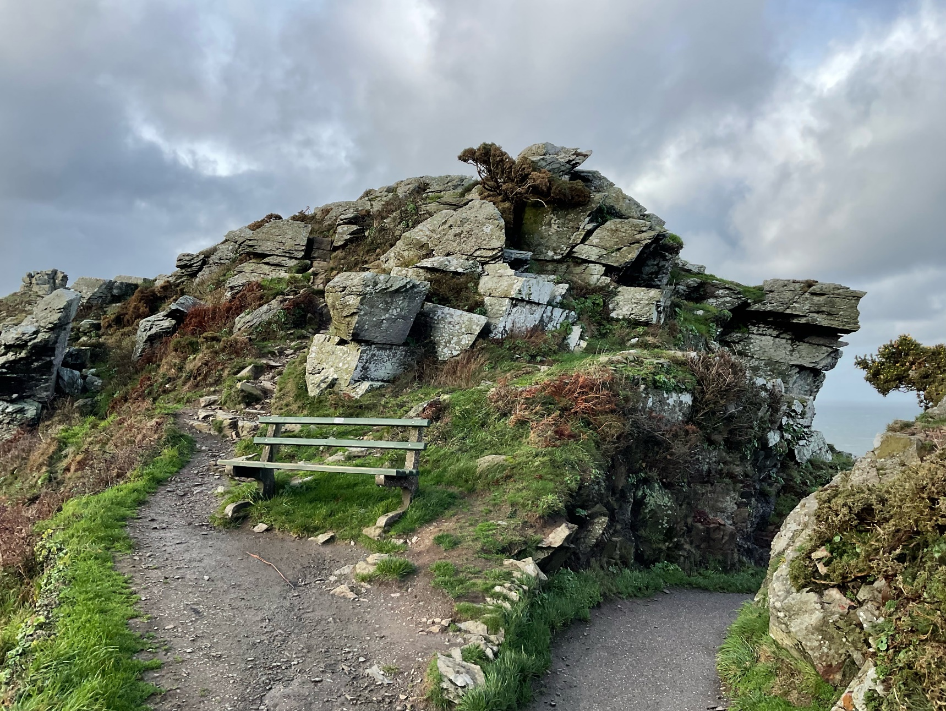
Most of all the Valley of Rocks is a place where I can enjoy time outdoors.

Slide 11
Some additional information for my visit
This Sensory Story starts from the Exmoor National Park Valley of Rocks Upper pay and display car park EX35 6JH
This car park has public toilets
There is a cafe near to the car park which is open in season

Slide 12
The Valley of Rocks Story
Produced For Exmoor National Park by Access & Inclusion UK 2023
www.accessandinclusion.com

